Slide 1
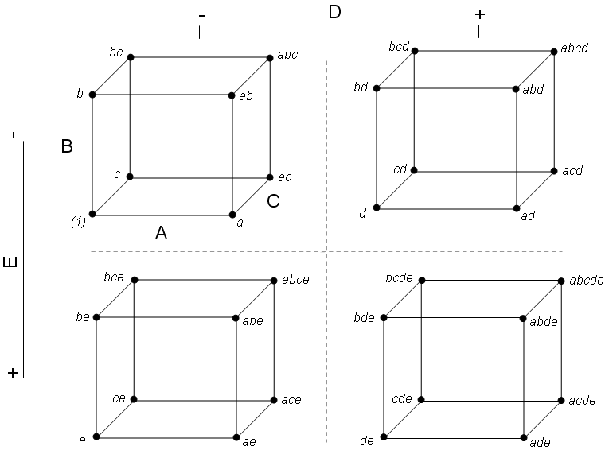
MY TITLE Chris Malone cmalone@winona.edu
Introduction
This is the contents of the introduction
Section 2
This is the contents of the section 2
Figure 1: 2^5 Design
Conclusion
This is the contents of the conclusion

