Slide 1
What is a Vector Field?
F(x, y) = P(x, y)i + Q(x, y)j = < P(x, y), Q(x, y) >
F = Pi + Qj

Slide 2
F(x, y) = -yi + xj
(x, y) | F(x, y)
(1, 0) | < 0, 1 >
(1, 1) | < -1, 1 >
(0, 1) | < -1, 0 >
(-1, -2) | < 2, -1 >
(2, 2) | < -2, 2 >
(-2, 1) | < -1, -2 >
(2, -2) | < 2, 2 >

Slide 3
F(x, y) = -yi + xj

Slide 4
F(x, y) = -yi + xj
(-2, 2)
< -2, -2 >

Slide 5
F(x, y) = x³i + y²j F(x, y) = sin(x)i + tan(y)j

Slide 6
Recall…
F(x, y) = P(x, y)i + Q(x, y)j = < P(x, y), Q(x, y) >
or
F = Pi + Qj
F(x, y, z) = Pi + Qj + Rk

Slide 7
F(x, y, z) = -xi + yj - zk
y
z
x
x
y
z

Slide 8
Applications
Wind pattern velocity
Water current
Gravitational fields
Electrical fields

Slide 9
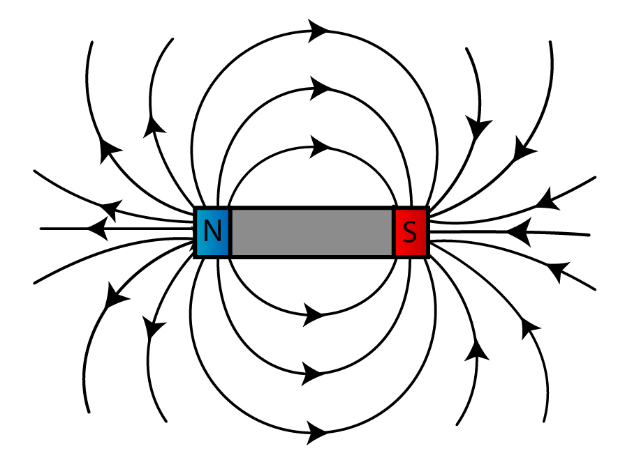
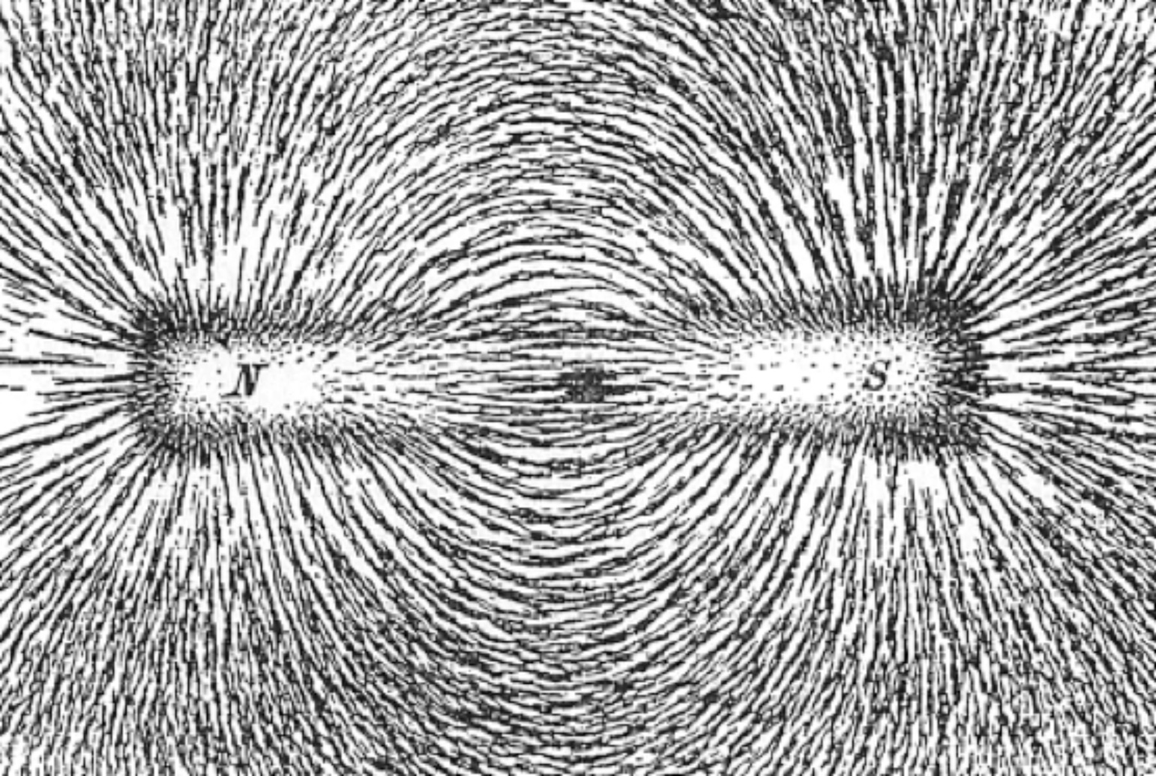
Magnetic Field

Slide 10
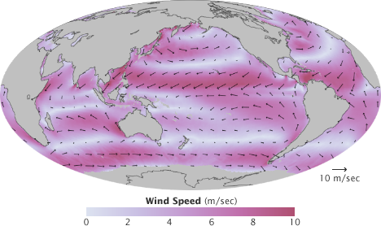
Map of wind velocity for January, 2005 from the QuikSCAT satellite.

Slide 11
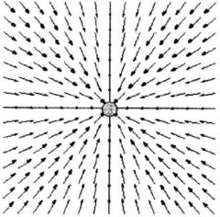
Gravitational Force of Earth

Slide 12
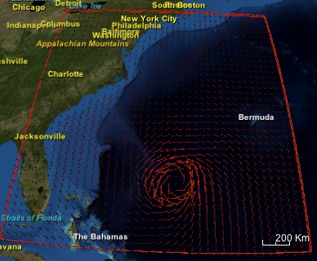
Hurricane Isabel in 2003

