Slide 1
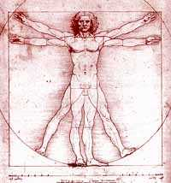
Bio 211: Anatomy and Physiology I
Summer 2019
Lecture: 9:40am-11:40am (Pasteur 229)
Lab: 8am-9:20am (Pasteur 301)
Instructor: Mark Garbrecht, Ph.D.
234 Pasteur Hall
mgarbrecht@winona.edu
Phone: 457-2261
Class website: http://course1.winona.edu/MGarbrecht/Bio211-Summer-new.htm
  Lecture notes, lab handouts, announcements, etc….
CONNECT website: https://connect.mheducation.com/class/m-garbrecht-bio-211---summer-2019
  Access to E-book, tutorials, animations, virtual anatomy lab
CHECK OFTEN FOR COURSE MATERIALS AND ANNOUNCEMENTS!!!!!

Slide 2
Bio 211: Anatomy and Physiology I
First ½ of a two-course sequence (Bio 211, 212)
Designed to provide a functional understanding of human anatomy and physiology
Intended for students in allied health – nursing and health and human performance
Not intended for Pre-med biology majors (see Dr. Garbrecht)
Major topics: 1. Cell structure and function
-Basic chemistry
-DNA, RNA synthesis
-cell division
2. Histology of human tissues
3. Integumentary system
4. Skeletal system
5. Muscular system
6. Nervous system

Slide 3
Housekeeping
Lecture notes, syllabus, and announcements are posted on my website
http://course1.winona.edu/MGarbrecht/Bio211-Summer-new.htm
Lab Handouts
Please be sure to read the lab exercise handouts BEFORE coming to lab!!!!
This will make things much easier to understand and will allow you to cover more material in the 2 hour lab session we have each week
IT IS YOUR RESPONSIBILITY TO MAKE SURE YOU UNDERSTAND THE LAB MATERIAL BEFORE YOU LEAVE LAB EACH DAY – “OPEN LAB” TIMES ARE AVAILABLE AND SHOULD BE USED TO SUPPLEMENT WHAT YOU LEARN IN LAB
PLEASE TURN CELL PHONES OFF AND USE LAPTOPS/iPads RESPONSIBLY!!!

Slide 4
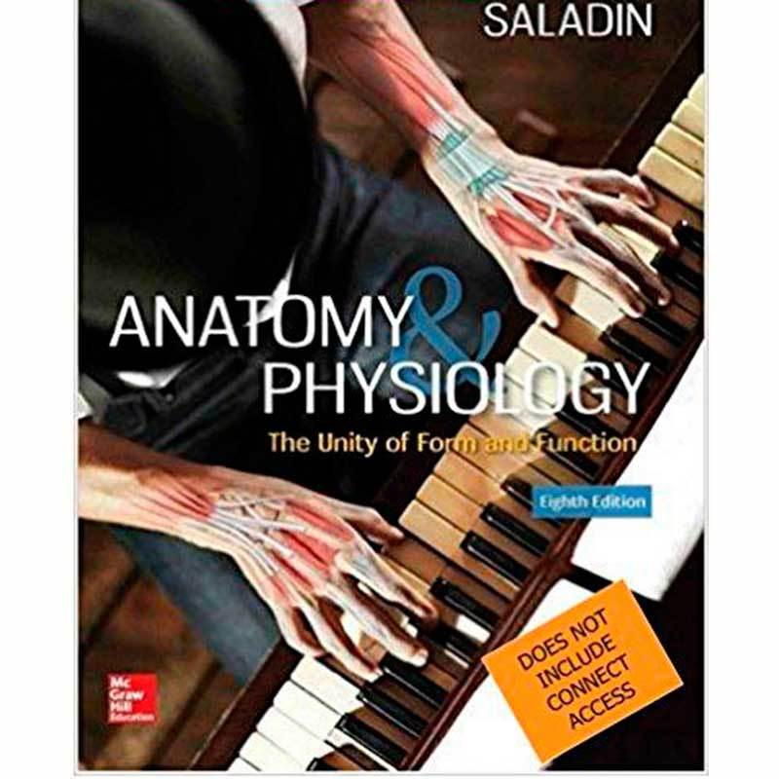
Textbook
Kenneth S. Saladin: Anatomy and Physiology, 8th Edition (2017)
Copy of E-Book comes with your CONNECT access card
CONNECT access is required to access tutorials, use practice quizzes, etc….
Lab Handouts
In order to succeed in this class you will need two things for lab :
  Your textbook (paper copy or E-book)
  A printed copy of the lab handout from my website
You DO NOT NEED to purchase an additional “Anatomy Atlas” or flash cards

Slide 5
McGraw Hill CONNECT web address
https://connect.mheducation.com/class/m-garbrecht-bio-211---summer-2019
Registration code comes with the card you purchased from the bookstore
Gives you access to tutorials, videos, quizzes, and assignments that you will be REQUIRED to complete (more information coming).

Slide 6
OPEN ANATOMY LAB
Pasteur 301
11:40am -4pm Mon-Thur
8am-4pm Friday
** The anatomy lab will be closed the evening/morning prior to lab exams
++++++++++++++++++++++++++++++++++++++++++++++++++++++++++++++++++++++++

Slide 7
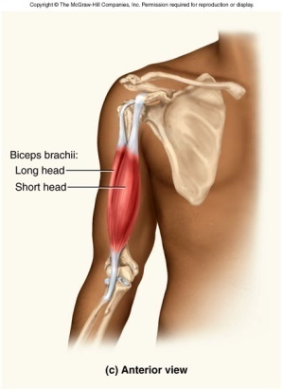
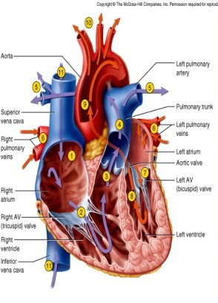
What is the study of Anatomy and Physiology?
“Form and Function”
Anatomy
“Form”
What is it?
1.Scientific name (SPELLING!!)
2.Location
3.Relation to other structures
4. Association with other structures
Physiology
“Function”
What does it do?
1.How does it do it?
2.How does it affect other organs, structures
3.What regulates its action/function

Slide 8
How do we study anatomy?
Observation
See it, feel it, hear it!
Palpation-
- What does it feel like?
- Is it hard, soft, dense, spongy, light, heavy?
Auscultation and percussion
- What does it sound like, what sound does it make?
- Is it hollow, solid? Check for air/fluid pockets in medical exam
- Does it sound “normal”? Check heart rhythm, pulse

Slide 9
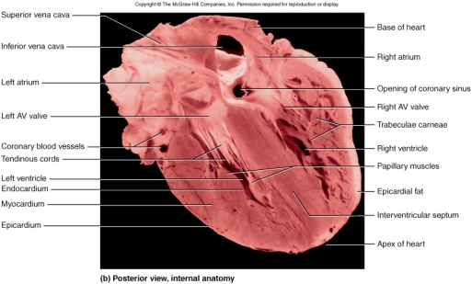
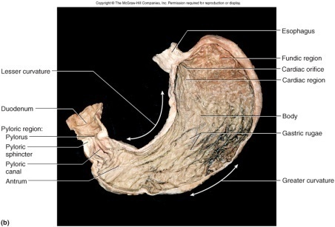
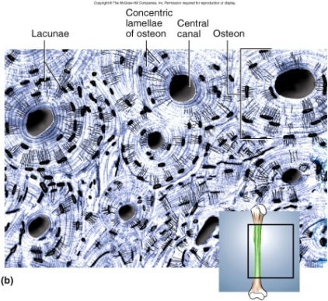
Gross anatomy- study of structures that we can see with naked eye
Histology (microanatomy)- study of structures at the microscopic , cellular level using a microscope

Slide 10
How do we study physiology?
Experimentation, Measurement, Data Analysis
Do something to someone or something under defined circumstances and OBSERVE what happens and compare that to what happens to a CONTROL group
Example:
1. 200 people get a pill with Drug A, that is supposed to lower blood pressure (EXPERIMENTAL GROUP)
2. 200 more people get a pill that doesn’t have any Drug A (CONTROL GROUP)
3. OBSERVE blood pressures in all of the people and compare experimental group to control group
Were the blood pressures different between the two groups after they took the pill?
Yes- Drug A does in fact lower blood pressure
No- Drug A has no affect on blood pressure
Its important to make sure both groups were treated EXACTLY the same way.
i.e., one group didn’t run a marathon prior to taking the pill
-this would make the results invalid

Slide 11
Bio 211- Anatomy and Physiology I
Today’s Topics:
Hierarchy of the human body
General orientation of the human body
  Anatomical position
  Anatomical planes
  Directional terms
  Body regions
  Body cavities
Homeostasis
  Positive Feedback
  Negative Feedback

Slide 12
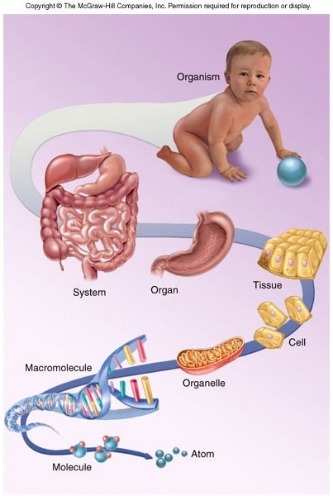
Structural hierarchy in human biology
Biggest, most complex
Human Body
Organ system (cardiovascular system)
Organ (Heart)
Tissue (cardiac muscle)
Cells (cardiomyocytes)
Organelles (nucleus, mitochondria)
Macromolecule (Protein, DNA)
Molecule (amino acid)
Atom (nitrogen, carbon, oxygen)
Smallest

Slide 13
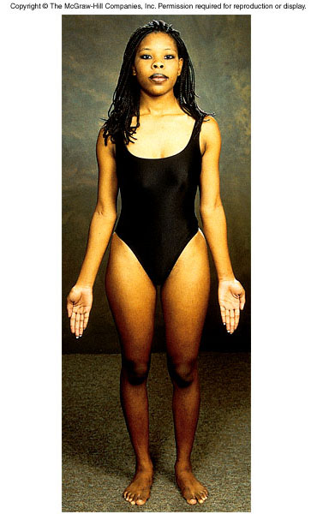
Anatomical Position
Standing upright
Feet flat on ground
Arms at side
Palms facing forward
Eyes and face forward
Important in anatomy because it provides a universal frame of reference that ALL anatomists use when talking about location

Slide 14
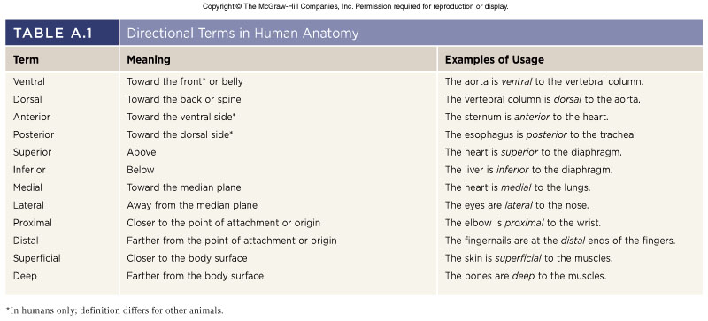
Anatomy Directional Terms
Allows you to describe the location of one structure in relation to another when the body is in the ANATOMICAL POSITION!

Slide 15
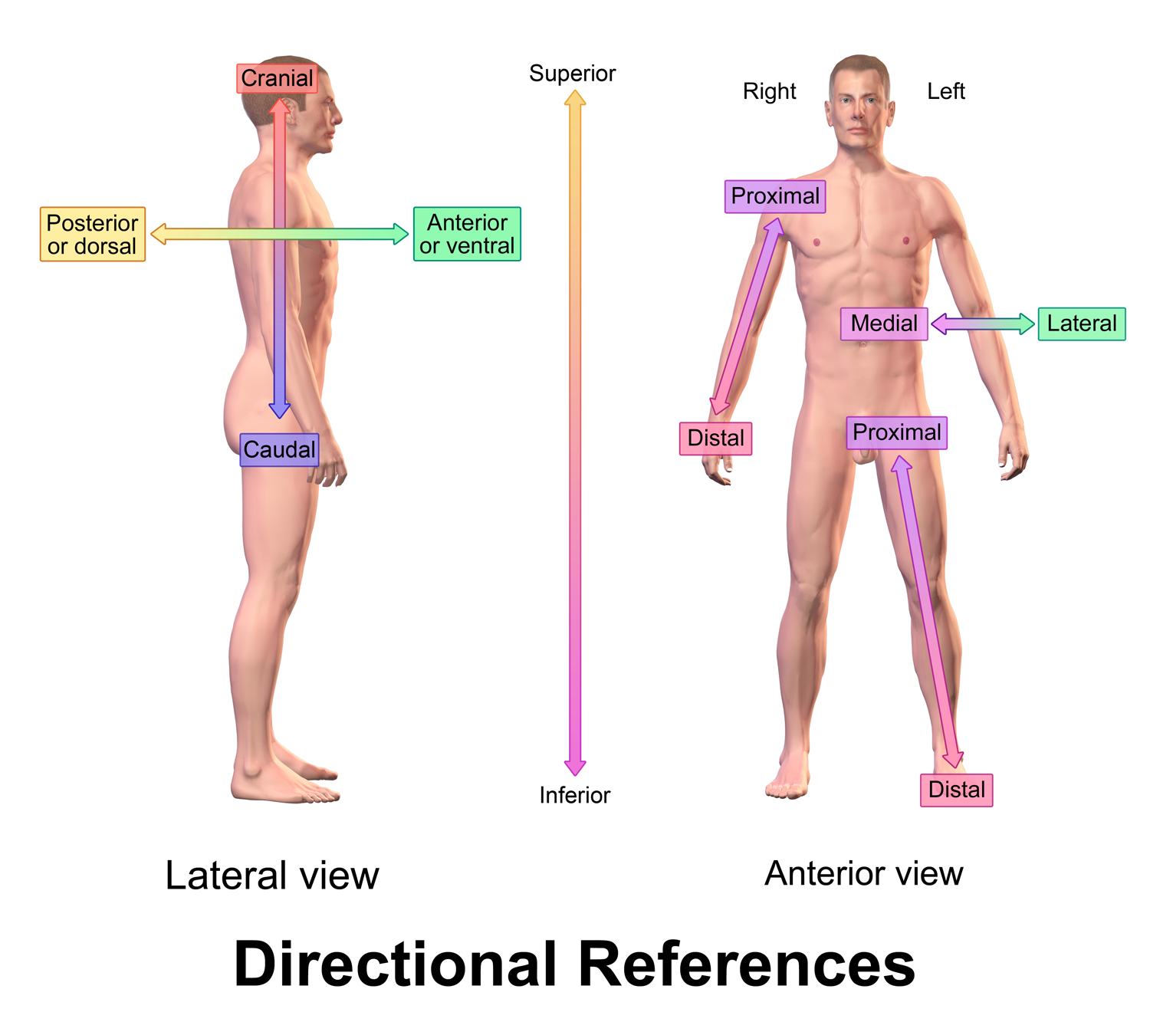

Slide 16
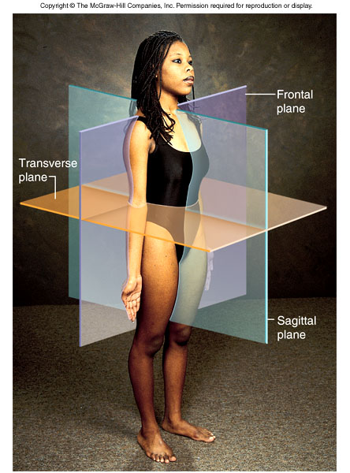
Anatomical Planes
Frontal: Extends vertically and divides body into
dorsal and ventral regions (i.e., front and back)
Sagittal: Extends vertically and divides body into left and right halves
Transverse: Extends horizontally and divides body into superior and inferior regions (i.e., top and bottom)

Slide 17
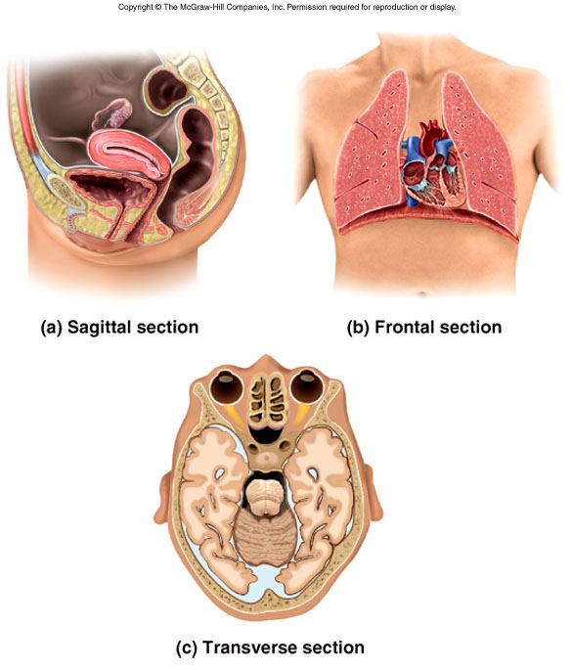
Anatomical Planes
Looking anteriorly/posteriorly
Looking laterally/medially
Understanding these planes is essential in radiology
  X-rays, MRI, CT-scans, etc
Looking inferiorly/superiorly

Slide 18
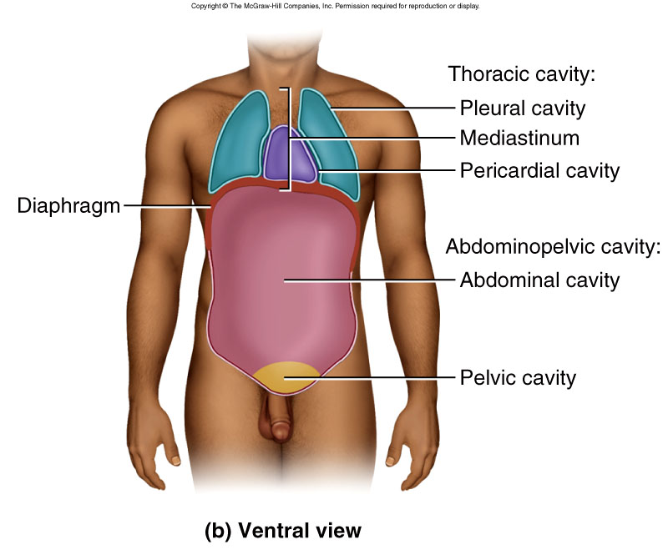
Body Cavities
Primary body cavities Secondary body cavities
Dorsal cavity
Ventral cavity
Cranial cavity - Brain
Vertebral canal – Spinal cord
Thoracic cavity :
  Mostly occupied by lungs and pleural cavity surrounding lungs
  Mediastinum- Contains esophagus, trachea, larynx, and heart and pericardial cavity surrounding heart
Abdominopelvic cavity:
  Abdominal cavity – digestive organs, spleen, kidneys
  Pelvic cavity – Bladder, rectum, reproductive organs

Slide 19
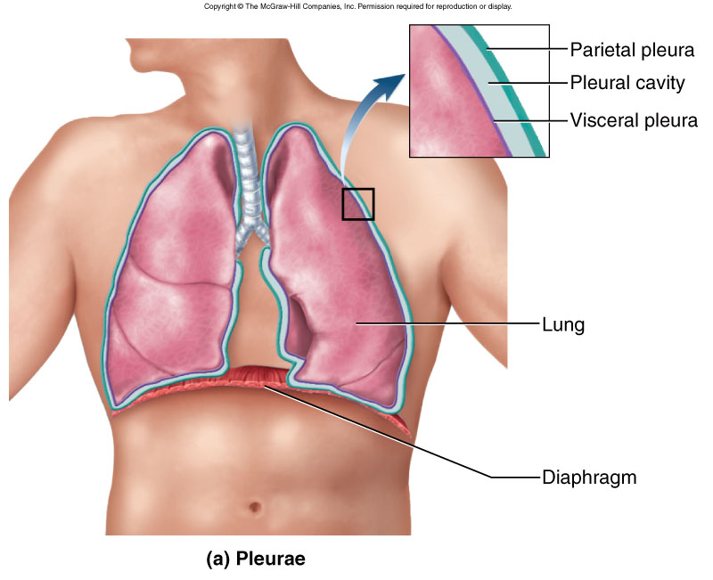
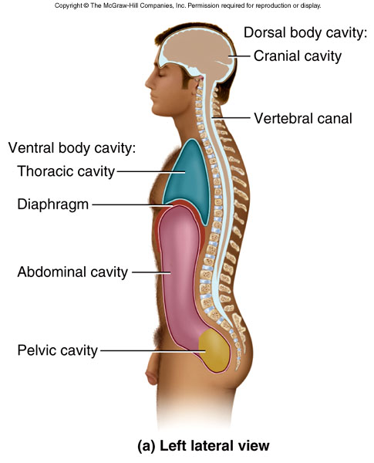
Body Cavities
Pleural, pericardial, peritoneal membranes are DOUBLE layers of membrane
  Parietal layer -lines a cavity (i.e., parietal pleura)
  Visceral layer –lies on the surface of an organ (i.e., visceral pleura)
  Membranes secrete lubricating fluid called SEROUS FLUID
Its important to understand body cavities and their membranes
  common site of infection, inflammation (pericarditis, meningitis, etc.), fluid accumulation

Slide 20
Homeostasis
Concept that the body will react to INTERNAL or EXTERNAL changes in order to maintain the status quo or a “normal” state and meet body’s metabolic demands
Body is constantly monitoring and making adjustments to temperature, blood pH, blood sugar levels, blood pressure, etc……
Large focus of physiologists is to understand how this happens
  How does the body respond to changes and regulate itself?
Loss of homeostasis
Pathology and Disease!
Positive and negative feedback mechanisms

Slide 21
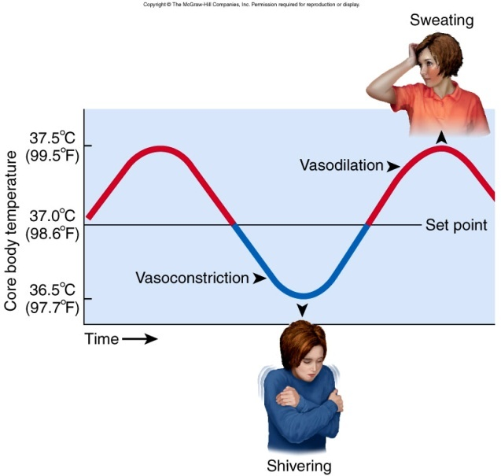
Negative Feedback
Process by which the body detects a change (BAD!) and then tries to reverse those changes
Primary mechanism that the body uses to maintain homeostasis
Example : Body temperature maintenance
Body temp rises on a hot day
Body reacts by causing vasodilation (blood vessels expand) and sweating
Excess heat escapes through skin, evaporation of sweat
Body temp falls and returns to normal
Often times changes in many organ systems are required to maintain homeostasis

Slide 22
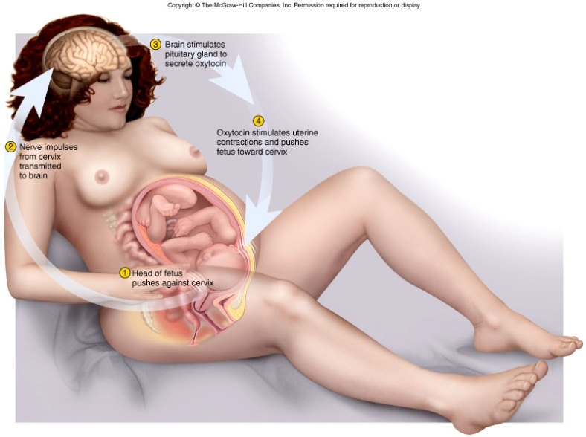
Positive feedback
Process by which the body detects a change and causes a GREATER change in the SAME DIRECTION (i.e., more of the same)
  A self-amplifying response
Less common than negative feedback, but still very important!
Example: Uterine contractions during childbirth
Pressure of baby against cervix activates stretch receptors
Body reacts by triggering the release of hormone that INCREASES contractions
Contractions increase and forces baby towards cervix, causing more pressure
Also seen in function of digestive system, cardiovascular system, immune system etc…

Slide 23
Positive and negative feedback loops
Feedback loops utilize receptors, control centers in brain, and effectors to bring about change
Brain
Control centers for respiration, cardiovascular function, etc…
Receptors and sensors
Structures found in blood vessels, organs that monitor and detect changes
Effectors
Structure (heart, lung, glands, etc…) that gets signal from brain and CAUSES change to restore homeostasis

Slide 24
Bio 211- Anatomy and Physiology I
Today’s topics
Atomic structure, charge
Polarity
Chemical bonds
Solubility
pH
Chemical reactions and enzymes

Slide 25
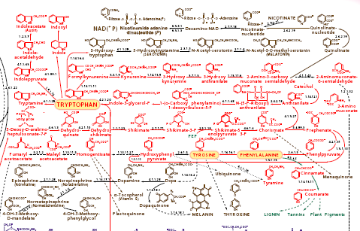
Why do we need to understand chemistry to understand biology?
Essentially, the human body is one big chemistry experiment
  At any one time there are BILLIONS of chemical reactions are taking place
  Your ability to see, hear, breathe, and think are all dependent on chemistry
Chemical reactions involved in the production of tryptophan (an amino acid)

Slide 26
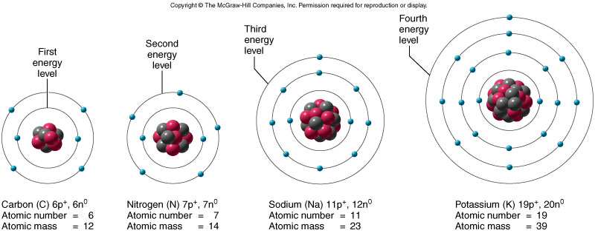
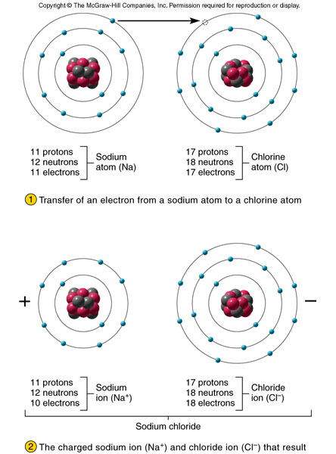
Atomic Structure and Charge
Electrons: - charge
Protons : + charge
Neutron: no charge
Surround the nucleus like a cloud
Nucleus of an atom
ATOMS
IONS
Atoms can give up or take electrons from other atoms in a process called ionization
If an atom has UNEQUAL numbers of protons and electrons it is an ION
Positively charged ion = CATION
Negatively charged ion = ANION

Slide 27
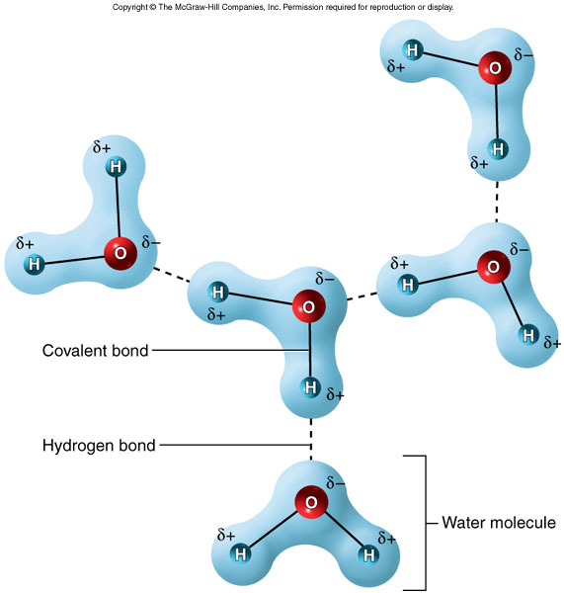
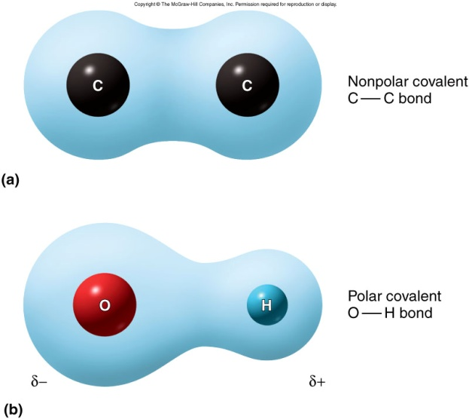
Polarity
When two atoms form a bond, electrons are often shared between the two atoms
Unequal sharing of electrons occurs when electrons are “pulled” towards one nucleus over another – occurs when one nucleus possesses more protons
The result is a molecule with one part being positively charged and one part being negatively charged – a POLAR molecule (note: water is a polar molecule)
Remember that opposite charges attract and like charges repel

Slide 28
Chemical bonds
Chemical bonds allow atoms to get together and form molecules and allows molecules to come together to form larger macromolecules
Hydrogen bonds – Very weak, easily made and broken
- no transfer or sharing of electrons
- VERY important in biology!!!
2. Ionic bonds – Pretty weak
- involves transfer of electrons from one atom to another
3. Covalent bonds – Very strong, not easily broken
- involves sharing of electrons between atoms

Slide 29
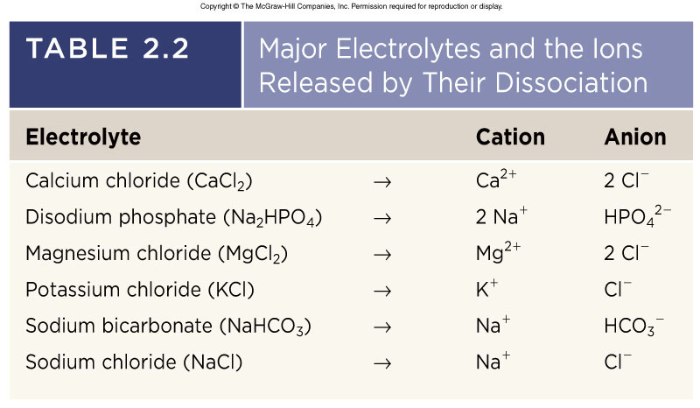
Ionic Bonds
Formed by attraction of a cation to an anion
Easily broken
Important for the chemistry of electrolytes
Dissociation occurs because Na+ and Cl- are more attracted to very polar water than to each other
Important because Na+ and Cl- need to be IONS in the human body (lots of water) – required for nerve and muscle function

Slide 30
Hydrogen bonding
Weak interaction between the slightly positive charge of a H+ atom and the slightly negative charge of O, N, or P
  very important in physiology – H, O, N, P make up almost 80% of your body!!!
  allows molecules to be built up and broken down relatively easily
  works sort of like a magnet
  Important for structure of protein, DNA, RNA
-
+

Slide 31
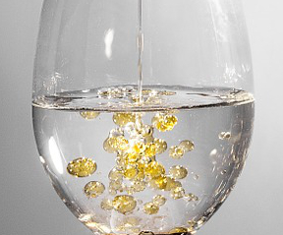
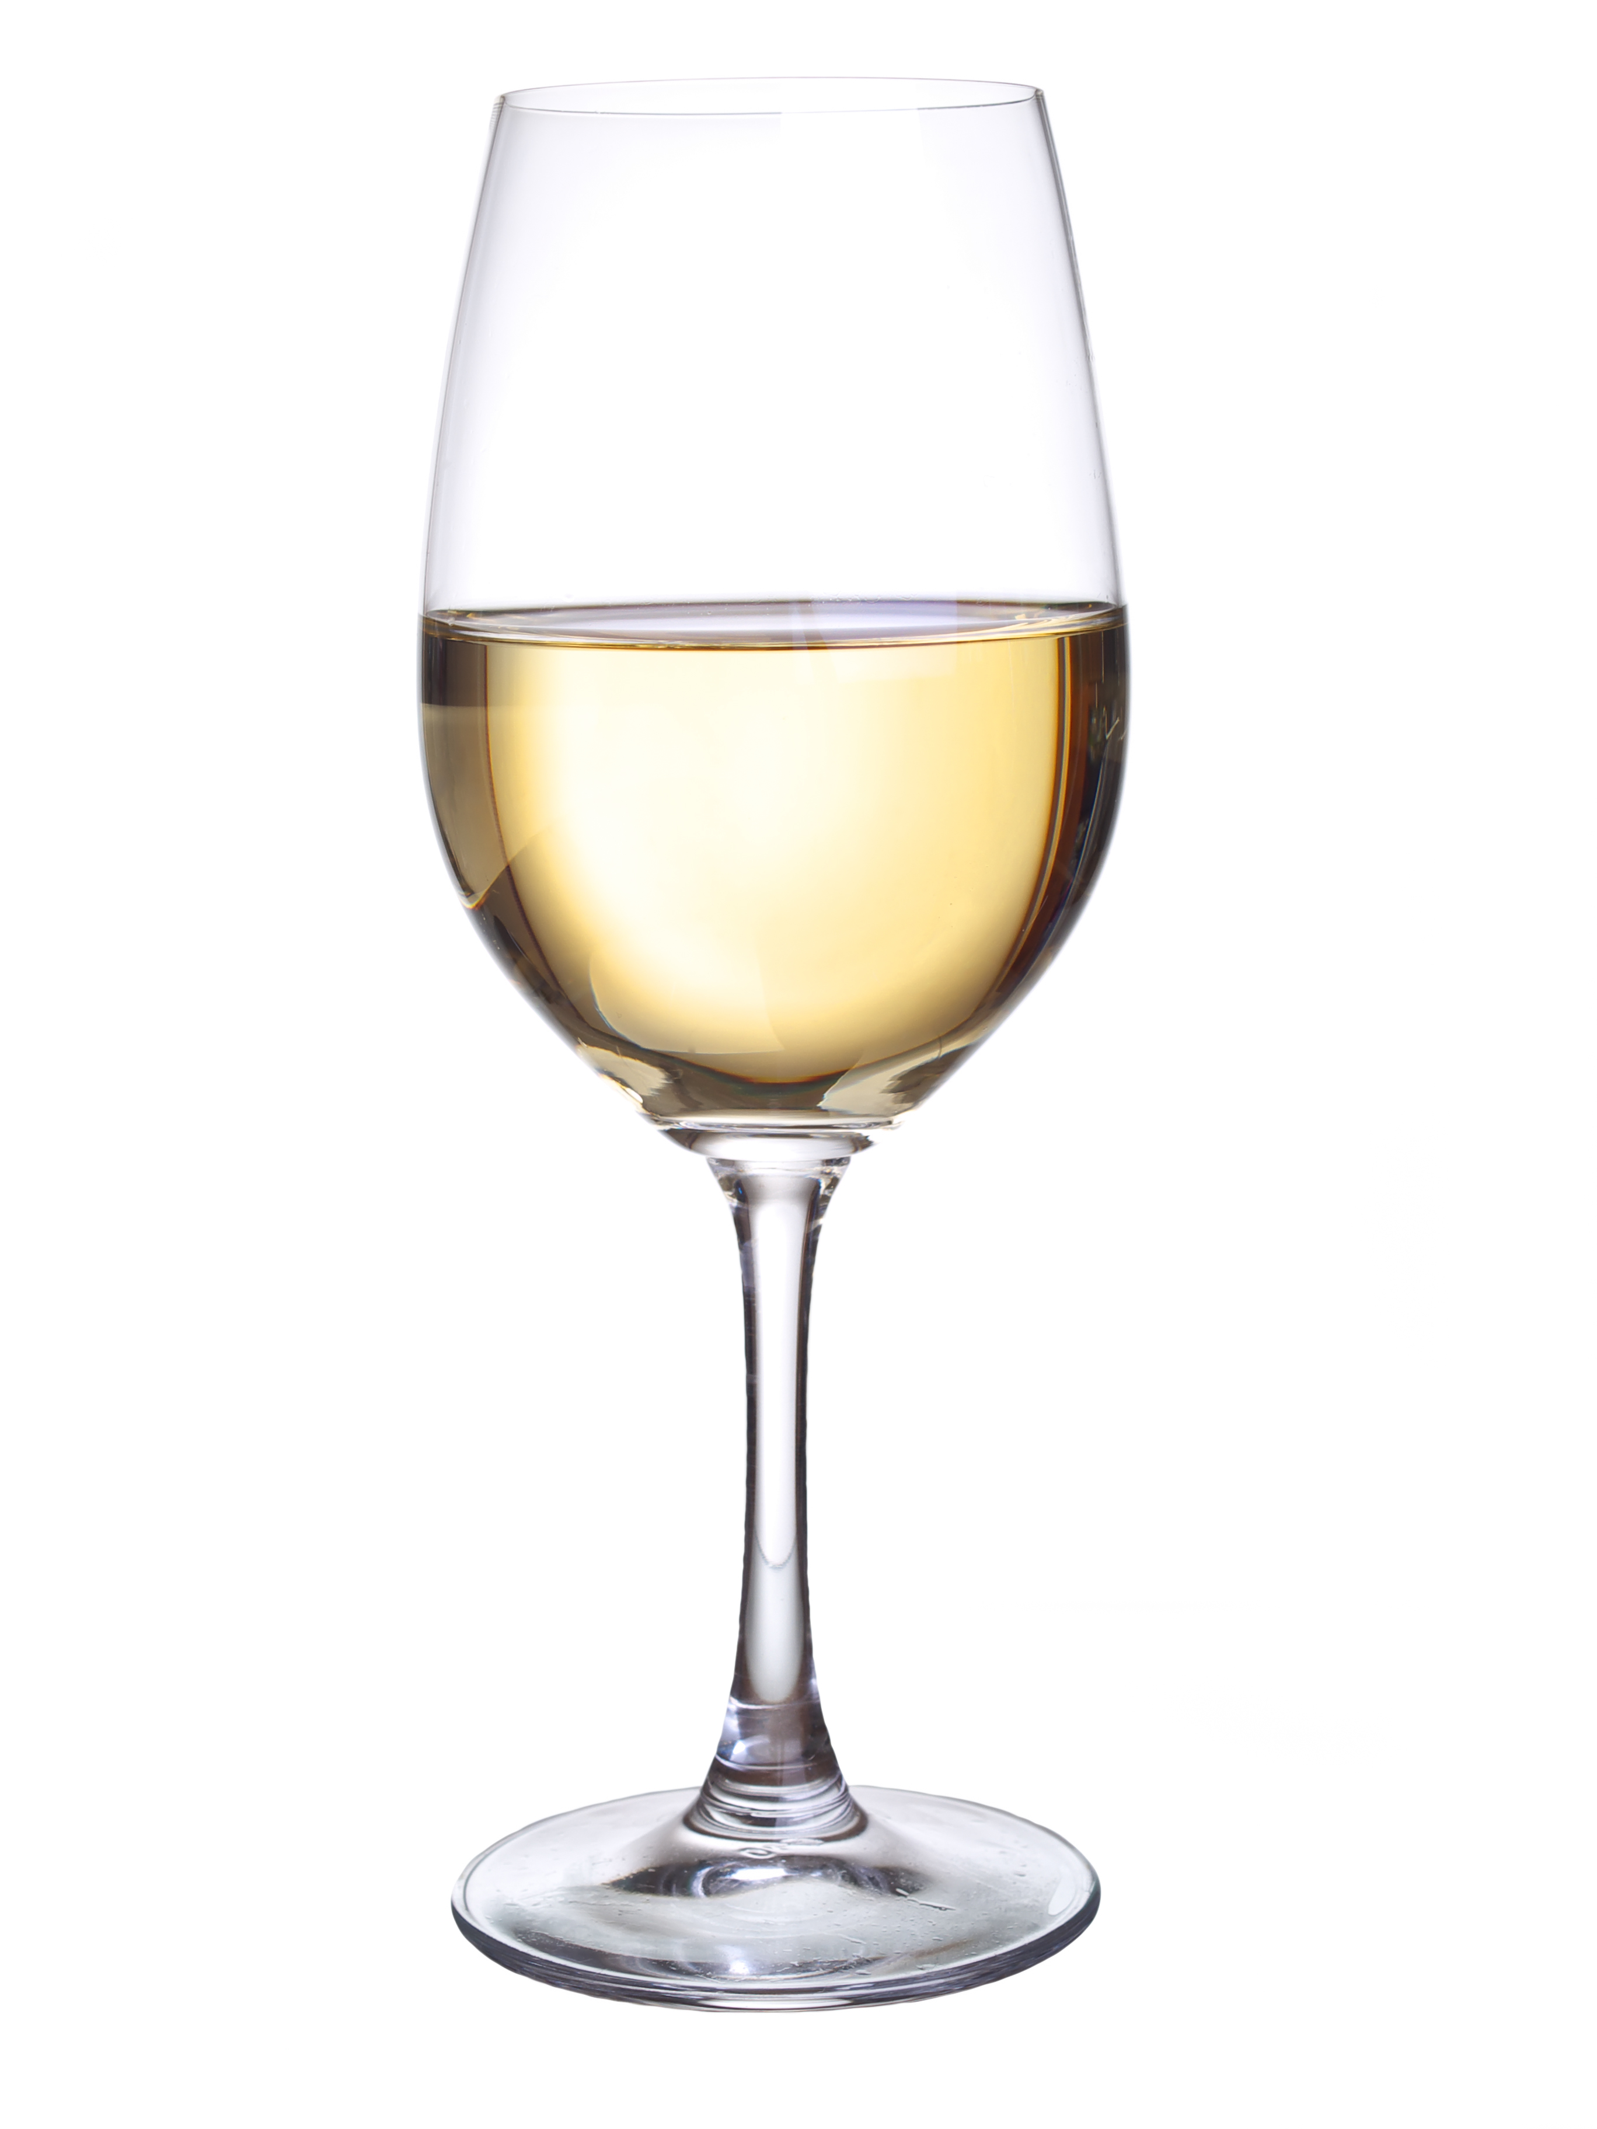
Solubility
General rule is that “like dissolves like”
  Polar molecules are soluble with other polar molecules
  Nonpolar molecules are soluble in other nonpolar molecules
Since water makes up ~60% of our bodies, solubility in water (polar) is an important consideration (drugs, hormones, waste products, etc….):
Hydrophilic molecules dissolve in water….because they are typically polar (or have a polar region)
Hydrophobic molecules do not dissolve well in water - typically nonpolar (oils and fats)
Oil vs Alcohol
Oil is hydrophobic
  Doesn’t mix well in water
Ethanol (alcohol) is hydrophilic
  Mixes easily in water

Slide 32
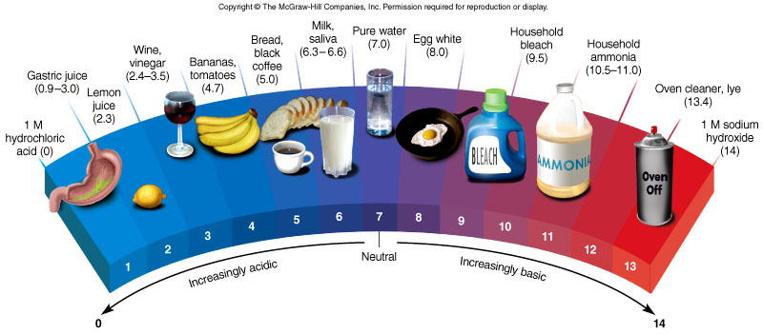
Acids, bases, and the pH scale
Acids are molecules that can give up H+ ions
Bases are molecules that can accept H+ ions
pH is a measurement of the relative concentration of H+ ions as compared to pure water
Adding an acid to water will increase H+ concentration making the solution acidic
Adding a base to water will decrease the H+ concentration making it basic
pH scale ranges from 0 (very acidic) to 14 (very basic) -----Water pH = 7.0

Slide 33
Acids, bases, and the pH scale
pH is very important to human physiology
  blood pH MUST be near 7.4 for normal health
  if blood pH is altered, that means the H+ concentration is too high or too low
  changes in pH affect hydrogen bonding and therefore affect the function of many enzymes, hormones, and drugs
  low pH (acidic) environment DENATURES proteins, DNA, RNA and prevents cells from functioning

Slide 34
Catabolic and Anabolic reactions
In living cells, molecules are constantly being broken down into smaller molecules (catabolic reaction) or built up into larger molecules (anabolic reactions)
Anabolic reactions often USE energy, catabolic reactions often RELEASE energy
  Example: The breakdown of ATP into ADP + P yields energy
ATP + H2O ADP + P + ENERGY (to be used by cell)
anabolic
catabolic
“What ANA makes, the CAT breaks”

Slide 35
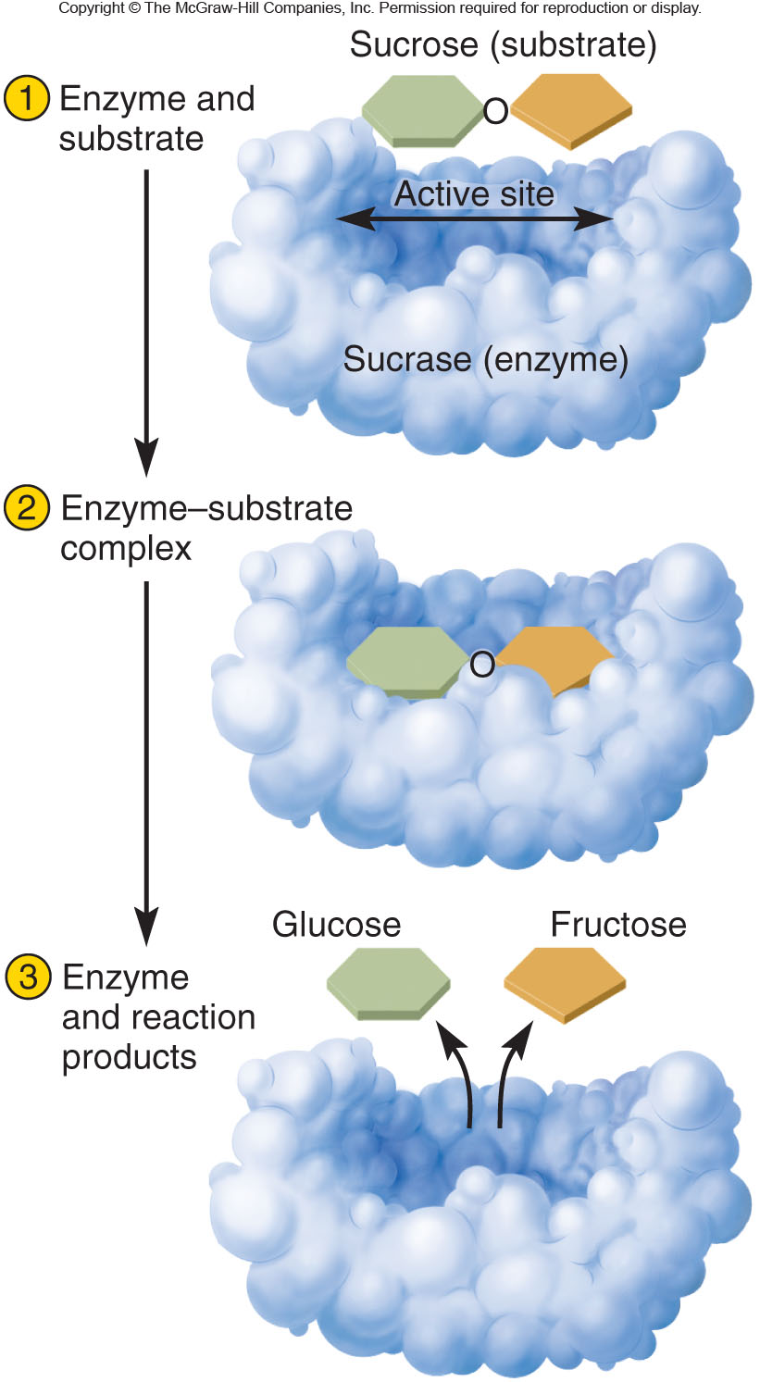
Reaction rates and catalysts
Many chemical reactions in the body occur VERY slowly and need to be sped up in order to keep us alive, therefore we need CATALYSTS to speed them up
CATALYSTS allow many reactions to occur at physiological temps/pH
Biological catalysts are called ENZYMES
Enzymes are proteins that help form OR break chemical bonds (often makes reactions occur 1,000s or 1,000,000s times faster!!)
  Sucrase enzyme breaks down sucrose sugar (bigger) into glucose and fructose (smaller)
Enzymes are usually very specific about which molecules they will bind and reactions they carry out

Slide 36
Bio 211- Anatomy and Physiology I
Today’s topics
Oxidation/reduction
Organic chemistry
Monomers/polymers
Proteins

Slide 37
Oxidation/Reduction Reactions
Oxidation – a reaction in which a molecule GIVES UP an electron
Reduction – a reaction in which a molecule GAINS an electron
Redox reactions are very important in biology and allow the transfer of energy (in the form of electrons) from one molecule to another
**** Important for metabolism of nutrients needed for ATP production, metabolism/breakdown of waste products, metabolism/breakdown of hormones and signaling molecules
LEO the lion says GER!!!!
Loss of Electrons = Oxidation
Gain of Electrons = Reduction

Slide 38
Oxidation/Reduction Reactions, cont…
When good Redox reactions go BAD (sometimes)!
Free Radicals: molecules with an extra electron
Ex. : O₂^{-.} (superoxide anion – an oxygen free radical)
Oxygen normally exists as a molecule (O₂) but can pick up an extra electron during normal metabolic reactions, or through exposure to radiation (UV light, X-rays) or chemicals
Oxygen free radicals do have a useful purpose in the killing of bacteria and viruses by white blood cells (only need a small amount in the right place though)
Free radicals are VERY dangerous and can damage DNA, proteins, cell membranes, etc…
  Damage from oxidation is linked to heart disease, inflammatory diseases, and CANCER!
Free radicals are normally controlled and neutralized by ANTIOXIDANTS
  Antioxidant enzymes (made by our body) and vitamins in our food (vitamin A, C, E, etc..)

Slide 39
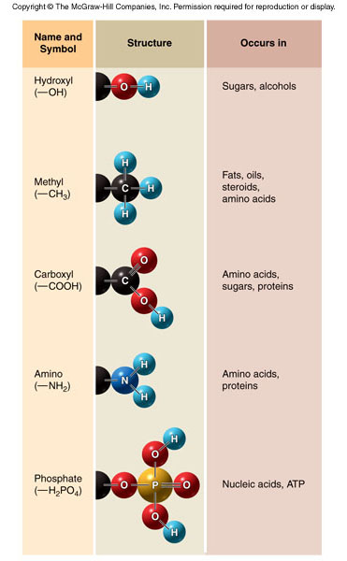
Organic Chemistry
Organic chemistry is the study of carbon containing compounds
Organic molecules contain a CARBON BACKBONE (often branched or a ring structure) with a variety of FUNCTIONAL GROUPS attached
The type of functional group attached determines the properties of the molecule
  Make sure you can identify these by sight
C
I
C
I
C-C-C-C-C=O
Functional group (called the “R” group)
OH
Carbon backbone

Slide 40
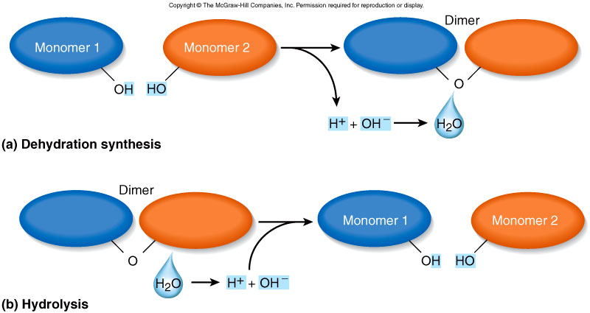
Monomers/Dimers
Many biological macromolecules exist as MONOMERS that combine to form POLYMERS
Mono=1, Di=2, Tri=3, Poly=many
MONOMERS (one molecule)
Amino Acids
Nucleotides
Monosaccharides
Fatty Acids
Glycerol
POLYMERS (many molecules)
Proteins
DNA, RNA
Polysaccharides (sugars)
Lipids, fats
Dehydration synthesis: required for polymerization, involves removal of water (H2O)
Hydrolysis: addition of H2O required to break polymers into monomers

Slide 41
What do proteins do in our body??
Proteins pretty much “do” everything:
Structure: collagen and keratin make up our bones, skin and hair
Communication: peptide hormones carry messages from cells in one area of the body to another; receptors needed for all cell signaling molecules
Transport: channels and transporters on the cell surface regulate what goes in and what goes out of a cell
Catalysis: enzymes speed up normally slow chemical reactions
Recognition and protection: proteins on our cell surface specify “self” vs. “non-self” - helps our body recognize our own cells vs. bacteria or viruses
Movement: cilia, flagella help move things within an organ. Actin and myosin allow muscles to contract and move the whole body
Cell adhesion: proteins allow cells to attach to one another and attach to other structures (i.e., muscle to bone)

Slide 42
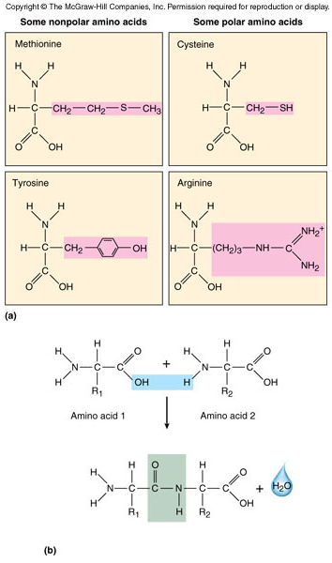
Amino Acids and protein structure
Proteins are polymers of amino acids
20 different amino acids combine in different variations to form ALL the proteins in your body!
All amino acids contain a similar “backbone” and then a variable FUNCTIONAL GROUP (R group)
Our bodies can synthesize most amino acids from other materials (12), but some have to come from food we eat
  8 “Essential Amino Acids”
Dehydration synthesis
Peptide bond

Slide 43
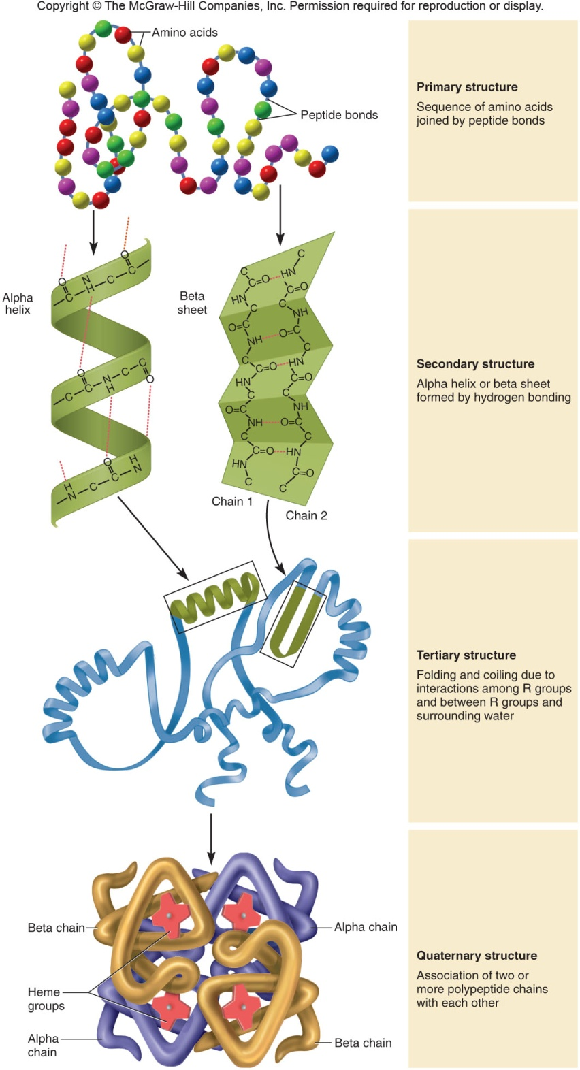
Amino Acids and protein structure
Amino acids are connected to each other by PEPTIDE BONDS
  2 amino acid chain = dipeptide
  3 amino acid chain = tripeptide
  Anything longer we just call a POLYPEPTIDE
The CONFORMATION (3D shape) of a protein is critically important to its function
The amino acid sequence will determine a protein’s conformation and therefore its function
  i.e., changes in a.a. sequence lead to changes in protein conformation and function
Even a small alteration in conformation or amino acid sequence can alter its function

Slide 44
Amino Acids and protein structure
Protein conformation and function is heavily dependent on :
  pH – changes in pH alter H+ ion concentrations and affect hydrogen bonding Loss of hydrogen bonding = loss of secondary structure
  Temperature – high temperatures (lots of kinetic energy) can cause hydrogen bonds to break
  Redox environment – oxidizing or reducing conditions alter the ability of proteins to maintain disulfide bonds leading to altered tertiary structure. Also affects hydrogen bonding (secondary structure)
When a protein loses its normal structure, it is said to be DENATURED - BAD!!!
Therefore, it is important to closely monitor and maintain proper the pH, temperature, and oxidation state of tissues in the body---HOMEOSTASIS!!!

Slide 45
Bio 211- Anatomy and Physiology I
Today’s topics
Carbohydrates
DNA/RNA
Lipids

Slide 46
Carbohydrates
Carbohydrates are organic molecules composed of C,H,O
  An important molecule the body uses for energy
  Readily available from plants and are main source of calories in most diets
  The oxidation of sugars during metabolism releases a great deal of energy that is used in the production of ATP
      Of all the nutrients (carbs, fats, proteins) carbs are easiest to convert to usable energy---SUGAR HIGH!
  Like proteins, carbohydrates are often large polymers of smaller sugar monomers

Slide 47
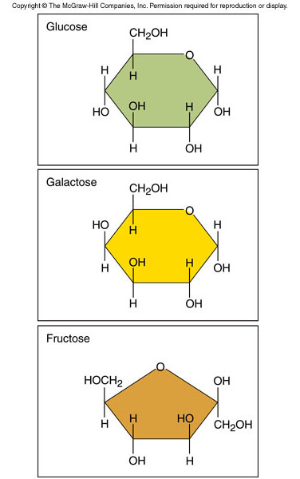
Carbohydrate Monomers
“Monosaccharides”
3 Primary carbohydrate monomers
Glucose-main energy source for most cells, brain cells and nerve cells actually demand it
  Commonly referred to as “blood sugar”
Galactose-chemically similar to glucose
  Body converts galactose to a glucose derivative for use
Fructose-common sugar found in fruits
  Also converted to a glucose derivative before use

Slide 48
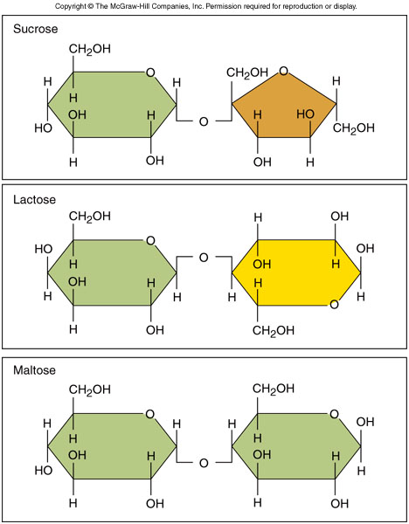
Disaccharides
3 Primary Disaccharides
Sucrose-common table sugar, cane sugar
  Digested to 1 glucose and 1 fructose
Lactose-milk sugar
  Digested to 1 glucose and 1 galactose
Maltose-malt sugar that comes from starch digestion
  Digested to 2 molecules of glucose
Disaccharides are linked via DEHYDRATION SYNTHESIS reactions and broken down into monosaccharides by HYDROLYSIS
All the disaccharides are metabolized to glucose and some “other” sugar
  The “other” sugar is also eventually converted to glucose as well
  Obviously, glucose is a very important energy source!

Slide 49
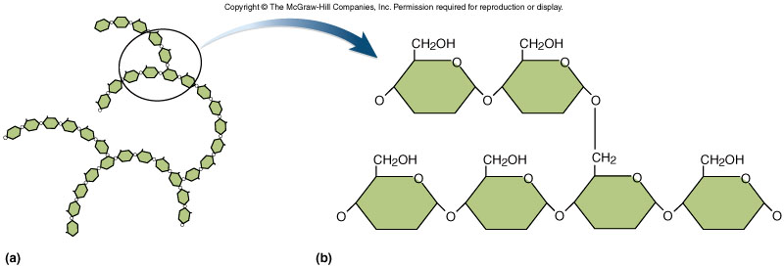
Polysaccharides
Large carbohydrate polymers made up of long chains of GLUCOSE monomers
Cellulose - Structural carbohydrate in plants
  Can’t be digested by humans
  Also referred to as “dietary fiber” or roughage like lettuce
Starch - Energy storage carbohydrate in plants
  The main digestible polysaccharide in our diets
  Potatoes, rice and wheat have a lot of starch
Glycogen – Energy storage carbohydrate in HUMANS
  Readily accessible source of energy stored up when we eat excess food
  Primarily stored in liver, but also found in muscle and brain tissues

Slide 50
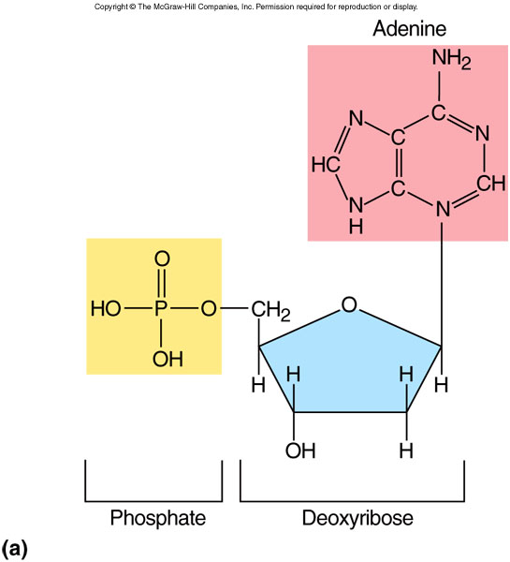
Nucleic Acids : DNA / RNA
DNA – deoxyribonucleic acid
  carries the genetic information of a cell-needed for making proteins
  nucleic acids are extremely long polymers of NUCLEOTIDES
  remains inside the nucleus of the cell
RNA – ribonucleic acid
  chemically similar to DNA
  functions as a disposable “copy” of DNA used in the actual production of proteins in the cytoplasm – don’t want to risk damage to DNA!!!!
Both nucleic acids are composed of 4 different nucleotides
DNA : Adenine, Guanine, Cytosine, Thymine
RNA : Adenine, Guanine, Cytosine, Uracil

Slide 51
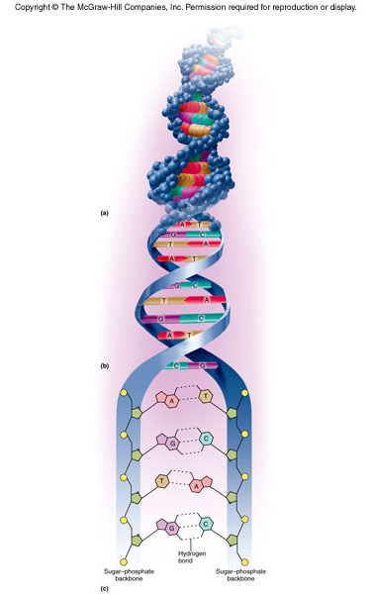
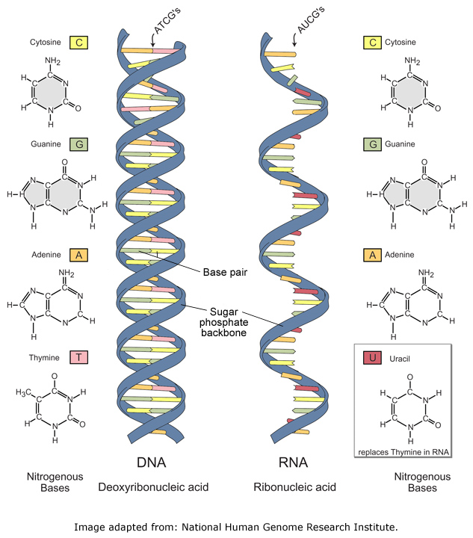
Nucleic Acid Structure
DNA is a double stranded molecule that takes on a DOUBLE HELIX conformation
  Nucleotides are bound to each other via HYDROGEN BONDS
* RNA is single strand of nucleotides
HYDROGEN BONDING

Slide 52
Lipids
Lipids are organic, hydrophobic molecules that play a large number of roles in human physiology
5 Major types of lipids :
Fatty acids: Fairly small molecules which are often precursors to triglycerides
2. Triglycerides: Molecule consisting of glycerol bound to three fatty acids via DEHYDRATION SYNTHESIS. Common type of fat found in foods we eat
3. Phospholipids: Similar to triglycerides except one fatty acid is replaced by a PHOSPHATE group. Very important component of all cell membranes
4. Eicosanoids: 20-carbon lipid derived from arachadonic acid that play an important role in inflammation, cell signaling, blood clotting (prostaglandins)
5. Steroids: 17-carbon, 4-ring lipid. Cholesterol is the “parent” steroid. Hormones like testosterone, estrogen, cortisol are steroids derived from cholesterol.

Slide 53
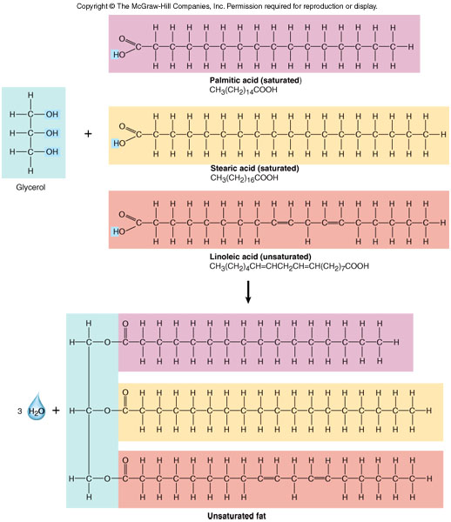
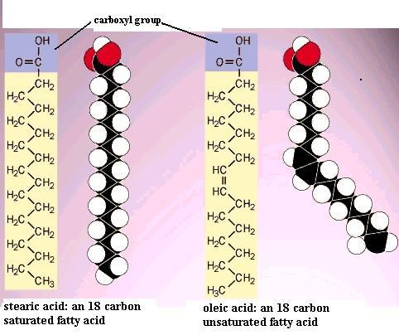
Chemical characteristics of some lipids
Saturated fats have fatty acid tails that are “saturated” with hydrogen
  Carbon can form 4 chemical bonds
  Overconsumption linked to CV diseases
Unsaturated fats have fatty acid tails that are not saturated with hydrogen
  One or more carbon atoms have double bonds to other carbon atoms
  Liquid at room temp (Oil)
  Come from plants (olive oil, corn oil, etc…)
Carbon/Carbon double bonds in unsaturated fats causes kinks and bends in F.A. tail, preventing molecules from packing together (stays liquid at room temp.)

Slide 54
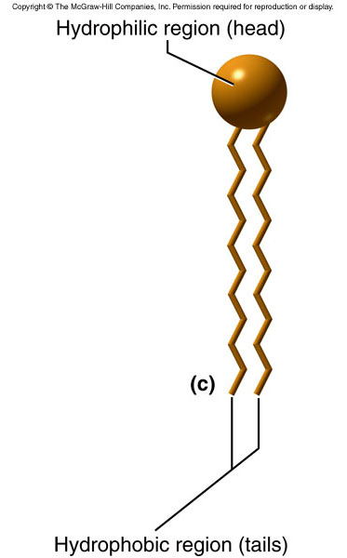
Chemical characteristics of some lipids
Phospholipids are a major component of all cell membranes
Head region is composed of glycerol and a phosphate group
  Makes the head region very POLAR AND HYDROPHILIC!
Fatty acid tail is largely NONPOLAR AND HYDROPHOBIC
Molecules that have a hydrophobic AND hydrophilic regions are called AMPHIPATHIC
(POLAR)
H₂O outside
Phospholipid bilayer of a cell membrane
(NONPOLAR)
H₂O inside

Slide 55
Bio 211- Anatomy and Physiology I
Today’s topics
Introduction to cell structure and function
Osmosis and cell transport

Slide 56
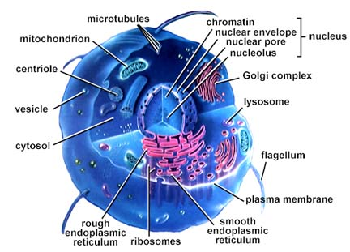
Modern Cell Theory
Set of generalizations that describe cell structure and its relationship to the organism
All organisms are composed of cells and the products of those cells
The cell is the simplest structural and functional unit of life
An organism’s structure and function is due to the characteristics of its component cells
Cells are only derived from other cells
Since all cells in an organism share a common ancestry, they all share some similarity in composition and metabolism
  Ex. All cells in your body have a nucleus and replicate DNA in the same way

Slide 57
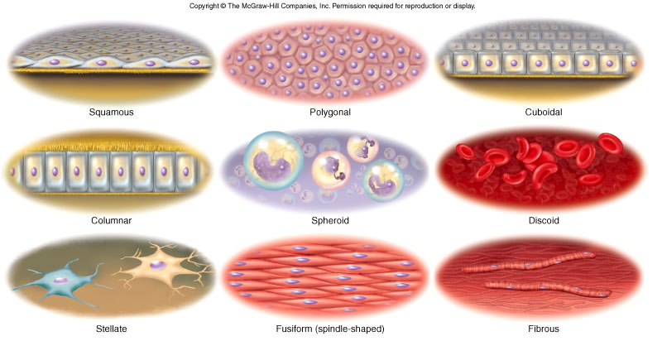
General Cell Structure
There are over 200 different types of cells in the human body
Wide variety of shapes and sizes; although most are in the range of 10-15 microns (1/1,000,000 of a meter)
Size and shape of a cell are related to its function
Upper limit of size is dictated by relationship between volume and surface area
  Very large cells cannot coordinate exchange of nutrients and waste properly (volume increases faster than surface area)

Slide 58
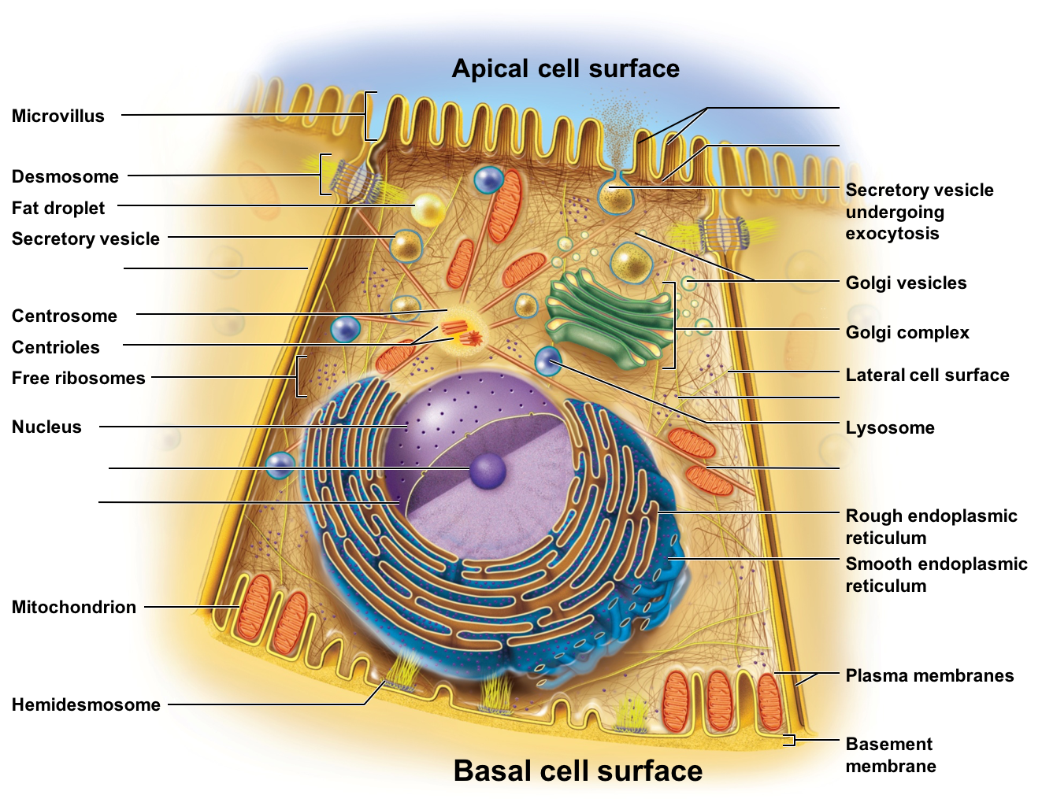
General Cell Structure
For the most part, all cells in the human body have:
  Cell membrane (plasma membrane)
    Envelopes the cell and regulates what comes in/out of the cell
    Phospholipid bilayer with many proteins, other molecules
  Organelles
    Structures that carry out specialized cellular tasks
  Cytoplasm
    Intracellular environment consisting of cytosol (fluid) and cytoskeleton
    Cytoskeleton provides structural support and coordinates transport of materials within the cell

Slide 59
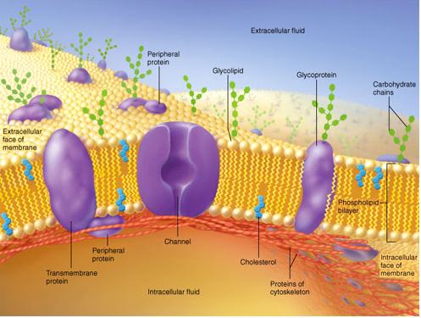
Plasma Membrane
Double layer of phospholipids that envelopes the cell – PHOSPHOLIPID BILAYER
Hydrophilic, polar heads face the extracellular and intracellular side (exposed to water)
Hydrophobic fatty acid tails are buried in the middle of the membrane (avoiding water)
Creates a SEMI-PERMEABLE membrane that surrounds the cell
MANY proteins are found embedded in the plasma membrane
  Regulate movement of solutes in/out
  Allows for interaction with other cells
  Allows cell to communicate with other cells, hormones, etc…

Slide 60
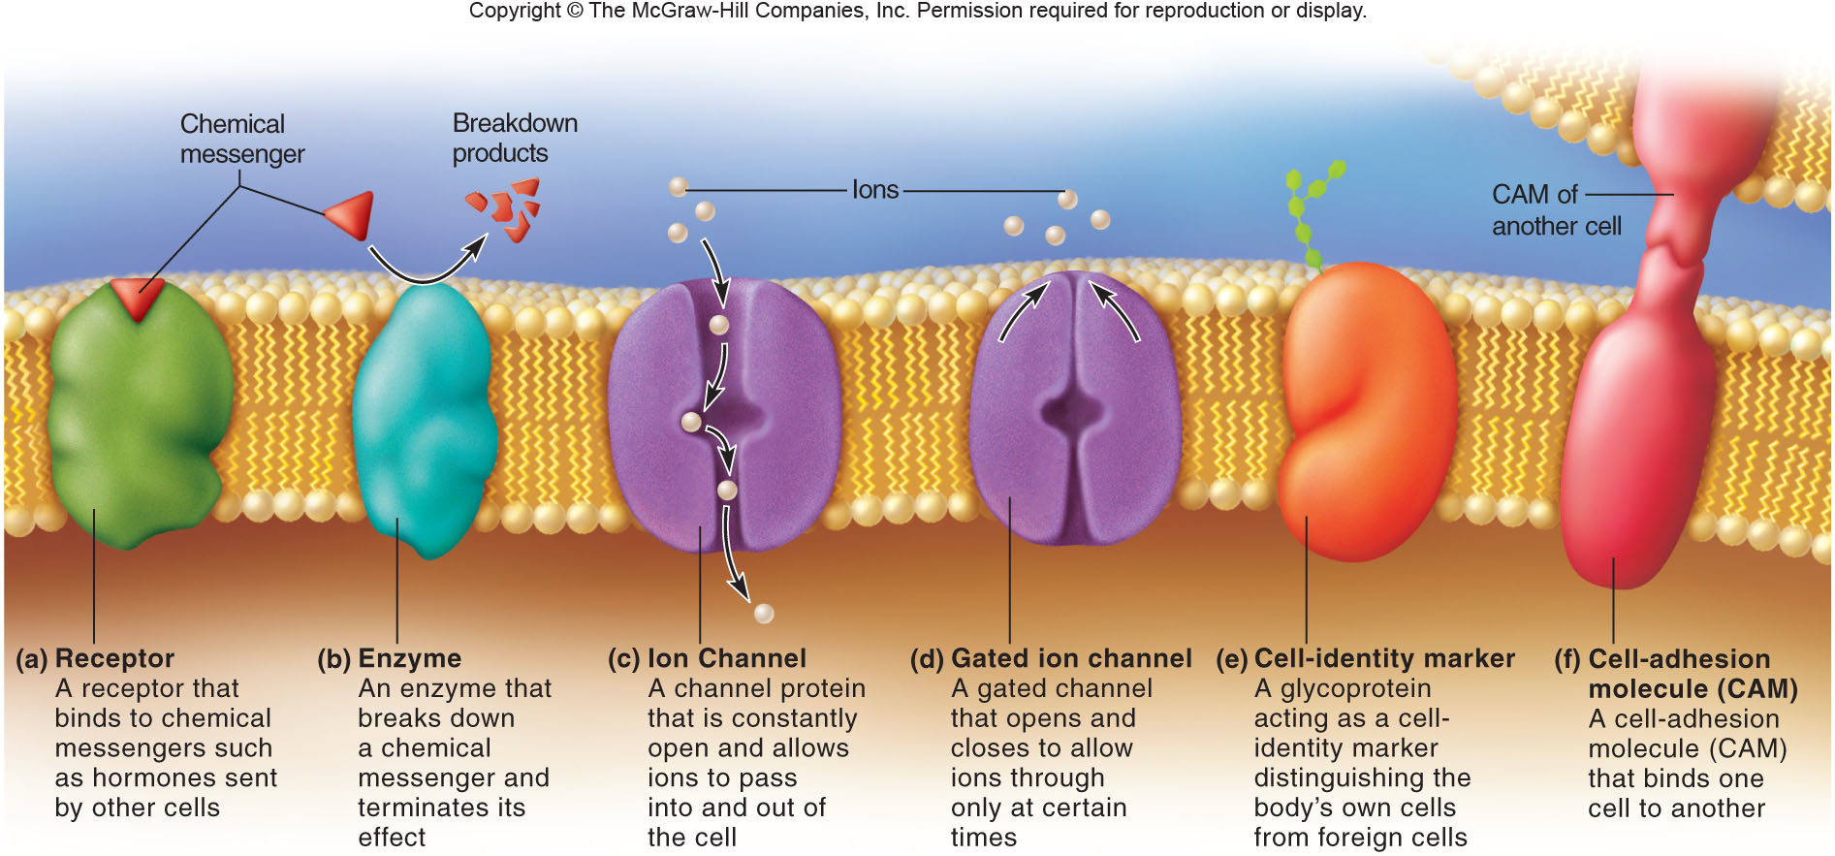
Some types of membrane proteins
Receptors – receive chemical signals from other cells
Enzymes – responsible for breakdown of chemical signals
  Prevent “overstimulation”
Channel proteins – allow solutes and large hydrophilic molecules in/out of cell
  Can either be open all the time or “gated” and only allow molecules to pass under certain circumstances (ligand-gated, voltage-gated)
Cell identity proteins- identify “self” vs. “non-self” (important for immune system)
Cell-adhesion molecules – help cells attach to one another or to extracellular material

Slide 61
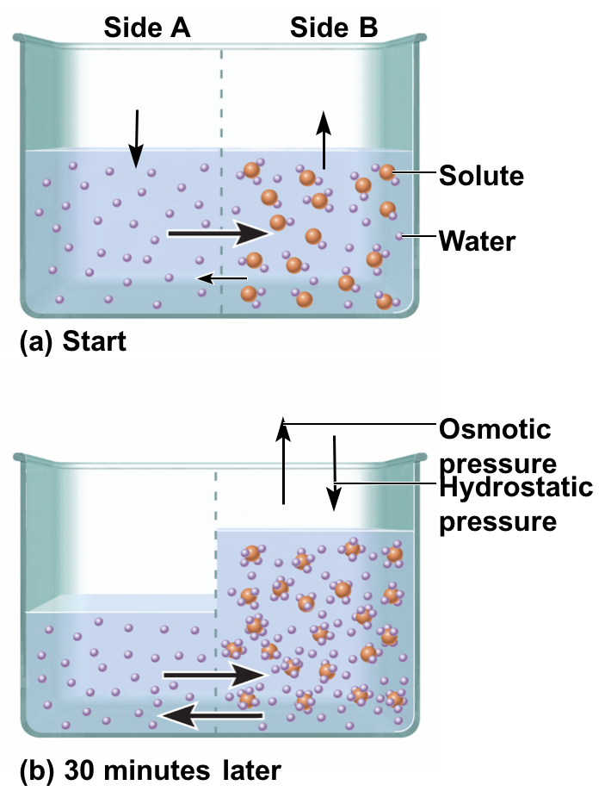
Osmosis and Transport Across Cell Membranes
Solution – Any particulate matter (SOLUTE) dissolved in a liquid (SOLVENT)
  In biology, solutes are often ions, proteins, hormones, etc… dissolved in water (the solvent)
Osmosis = the diffusion of water down its concentration gradient
  Water is free to move across cell membranes and will move from an area of LOW solute concentration to an area of HIGH solute concentration
  Water is attracted to many solutes
Cell membranes are SELECTIVELY PERMEABLE, some things pass freely (water, some small, uncharged molecules), while others cannot (proteins, large molecules, ions)

Slide 62
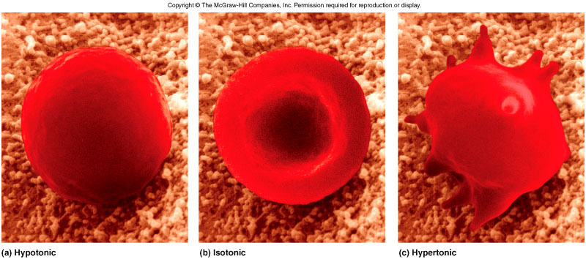
Tonicity and Osmosis
Hypertonic – when concentration of solute is greater outside than inside
Isotonic – when concentration of solute is the same inside and out
Hypotonic – when concentration of solute is lower outside THAN INSIDE
  We normally use these terms to describe a solution that is outside of a cell
  Example : A hypertonic solution has a HIGHER concentration of a solute than what is found inside the cell
Example: Red blood cells in solutions of varying ion concentration
Hypotonic Isotonic Hypertonic
Water (solvent) will travel into or out of a cell until NaCl concentrations are equal inside and outside the cell.
  NaCl is the solute (trapped in cell)
Water 0.9% NaCl 5% NaCl
(0% NaCl)

Slide 63
Carrier-mediated transport
Movement of SOLUTES (ions, proteins, etc…) across a cell membrane
When allowed, solutes will diffuse from an area of high concentration to an area of low concentration until equilibrium is reached
2 main types of transport:
  Facilitated diffusion – describes a situation in which solutes travel across the cell membrane DOWN ITS CONCENTRATION GRADIENT
    Solute travels across the plasma membrane using a membrane protein (channel or transporter) but DOES NOT REQUIRE ENERGY (ATP)
  Active Transport – describes a situation when solutes travel AGAINST ITS CONCENTRATION GRADIENT
    Uses energy (ATP) and creates or maintains a concentration gradient where solute concentrations are higher on one side of the membrane

Slide 64
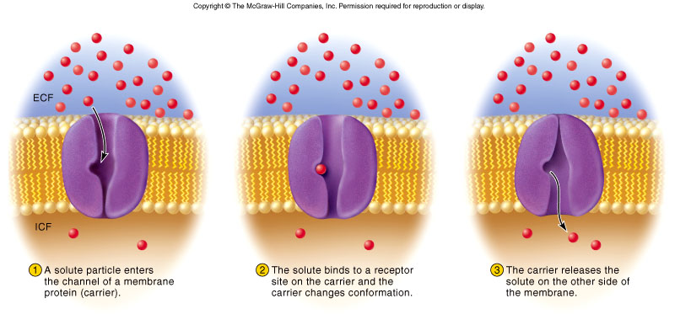
Types of transporters
Transporters are membrane proteins and are VERY SPECIFIC about what solutes they can transport
HIGHER CONCENTRATION
LOWER CONCENTRATION
Facilitated diffusion: membrane proteins either carry or allow movement of solutes
  Channels or pores allow solute to travel freely
  Carriers bind solute and then move it across the membrane
  In both cases solute travels down conc. gradient.

Slide 65
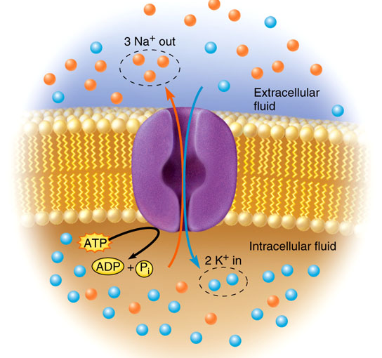
Active Transport
Active transport: membrane protein uses energy (ATP) to move solutes from one side of the membrane to the other AGAINST THE CONCENTRATION GRADIENT
  Moves solutes from an area of LOW concentration to and area of even HIGHER concentration (i.e., LOW to HIGH; opposite of facilitated diffusion)
High Concentration
Low Concentration

Slide 66

Vesicular Transport
Many molecules can be transported across the P.M. via membrane carrier proteins (active transport and facilitated diffusion). However, very LARGE molecules, large numbers of molecules, and liquids are better transported via VESICULAR TRANSPORT
Vesicles – bubble-like structures made up of pieces of the P.M.
Endocytosis: process by which particles or liquid are brought INTO the cell
  Small section of plasma membrane pinches off and forms a vesicle
Exocytosis : process that sends particles or liquids OUT of the cell
  Basically the reverse of endocytosis

Slide 67


Types of Endocytosis
Phagocytosis, pinocytosis, receptor-mediated endocytosis
Phagocytosis – “cell eating” process by which a cell engulfs particles or debris
  Neutrophils use this to “eat” bacteria and kill them
  Use pseudopodia to “grab” things; not common in many cells
Pinocytosis – “cell drinking”; cell takes in droplets of liquid containing solutes
  Fairly non-specific; but very common in many cells
Receptor-mediated endocytosis – Very SELECTIVE, and most common form of endocytosis where cells only take in certain solutes in certain quantities
  Involves the use of RECEPTORS on outer surface of P.M

Slide 68

Organelles
Nucleus
Endoplasmic Reticulum
Ribosomes (bound to E.R.)
Golgi Apparatus
Lysozomes/Peroxisomes
Mitochondria
6
4
5
1
2
3

Slide 69

Nucleus
Largest of the organelles
Sometimes spherical, but often matches shape of cell
Surrounded by NUCLEAR ENVELOPE – 2 phospholipid bilayers (inner and outer)
Contain NUCLEAR PORES- allow transcription factors and RNA molecules in/out
Stores and protects the cell’s DNA (packaged into 23 pairs of chromosomes)

Slide 70

Endoplasmic Reticulum
Series of networks adjacent to the nucleus
“Rough” E.R. is dotted with ribosomes for protein synthesis
“Smooth” E.R. has no ribosomes
E.R. plays important role in the synthesis of steroids and lipids, and has enzymes that are responsible for the detoxification of drugs and alcohol
  Contributes to tolerance of drugs and alcohol
  Also explains why some GOOD drugs (i.e., medicines) stop working after a while

Slide 71
Ribosomes
Found in the nucleolus, rough E.R. and in the cytoplasm
Ribosomes are complexes of protein and RNA
Function to translate RNA messages (mRNA) into proteins
More on protein translation later!!
Lysozomes and Peroxisomes
Lysozomes
  Membrane-bound vesicles that contain LYSOZOMAL enzymes
  Lysozomal enzymes hydrolyze (break down) fats, proteins, DNA/RNA, carbohydrates
  White blood cells use lysozomes to degrade bacteria, viruses, damaged cells that they have phagocytosed
Peroxisomes
  Similar to lysozomes, but contain oxidative enzymes that produce and utilize H₂O₂ in order to metabolize organic compounds

Slide 72

Golgi Apparatus
Golgi apparatus is system of sacs often found in proximity to the rough E.R.
Functions to synthesize carbohydrates and add sugars to glycoproteins
Golgi receives newly made proteins from the E.R., modifies them, sorts them, and packages them into GOLGI VESICLES for transport to other parts of the cell.
  Sort of acts like the cell’s post office!
Vesicles leaving the Golgi have “tags” that indicate where the vesicle of newly formed proteins will go…i.e., plasma membrane, storage vesicles, etc…

Slide 73

Mitochondria
The “Powerhouse” of the cell – responsible for the production of ATP
Also contain their own DNA (small amount) different from nuclear DNA
  Allows the mitochondria to make their own proteins and enzymes
Many reactions that take place in the mitochondria are oxidative reactions (Redox reactions)
  Dysfunction or damage to the mitochondria leads to the release of oxygen free radicals (BAD!) and eventually can lead to cell and tissue death
  Alzheimer’s disease, Parkinson’s disease and some cardiovascular diseases are linked to oxidative stress from mitochondrial damage!

Slide 74

Cytoskeleton
Cytoskeleton – collection of protein filaments that supply structural support and transport within the cell
Made up of microfilaments, intermediate filaments, microtubules
  Gives cell unique shape, rigidity, loosely holds things in place, provides way to move materials from place to place within the cell

Slide 75


Slide 76
Bio 211- Anatomy and Physiology I
Today’s topics
Protein synthesis
  RNA Transcription
  Protein translation
Protein processing and secretion

Slide 77
Flow of genetic information
DNA
How does a cell “know” how to make all the 1,000s of proteins required for life?
  The genetic information is stored as DNA which is found in the nucleus of every cell
  DNA can be thought of as the blueprint for making proteins
  When a cell wants to make a protein, a copy of the DNA is made, called mRNA
  The mRNA “copy” is then used by machinery in the cell to make the protein
Transcription
mRNA
Translation
Protein
Transcription = process of making a copy of the DNA into mRNA
Translation = process of making a protein using information encoded in the RNA

Slide 78

DNA and Chromosomes
Chromosomes are composed of long strands of DNA (millions of nucleotides) wrapped around stabilizing proteins
  Most cells contain 23 pairs of chromosomes
  22 pairs of autosomes and 1 pair of sex chromosomes
DNA molecules are divided into functional units called GENES
Each gene possesses the genetic information for the synthesis of one protein
  Example: the insulin gene contains the genetic information encoding the insulin protein

Slide 79
RNA Synthesis (TRANSCRIPTION)
RNA synthesis (transcription) is carried out by an enzyme called RNA POLYMERASE
  RNA polymerase “reads” the DNA and makes an RNA copy called MESSENGER RNA (mRNA)
  mRNA is sent out of the nucleus and then used by ribosomes to make proteins out in the cytoplasm
GENE #1
GENE #2
GENE #3
DNA
Double stranded
Made of millions of nucleotides
TRANSCRIPTION
GENE #2
mRNA
Single stranded
Made of thousands of nucleotides
Important process because:
  Allows for selective expression of genes
  DNA stays protected in nucleus
  ~95% of our DNA is “Junk DNA”

Slide 80

Translation
Process by which the genetic information encoded in mRNA is used to synthesize proteins
  Converts the language of nucleotides into the language of amino acids
Major players involved:
  mRNA – contains the genetic information
  Ribosome – protein complex that coordinates the assembly of the polypeptide
  Amino acids – the building blocks of a protein
GENE #2
mRNA
Single stranded
Made of thousands of nucleotides
TRANSLATION
Protein (polypeptide)
Single stranded
Complex 3D shape
Made of thousands of AMINO ACIDS

Slide 81

CODON = sequence of three nucleotides that encode one amino acid in a protein
Genetic Code = set of rules that determine which codon encodes each amino acid
  The genetic code is redundant (some amino acids are encoded by more than one codon)

Slide 82
DNA Replication and Cell Division
DNA Replication and cell division are closely linked – one cannot happen without the other
Both are influenced to topics we talked about earlier
  Modern cell theory – states that all cells can only arise from other pre-existing cells
    Needed to replace old, damaged cells and sperm/eggs
  A cell needs to duplicate ALL of its DNA before it can divide
DNA replication is probably the most important function that a cell carries out
  We know that DNA encodes the proteins that carry out almost every cell process
  When DNA is replicated, it must result in a exactly perfect replica of the original
Mutation

Slide 83

Cell cycle and DNA replication
Major Steps in DNA replication:
Unwinding of DNA from its packaged double helix structure
DNA POLYMERASE binds to each of the two exposed strands and “reads” the DNA, incorporating free nucleotides to make a new complementary strand for each
DNA Replication is sort of like mRNA transcription, except we are copying both strands

Slide 84
Genetic Mutations
Even though DNA polymerase is very good at replicating DNA correctly, and we have “proofreading” polymerases, sometimes mutations are made and passed on to the daughter DNA and cell
Some mutations are very bad while others may have no detectable affect on the cell
Types of mutations:
  Point mutations
    Simple replacement of one nucleotide for another – i.e., A➔T or G➔C, etc….
      Silent – change in nucleotide doesn’t change amino acid sequence of protein (remember redundancy of genetic code!) AUU, AUC both encode the a.a. leucine, or mutation occurs in “junk” DNA
      Missense – change in nucleotide leads to change in a.a. sequence of protein
      Nonsense – change leads to formation of a STOP codon, shortened protein
  Insertions/Deletions
    Addition or removal of a nucleotide
    Can alter how a ribosome reads the mRNA → mutant protein!!
THE DOG CAN RUN
THE HDO GCA NRU N

Slide 85
Genetic Mutations
Mutations can also be classified by function
  Gain of function- mutation leads to protein with new function or activity
  Loss of function- mutation causes protein to be non-functional
It is tempting to think of genetic mutations as always being detrimental….BUT sometimes they are actually beneficial….or Both!!!
Deletion of a portion of the gene encoding the CCR-5 receptor found on T-cells
  Found in some Northern European populations
  Confers resistance to smallpox, Bubonic plague, AIDS (GOOD!)
Mutation of hemoglobin gene can cause sickle cell anemia AND/OR confer resistance to malaria
  Since all of our cells have PAIRS of chromosomes, we have TWO copies of every gene
  HOMOZYGOUS mutation-both copies of gene are mutated (with hemoglobin, causes sickle cell anemia)
  HETEROZYGOUS mutation-one copy is mutated, other is good
    Individual has very mild symptoms of sickle cell anemia (may not even know it) and has resistance to malaria infection (prevents malaria from infecting RBCs)

Slide 86
Cell Cycle
Process by which ONE parent cell grows and replicates all of its component structures (plasma membrane, organelles, etc…), undergoes division, and yields TWO daughter cells
The length of the cell cycle varies widely between cell types and is usually related to their function
  Some cells divide very rapidly all the time (i.e., skin, GI tract), while some cells divide very slowly or not at all (neurons, muscle)…
Two different types of cell division:
  Mitosis – “normal” cell division where one cell divides to produce TWO genetically identical cells – almost all cells in our body divide this way
  Meiosis – “special” cell division used to produce gametes (sperm and eggs)… each cell produced contains HALF the normal amount of genetic material

Slide 87
What regulates the timing of the cell cycle??
This is a VERY IMPORTANT question in biology since a cell that has lost control of its cell cycle can divide more often than it should and may not stop
CANCER!!!
Cell conditions
  Cell division is triggered if a cell has grown large enough to become two cells (cytoplasm, organelles, etc…)
  DNA is duplicated
  Nutrient levels – cells will not divide if sufficient food is not present
Growth factors
  Hormones and cell signaling molecules that trigger cell division in other cells
Environmental conditions
  Contact inhibition – cells will stop dividing when they “feel” other cells all around them and start dividing if they detect open space
Many cancer medicines attempt to inhibit DNA synthesis or block the signals of growth factors

Slide 88


Mitosis
The cell cycle is divided into two main periods :
  Interphase – time when the cell is either quiescent or beginning preparations for cell division - the majority of a cell’s life is spent in interphase
      G₁ phase, S phase, G₂ phase
  Mitotic phase – time when the cell is actively dividing (nuclear components are duplicated, DNA is divided up, parent cell pinches off into 2 daughter cells)
Almost all cells in human body use mitosis to divide and reproduce
  Some human cells are incapable of division and reproduction
Results in the formation of 2 daughter cells that are GENETICALLY IDENTICAL to the parent cell

Slide 89

Meiosis
Meiosis is the process of cell division that results in the production of 2 cells with HALF the normal genetic material (one copy of each chromosome)
  This process is only involved in the production gametes (sperm and egg – 23 chromosomes each)
  Union of sperm and egg results in offspring with normal complement of chromosomes (23 pairs)
Meiosis is characterized by one DNA duplication and two cell divisions (meiosis I and meiosis II)
  During meiosis I, the chromosomes duplicate AND undergo CROSSOVER RECOMBINATION between chromosomes
  During meiosis II the cells undergo another cell division WITHOUT duplicating DNA
Cells with 23 pairs of chromosomes = diploid cell
Cells with 23 chromosomes – haploid cell

Slide 90
Errors in Meiosis
NONDISJUNCTION describes a situation where cells do not receive the appropriate chromosomes during meiosis II (i.e., each cell receives 1 copy of chromosome #1, #2, etc…)
  Ultimately, if this gamete is used in reproduction the resulting offspring will end up with the wrong number of chromosomes
    3 copies = TRISOMY
    1 copy = MONOSOMY
In most cases embryos with monosomy or trisomy of a chromosome are not viable and do not survive
  However, there are a few cases where the fetus will survive
Nondisjunction of a chromosome

Slide 91
Bio 211- Anatomy and Physiology I
Today’s topics
Heredity

Slide 92
Heredity, Genotype, and Phenotype
Since we all have two copies of every chromosome (one each from mom and dad), that also means that we have two copies of every gene
  Different forms of each gene are called ALLELES
  Ex.: You might possess two slightly different versions of a given gene (one was inherited from mom and one from dad)
  There might be dozens or even hundreds of different versions of a gene in a population of people
Genotype = term that describes the GENETIC makeup of our cells (i.e., which alleles we have)
Phenotype = term that describes how those alleles are expressed (i.e., our outward appearance or characteristics)

Slide 93
Dominant and recessive alleles
If our genotype dictates that we all have two copies of each gene (alleles), how do we know what our phenotype will be?
DOMINANT ALLELES are expressed in our phenotype since they typically encode the “normal” protein and mask the effects of the “abnormal” recessive protein
RECESSIVE ALLELES typically encode the “abnormal” protein and are only expressed in our phenotype if a cell contains 2 recessive alleles
Mutation in CFTR gene is recessive and can cause the genetic disease cystic fibrosis
  “Carrier” has one dominant and one recessive allele – normal phenotype. But can pass that recessive allele to offspring increasing chances of offspring having that disease if other parent is also a “carrier”
Codominance – describes a situation where an individual has two different dominant alleles and both are expressed in the phenotype
  Blood type-dictated by proteins on surface of blood cells
    A and B are both dominant, O is considered recessive
    AA = Type A
    AO = Type A
    BB = Type B
    BO = Type B
    OO = Type O
    AB = Type AB (CODOMINANCE)

Slide 94


Incomplete dominance – describes a situation where two different dominant alleles lead to a “middle of the road” phenotype
  Red flower + White flower results in pink offspring
  In reality, this is a HUGE reason why humans are 99.9% genetically similar yet WE ARE ALL UNIQUE!!!
Polygenic inheritance – when more than one gene contributes to a particular phenotype
  Eye color, skin tone, etc…
  Many diseases are polygenic in nature
    Heart disease, hypertension, cancer are thought to be caused by the contribution of MANY different genes

