Slide 1
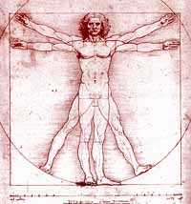
Bio 211- Anatomy and Physiology I
Today’s topics
Tissues

Slide 2
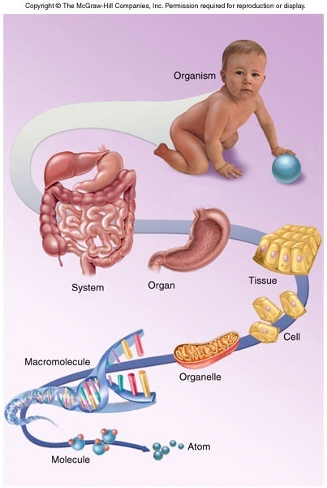
Structural hierarchy in human biology
Biggest, most complex
Human Body
Organ system (cardiovascular system)
Organ (Heart)
Tissue (cardiac muscle)
Cells (cardiomyocytes)
Organelles (nucleus, ribosome)
Macromolecule (Protein, DNA)
Molecule (amino acid)
Atom (nitrogen, carbon, oxygen)
Smallest
DONE!!

Slide 3
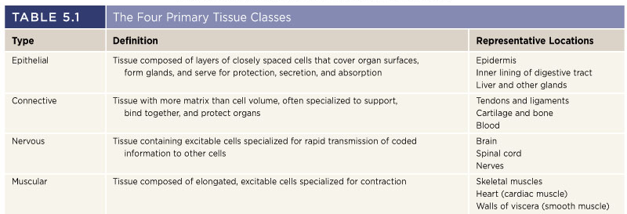
Histology
The study of cells and tissues and how they are arranged into organs
Allows us to see how cells are arranged in a particular tissue type and how tissues help form an organ
200+ types of cells in our bodies are broken down into 4 primary tissue classes or categories:
Epithelial
Connective
Nervous
Muscular

Slide 4
Tissues
A group of similar cells derived from a common embryonic origin that are arranged in a way that allows them to carry out a particular STRUCTURAL or PHYSIOLOGICAL function
STRUCTURAL
Bone (type of connective tissue) supports and protects the body and allows muscles to produce movement
PHYSIOLOGICAL
Epithelial tissues lining the digestive system allows the body to absorb nutrients from the foods we eat
Many tissues have both a structural and physiological function (bone)
Tissue = cells + extracellular matrix (or extracellular material)
Tissues differ from one another in the types of cells which make up the tissue, as well as by the type and amount of EXTRACELLULAR MATRIX that surrounds the cells
Matrix contains protein fibers, water, minerals, nutrients, waste products

Slide 5
Studying Histology
Biologists use microscopes to examine tissue sections (very thin slices) colored with various stains or antibodies (used to visualize proteins) to determine the location and arrangement of cells within a tissue
Depending on the stain used, you can visualize cytoplasm, nuclei, even specific proteins!
Purple nuclei
Brown stain shows location of a specific lung protein
Pink cytoplasm

Slide 6
Epithelial Tissues
EPITHELIAL TISSUES are characterized by a layer of tightly bound cells that are one or more layers thick (1-20), bound to a BASEMENT MEMBRANE and are usually exposed to the outside environment or to the inside of the body
Examples : skin, lining of digestive system, lining of lungs, lining of blood vessels, etc…
Epithelial cells
Basement membrane
Connective tissue
Basement membrane acts like a biological glue to hold cells to connective tissue underneath
composed of collagen, and a variety of glycoproteins and proteoglycans

Slide 7
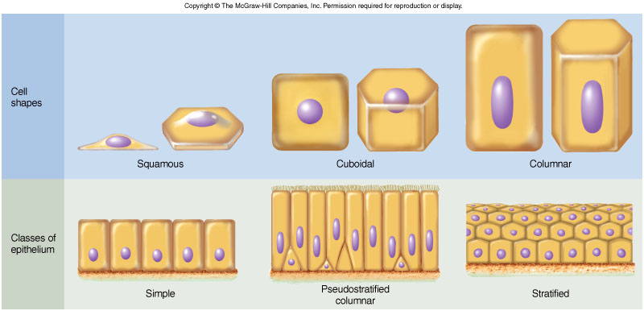
Classification of epithelial tissues
Cell Shapes
Squamous – thin, flat
Good for exchange of gases, nutrients, waste products (lung and blood vessels)
Cuboidal – typically square or round
Found lining the ducts of many glands
Columnar – tall and narrow
Found lining the intestines
Often have small projections on exposed surface (MICROVILLI) that increase surface area for absorption

Slide 8
Classification of epithelial tissues
Simple – have a single layer of cells
Pseudostratified columnar – all cells are bound to the basement membrane but not all cells reach the exposed surface.
Stratified – Tissue contains a few to many layers of cells on top of each other
Only bottom layer are bound to basement membrane
Upper layers have cells bound to other cells
Transitional – Specialized type of epithelia found in organs that stretch

Slide 9
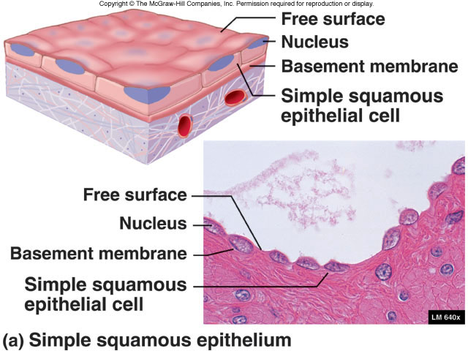
SIMPLE SQUAMOUS EPITHELIUM

Slide 10
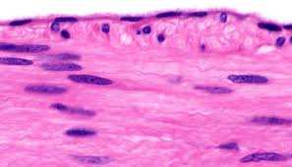
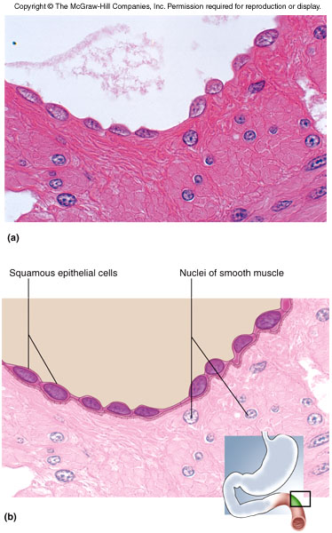
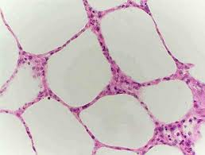
Epithelial tissue histology
Simple Squamous:
Single, layer of thin cells

Slide 11
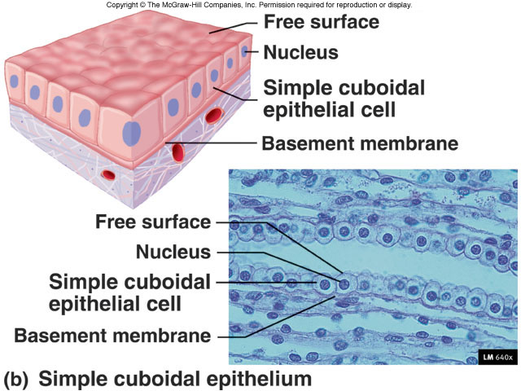
SIMPLE CUBOIDAL EPITHELIUM

Slide 12
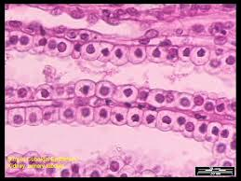
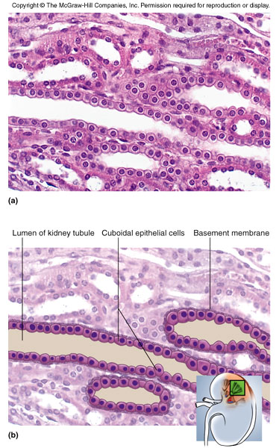
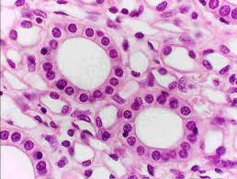
Epithelial tissue histology
Simple cuboidal:
Single layer of cube or round cells

Slide 13
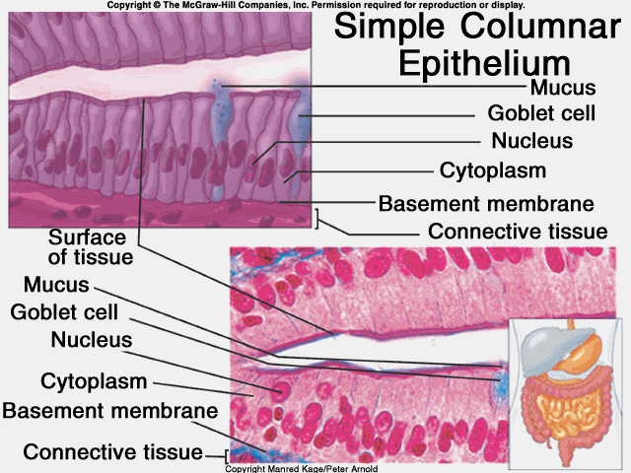
SIMPLE COLUMNAR EPITHELIUM

Slide 14
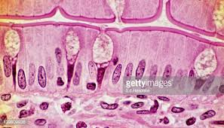
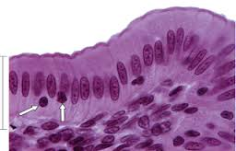
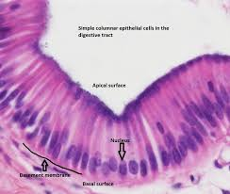

Slide 15
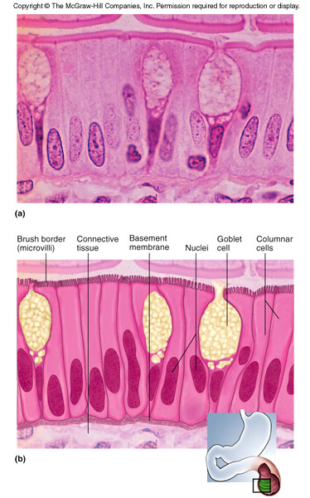
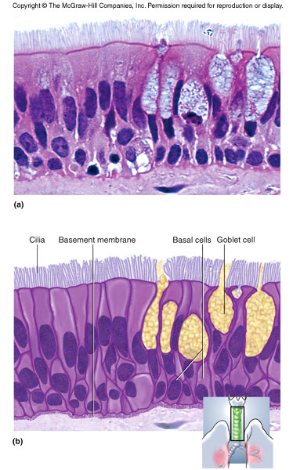
Simple columnar:
Single layer of tall cells, all cells reach the exposed surface, microvilli present
Pseudostratified columnar:
Single layer of columnar cells, nuclei are scattered, not all cells reach exposed surface
Microvilli

Slide 16
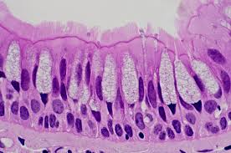
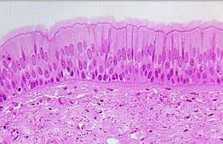
PSEUDOSTRATIFIED COLUMNAR EPITHELIUM
Note the nuclei at different levels
Note the presence of GOBLET CELLS

Slide 17
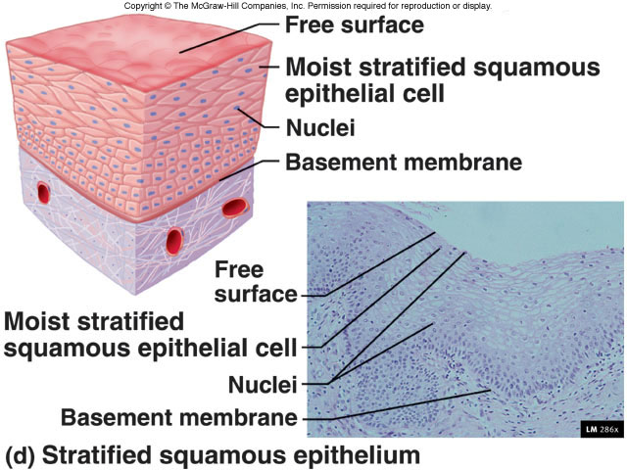
STRATIFIED SQUAMOUS EPITHELIUM

Slide 18
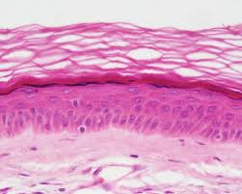
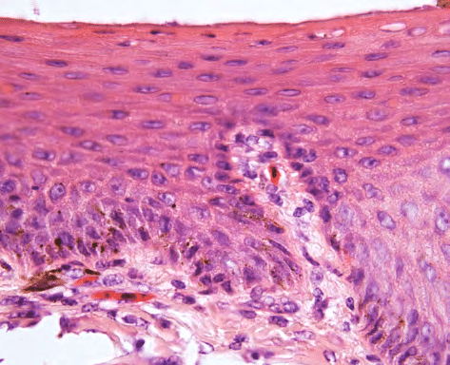
Keratinized, stratified squamous epithelia:
Many layers of cells, lower cells are alive and dividing, upper cells are dead and filled with keratin, CANNOT SEE NUCLEI
Non-keratinized stratified squamous epithelia:
Many layers of cells, all alive, CAN SEE NUCLEI

Slide 19
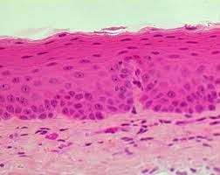
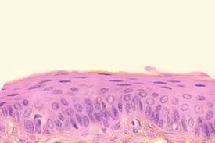
Non-keratinized
Stratified squamous epithelium

Slide 20
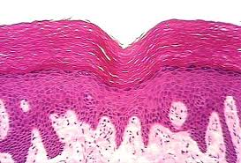
Keratinized stratified squamous epithelium
Dead, keratinized cells
Living cells

Slide 21
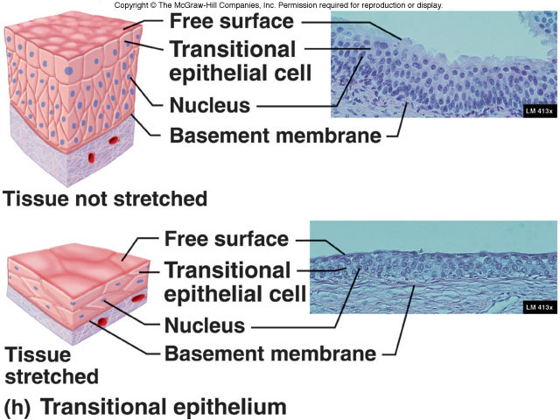

Slide 22
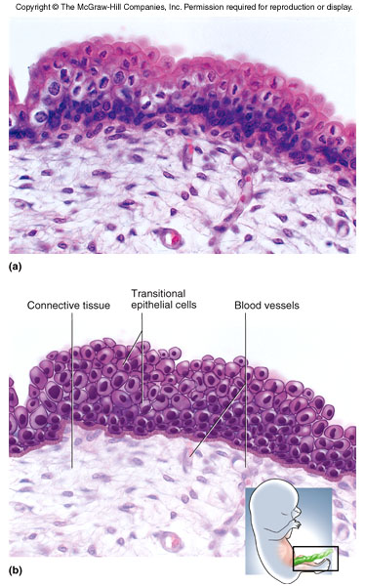
Transitional epithelium:
Cells are alive and overlapping, may appear single layer when tissue is stretched
Found in tissues that need to stretch on a regular basis
Have a cuboidal appearance in a relaxed tissue but “TRANSITION” to a squamous appearance when stretched

Slide 23
Tips to identifying and classifying epithelial tissues
Identify the number of layers of cells
Classify the shape of the cells
Number of layers and shape of cell tells you the name of the tissue
Stratified sqaumous (SEVERAL LAYERS of THIN, FLAT cells)
Simple cuboidal (ONE LAYER of CUBE-SHAPED cells)
Etc….
Since epithelial tissues are often found lining something you will typically see epithelial tissues next to open spaces (white space on a microscope slide)

Slide 24
Connective Tissue
Tissue derived from the mesoderm that provides protection and support for the body and its organs, often composed of dense fibers, large amount of extracellular material with relatively few cells
Major Functions:
Connection – connective tissue binds bones to muscle (tendons), bones to other bones (ligaments) and keeps organs in place
Support – bones help support the weight of the body, cartilage supports structures like the nose and ear
Protection –
Physical- delicate organs like the brain, kidneys, eyes, etc… are often surrounded by bone and adipose tissue for protection
Immune – LEUKOCYTES (white blood cells) and LYMPHATIC organs are connective tissues that protects the body from invasion by bacteria and viruses
Movement – Bones help move body with help of muscle, muscles attached to bones compress some body cavities
Storage and heat production – Adipose tissue (Fat) stores energy for later use and preserves/generates heat
Transport – Blood transports gases, nutrients, waste, hormones to distant parts of the body

Slide 25
Types of connective tissue
Fibrous connective tissue –
What most people think of when talking about connective tissue
Ligaments and tendons contain fibrous C.T.
Cartilage –
Rubbery C.T. that supports nose and ears, found between bones
Bone –
Rigid C.T. that protects body organs, supports weight of body, helps produce movement
Blood –
Fluid C.T. that functions to transport materials throughout body, also serves protective immune function through leukocytes

Slide 26
Fibrous Connective Tissue
A diverse type of C.T. composed of cells, fibers, and ground substance (appears as empty space)
Cells –
Fibroblasts – large cells that produce the fibers and ground substance
Leukocytes (WBCs) – important part of immune system that monitors body for invasion and coordinates immune response
Lymphocytes produce ANTIBODIES when a bacteria or virus is detected.
Antibodies are proteins that recognize specific proteins on surface of invaders and “flag” them so macrophages can destroy them
Macrophages – phagocytic cells that look for, engulf, and destroy pathogens
Adipocytes – cells designed to store large vacuoles of fat, cellular part of adipose tissue

Slide 27
Fibers –
Collagenous – made of a protein called COLLAGEN
Very strong and flexible
Major component of tendons and ligaments
Reticular fibers – collagen fibers COATED WITH GLYCOPROTEINS
Found inside several organs for structural support
Elastic fibers – Thin fibers made of the protein ELASTIN
Elastin fibers are coiled like a “slinky” and allow the fibers to stretch and then return to normal shape
Very important for elasticity of skin and lung tissue (makes things stretchy)
Ground substance –
Fills the space not occupied by fibers and cells
Composed of large carbohydrates, proteoglycans, and glycoproteins
Also contains water, waste products, electrolytes, etc….
Cushion and protect the cells of the C.T.

Slide 28
Types of Fibrous Connective Tissue
Loose fibrous connective tissue
Much more ground substance than fibers and cells
3 Types – Areolar : many randomly oriented fibers (COLLAGEN AND ELASTIN)
Reticular: many randomly oriented RETICULAR fibers
Adipose: Few fibers and many adipose cells filled with lipid
Dense fibrous connective tissue
Many more collagen fibers than ground substance and cells
2 Types – Dense regular: collagen fibers are densely packed and parallel to each other.
Dense irregular: collagen fibers are densely packed but run in random directions.

Slide 29
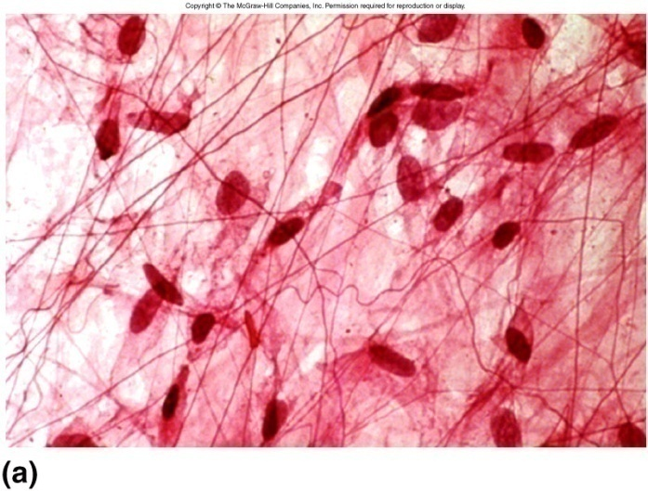
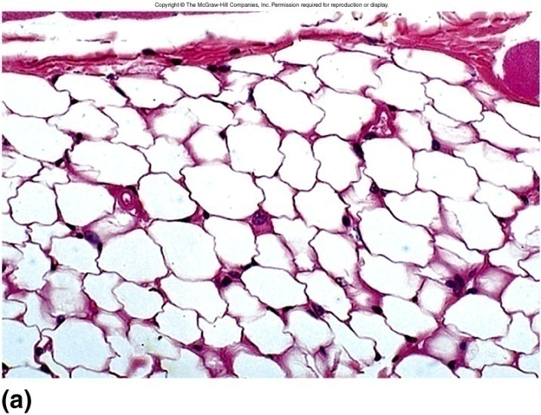
Loose Fibrous Connective Tissue
Areolar tissue – relatively few fibers, lots of ground substance, randomly arranged fibers
Adipose – very few fibers, tissue contains MANY adipose cells that look empty (where lipids are stored)

Slide 30
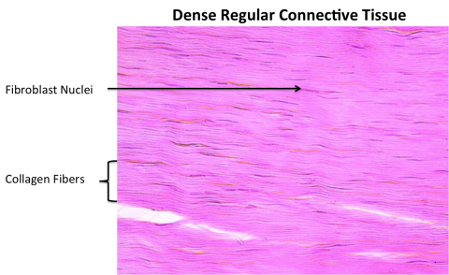
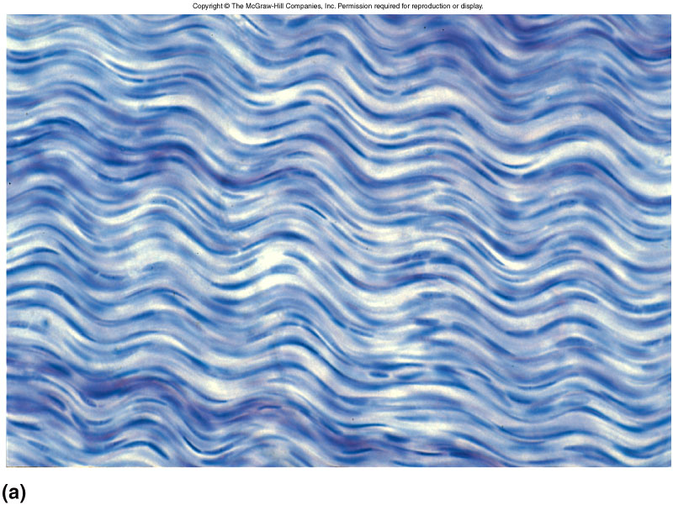
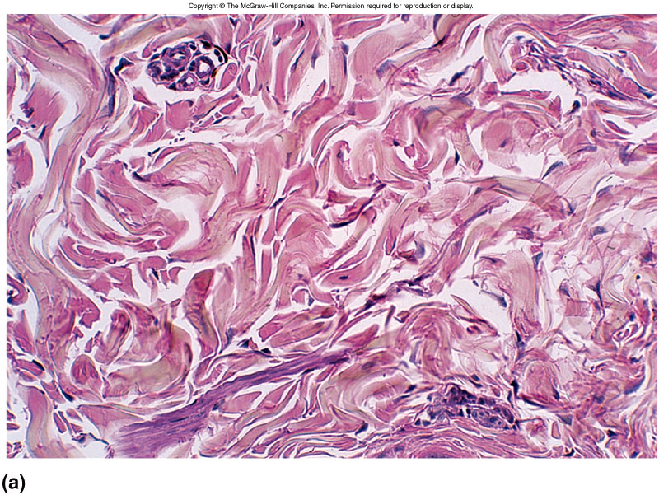
Dense Fibrous Connective Tissue
Dense regular – few cells , very little ground substance, tightly packed collagen fibers, all running parallel to each other
Dense irregular – very little ground substance, very few visible cells, tightly packed collagen fibers are randomly arranged

Slide 31
Tips for identifying fibrous connective tissues
First look at relative amount of fibers
Many fibers=dense C.T.
Few fibers=loose C.T.
Next, look at the direction the fibers are running
Parallel = Dense regular
Random=Dense irregular or any of the loose C.T.
Finally, look at the relative amount of ground substance and cells
On histology slides, ground substance usually looks like open space
Lots of open space and a few cells = areolar
Few fibers and BIG OPEN SPACES where lipid vaculoles used to be = adipose
Sort of has a honeycomb structure

Slide 32
Bio 211- Anatomy and Physiology I
Today’s topics
Connective tissue
Bone
Blood

Slide 33
Cartilage
Flexible, rubbery connective tissue that plays an important supportive role
Ears, nose, between bones of some joints
Cells of cartilage that secrete the matrix are known as CHONDROBLASTS, once surrounded by matrix (in small cavities called LACUNAE), they are known as CHONDROCYTES
Three types of cartilage:
Hyaline cartilage – has a clear, glassy appearance; contains many thin collagen fibers
Usually surrounded by PERICHONDRIUM made of dense, irregular CT (protective covering)
Precursor to osseous tissue,
Articular cartilage, trachea, larynx, costal cartilage
Elastic cartilage – contains many elastin fibers
Provides flexible support for the outer ear, part of larynx
Fibrocartilage – contains many course, collagen BUNDLES, rather than random collagen fibers, like in hyaline cartilage
Supportive CT that resists compression and absorbs shock
Found in pubic symphysis and between vertebrae (intervertebral discs)

Slide 34
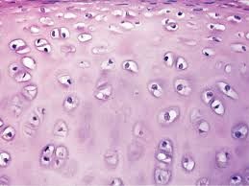
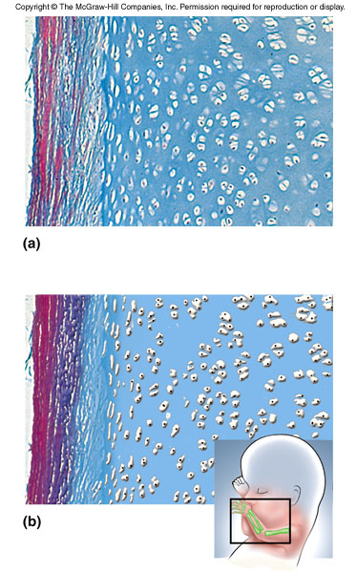
Histology
Hyaline cartilage:
Smooth, glassy appearance; individual fibers usually can’t be seen; often surrounded by fibrous PERICHONDRIUM

Slide 35
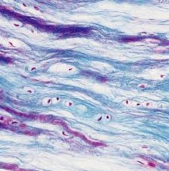
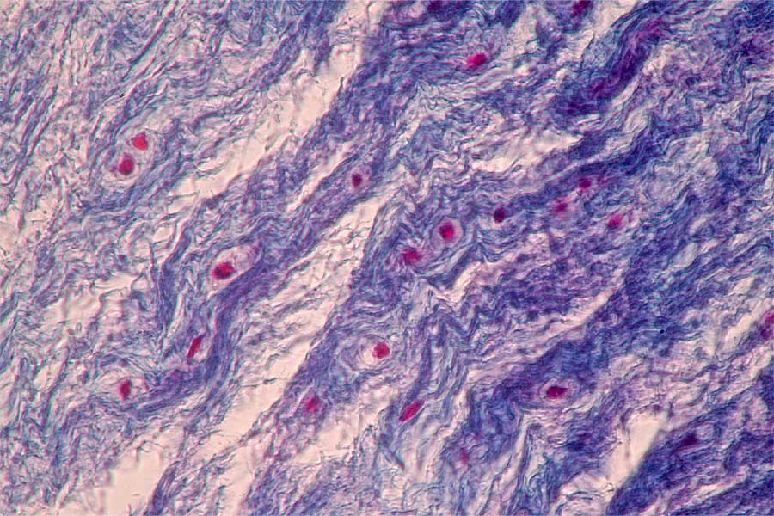
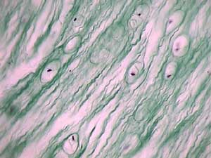
FIBROCARTILAGE
Visible collagen fibers (thin and fibrous)

Slide 36
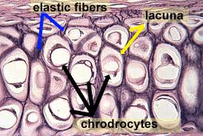
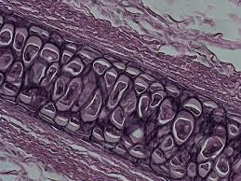
Elastic Cartilage
DARK, heavy fibers seen in between lacunae

Slide 37
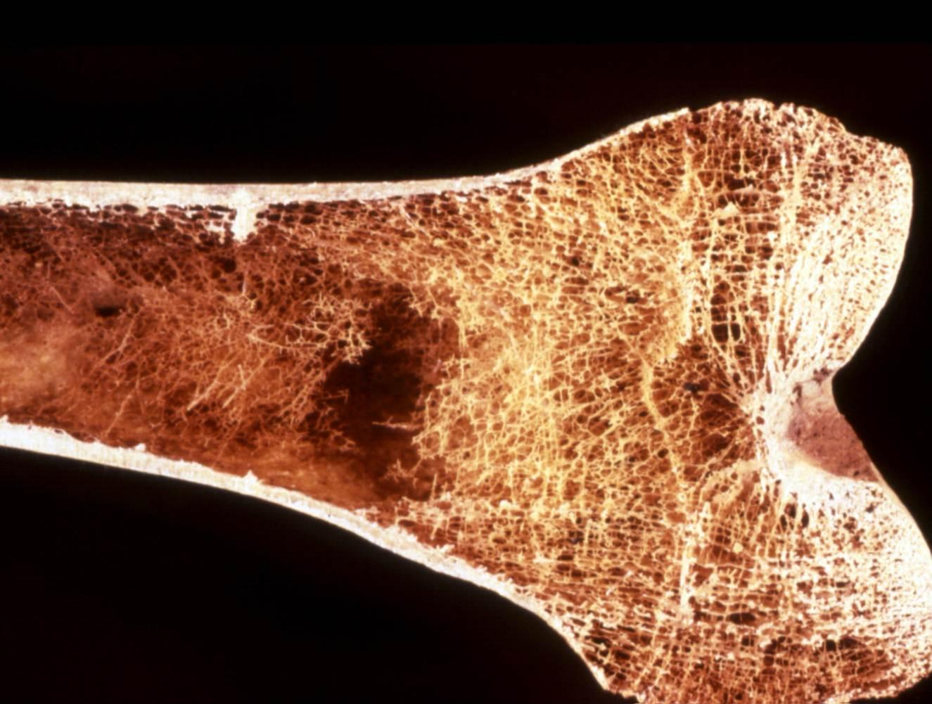
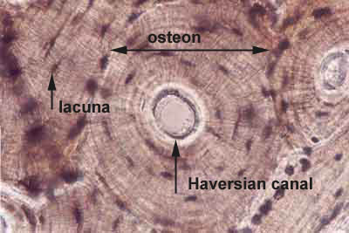
Bone
Technically, the word “bone” describes bone as an organ………. and not bone tissue
OSSEOUS TISSUE is the connective tissue commonly known as bone
All bones are covered by fibrous tissue known as PERIOSTEUM (similar to perichondrium) that serves as an anchor point for attachment of tendons and ligaments
Two types of osseous tissue (bone):
Spongy bone (cancellous) – osseous tissue found in the heads of long bones, vertebral bodies, etc…
Compact bone – dense osseous tissue that surrounds spongy bone
We’ll learn much more about bone anatomy and physiology shortly!!

Slide 38
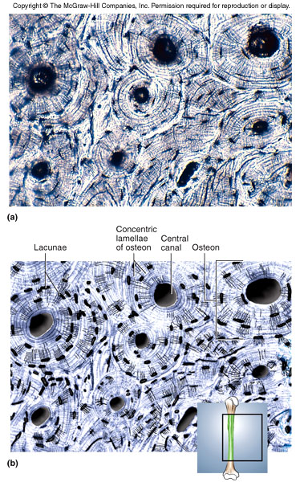
Compact Bone
Bone cells called OSTEOCYTES live in lacunae, like in cartilage
Blood vessels and nerves run the length of the bone in canals called HAVERSIAN CANALS (sometimes called Central Canal)
Osteocytes live in lacunae in concentric circles around the central canals (that’s where the blood supply and food is!)
One OSTEON consists of a Central canal and rings of osteocytes that are laying down bone matrix

Slide 39
Blood
Fluid connective tissue that plays an important role in transportation of many substances and also very important in immune protection via LEUKOCYTES (i.e., white blood cells)
Non-cellular ground substance is known as PLASMA
Cells and cell fragments are referred to as FORMED ELEMENTS of blood:
Erythrocytes (red blood cells)
The only cells in the body without a nucleus
Responsible for carrying O₂ and CO₂ between lungs and body tissues
Leukocytes (white blood cells)
5 different types of cells all with specific functions that contribute to immune protection
Platelets
Cell fragments that are important in the process of blood clotting and directing new blood vessel growth

Slide 40
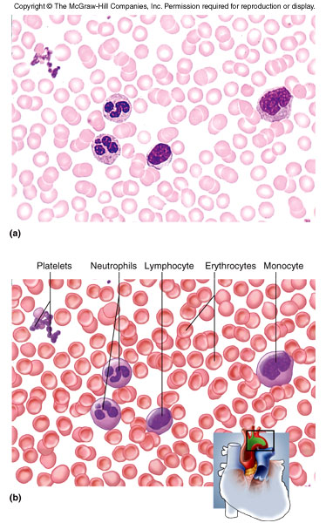
Blood
Consists of plasma, erythrocytes (RBCs) and leukocytes (WBCs)
Erythrocytes are round, with a faint center, and NO NUCLEUS
Leukocytes are larger and have a large, obvious nucleus
Different types of leukocytes can be identified by the shape and size of its nucleus (later on in Bio 212)

Slide 41
Nervous tissue
Specialized, “excitable” tissue found in central nervous system and peripheral nervous system
Tissues receive and transmit electrical signals (called an ACTION POTENTIAL) from one part of the body to another
Action potentials are generated when ions flow back and forth across the cell membrane
Central nervous system = brain and spinal cord
Peripheral nervous system = all the other nerves in our body
Cells are excitable, meaning they receive and respond to stimuli very rapidly and can transmit signals as well
Cells of nervous tissue :
NEURONS (nerve cells) – cells that transport signals
GLIAL CELLS – support cells in the nervous system that nourish and protect the neurons

Slide 42
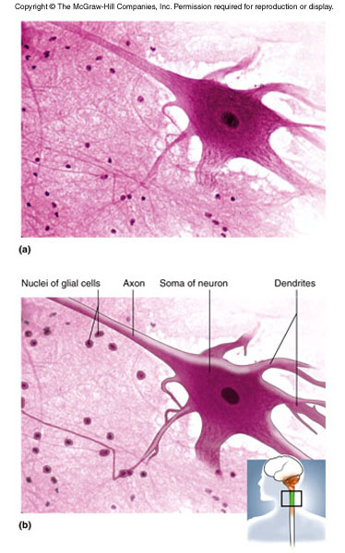
Neuron anatomy:
SOMA = cell body, often round or oval shaped. The soma contains the nucleus and other organelles.
DENDRITES = short processes that receive signals coming from other neurons
AXON = large nerve fiber that sends signals to other neurons or eventually to final organ or tissue

Slide 43
Muscle Tissue
Specialized tissue with cells which are designed to contract when stimulated
Muscle contraction exerts force on other tissues and organs
Required for movement of bones, movement of food through digestive system, breathing, movement of the eyeballs, constriction of blood vessels etc…
3 types of muscle tissue
Skeletal muscle – long cylindrical cells are called MUSCLE FIBERS
Overlapping ACTIN and MYOSIN protein fibers cause STRIATIONS (alternating light and dark bands)
Voluntary muscle tissue- typically under conscious control
Long, cylindrical and usually multinucleated
Cardiac muscle – shorter, often branched cells are called CARDIOMYOCYTES
Also striated
Contain one centrally located nucleus often surrounded by a clear “halo”
INTERCALATED DISKS are found at the ends of each cell
These are connections that allow signals to travel from one myocyte to another allowing all the cells of the heart to beat at nearly the same time
Cardiac muscle is INVOLUNTARY, meaning we can’t consciously control contraction

Slide 44
Smooth muscle – long cells that are tapered at the ends (thinner at the ends than in the middle)
Smooth muscle cells ARE NOT STRIATED
One nucleus per cell
Smooth muscle is involuntary
Body uses smooth muscle to control many important physiological functions
Dilation and constriction of the pupil in the eye
Contraction of GI tract (esophagus, stomach, intestines)
Dilation and constriction of blood vessels

Slide 45
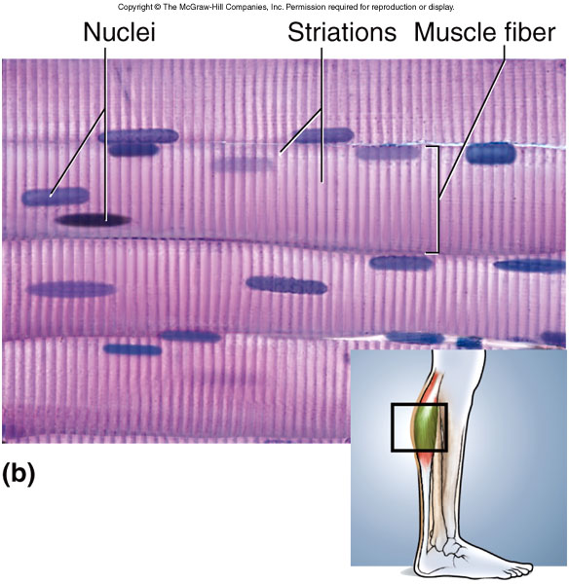
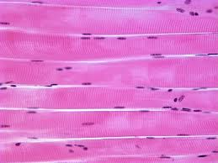
Skeletal muscle:
Muscle fibers are long and cylindrical
Muscle fibers run parallel to each other
Striations look like alternating light and dark lines
More than one nucleus can be seen in each muscle fiber and are typically located near the plasma membrane

Slide 46
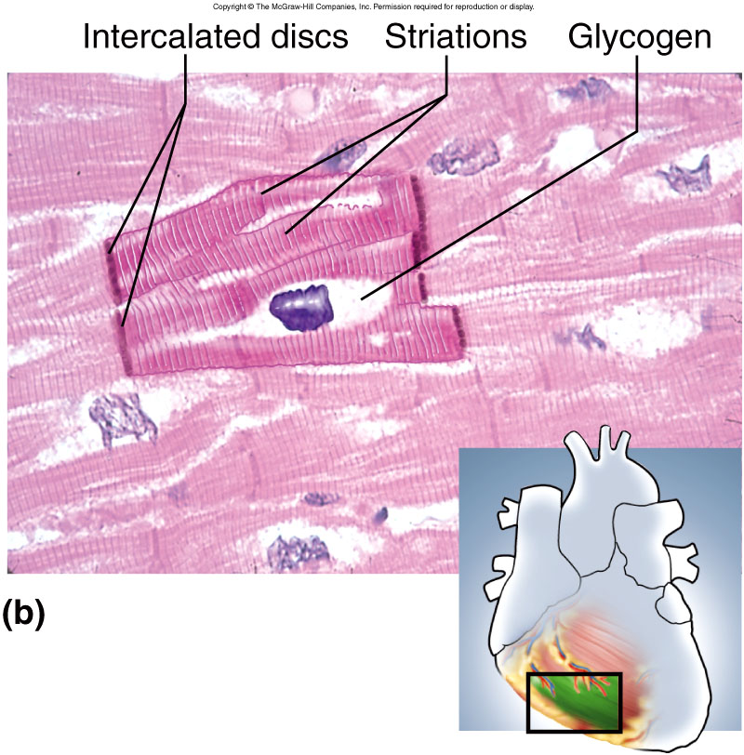
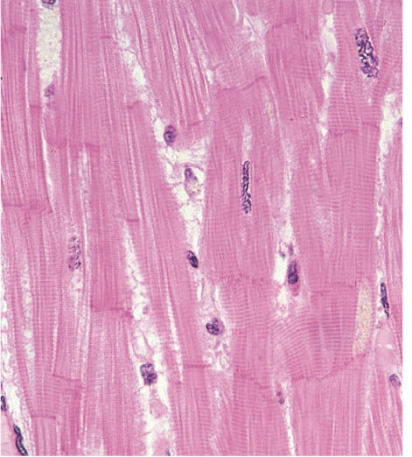
Cardiac muscle:
Cardiomyocytes are shorter than muscle fibers and are often branched
Visible striations
Intercalated disks appear as thick dark bands on each end of the cell
Single nucleus is centrally located

Slide 47
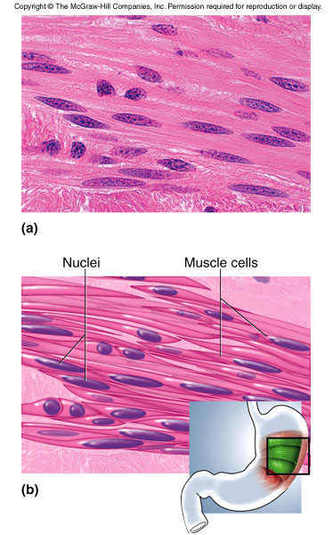
Smooth muscle:
Smooth muscle cells overlap each other and are short and tapered
Single nucleus that is located in the center of the cell
NO STRIATIONS!!

Slide 48
Tips for identifying different types of muscle:
First, look for striations
YES – it is either skeletal or cardiac
NO – it must be smooth
Look at the nuclei and shape of the cell
Skeletal muscle fiber has more than one nucleus and cells looks like a long cylinder
Cardiac myocytes are shorter and are often branched and only contain one nucleus surrounded by clear open space

Slide 49
Cell Junctions
With the exception of blood cells, all the cells in our bodies need to be in contact with other cells or tissues to function normally
allows nearby cells to communicate and perform coordinated functions
allows many cells to come together and form a tissue
3 Types of cell junctions
Tight junctions:
Plasma membrane proteins form grooves and ridges that help adjacent cells attach to one another like a zipper; like a Zip-loc bag
Tight junction completely circles the cell so there are no gaps between adjacent cells
Ensures that most things can’t pass between the cells of an epithelial tissue
Prevents pathogens from entering through skin, keeps fluids in proper location

Slide 50
Desmosomes:
Proteins on the surface of adjacent cells form a “patch” with intermediate filaments running through them
The desmosomes from 2 cells fit together like a button or snap
This provides a firm attachment between cells, but allows solutes to pass between cells (PARACELLULAR ROUTE)
Hemidesmosomes (half desmosome) attach epithelial cells to the basement membrane
Gap junctions:
Proteins form a pore called a CONNEXON that joins up with the connexon of an adjacent cell
Allows ions, nutrients, and cell signaling molecules to pass freely between cells

Slide 51
Glands
Glands are organs or cells that produce a substance that is to be used by another nearby tissue, a tissue in another part of the body, or eliminated from the body (waste)
Examples:
Salivary glands, sweat glands, prostate, pituitary gland, etc…
2 Categories of glands:
Endocrine glands – glands that produce substances that will be used by other cells or tissues WITHIN the body
Typically glands that produce hormones that enter the bloodstream (i.e., endocrine system)
Exocrine glands – produce substances that will leave the body or be deposited into the cavity of another organ (i.e., digestive or reproductive tracts)
Sweat glands, salivary glands, liver, pancreas, prostate, etc….

Slide 52
Glands can also be classified by the type of secretions……..
Serous – thin watery fluids (sweat, saliva)
Mucous – thick, stringy fluid (saliva, lung mucus)
Mixed – produce both serous and mucous secretions (some salivary glands)
Cytogenic – actually secrete whole cells!
Ovary and testes produce and secrete eggs and sperm
Or classified by their mode of secretion:
Merocrine – cells of the gland produce a substance and then release it into the duct via exocytosis
Holocrine – cells of the gland produce a substance and then rupture, thereby releasing the substance into the ducts

Slide 53
Membranes
Membranes describe the portion of an organ or tissue that is exposed to the lumen or external surface of that organ (3 types we’ll cover)
Composed of epithelial cell layer, basement membrane, and connective tissue
Skin is sort of a unique “dry” membrane
Mucous membranes secrete mucus and line organs exposed to the external environment (lungs, digestive system, reproductive system)
Serous membranes produce serous fluid, a thin and slippery lubricating fluid
Pleural, pericardial, and peritoneal membranes are serous membranes
Synovial membranes secrete synovial fluid of joints

Slide 54
Bio 211- Anatomy and Physiology I
Today’s topics
Integumentary system I

Slide 55
Integumentary system
The integumentary system is the organ commonly referred to as “skin” or INTEGUMENT
The integumentary system is composed of the skin itself PLUS all of the accessory organs associated with it:
Hair, nails, glands, etc….
Largest organ of the body and makes up about 15% of our body weight

Slide 56
Skin is very important both medically and socially/psychologically
The average person probably spends more time taking care of their skin than any other organ of the body
People in the USA spend BILLIONS of dollars per year on skin care products and cosmetics
Many of which don’t actually help the HEALTH of our skin
Whether we like it or not (or care to admit it) people often make judgments about a person based on their skin!
Skin conditions can also affect people’s own self image and sociability
Acne, dandruff, eczema, psoriasis, etc….

Slide 57
Skin is very important both medically and socially/psychologically
Many systemic disorders have symptoms that are seen in the skin
You can learn a lot about a person’s health and well-being just by looking at their skin
(important for those of you going into the healthcare field)
Pale skin – may be anemic
Excessive or lack of hair – may be a hormonal disorder
Ulcers on foot – may be a complication of diabetes
Thickening or thinning of the skin – may be a connective tissue disorder
Edema (Swelling) – may be an indication of heart disease or vascular damage
Overall skin tone:
Jaundice – a yellowing of the skin due to the buildup of bilirubin (indicates a poorly functioning liver)

Slide 58
Zander later on
He’s OK now!!
Zander at about two weeks old
Jaundice is pretty common in babies since their livers may not be able to efficiently remove bilirubin from the bloodstream

Slide 59
Skin Functions
Skin has many functions including protection, vitamin synthesis, thermoregulation, sensation, and social functions
Protection – Keratinized epithelial cells make the skin resistant to many injuries and acts as a great protection barrier
Skin acts as a barrier to keep water, chemicals and foreign invaders out
Keratin in skin cells makes them waterproof
Many dangerous chemicals can’t penetrate skin
Tight junctions of skin epithelial cells prevent bacteria and viruses from entering (skin surface is also slightly acidic)
Physical injuries are easily repaired since keratinized skin is very resistant to abrasion and trauma.

Slide 60
Skin Functions, cont…
Synthesis – When exposed to sunlight, the skin plays a role in the synthesis of Vitamin D
Sensation – Skin is the most extensive and important sensory organ
Sensory organs in skin tell us when something is too hot, too cold, too sharp, etc…
Serves both a protective function and information processing
Distribution of sensory structures will vary in different parts of the body
Thermoregulation – Thermoreceptors in skin provide information on temperature and play a role in the feedback loops that cause shivering, sweating, vasoconstriction, and vasodilation
Social functions – facial expressions and blushing give non-verbal communication cues

Slide 61
Structure of the skin
Skin consists of two distinct layers: EPIDERMIS and the DERMIS
EPIDERMIS – the upper layer of skin that is composed of a layer of stratified, squamous, keratinized epithelial cells, stem cells, and sensory cells
This epithelial layer of the skin lacks blood vessels and contains cells packed with tough keratin
There are 5 cell types found in the epidermis:
Keratinocytes: responsible for synthesizing keratin and make up the bulk of the cells in the epidermis
Stem cells: undifferentiated cells that actively divide and give rise to cell that become keratinocytes
Melanocytes: pigment cells found near the base of the epidermis. Melanocytes produce the pigment MELANIN that gives everyone’s skin a different shade of color
Merkel cells: specialized sensory cells located near the base of the epidermis. These cells are responsible for the sense of touch
Dendritic cells: specialized immune cells that monitor the skin for invasion by bacteria and viruses and help coordinate the immune defense. Sort of like security guards for the skin!

Slide 62
Layers of the epidermis
Histologists have divided the epidermis into 5 separate layers that overlap to a certain degree
Stratum corneum – layers of dead, keratinized skin cells
Stratum lucidum – thin layer of cells found only in thick skin. Filled with a precursor to keratin
Stratum granulosum – layer of cells that contain granules of a waterproofing substance and other material used to make keratin. Cells in this layer undergo APOPTOSIS (cell suicide)
Stratum spinosum – the thickest layer of the epidermis. Desmosomes that hold the cells together can be seen and make the cells look “spiny”
Stratum basale – lowest layer of cells attached to the basement membrane. Most cells are stem cells that divide and produce daughter cells that grow into keratinocytes. Melanocytes and Merkel cells are also found here

Slide 63
Thin Skin – Similar to what WE will see in lab

Slide 64
Skin Life Cycle
OLDEST
Skin cells in stratum basale are cuboid or columnar in shape and become more flattened (squamous) as they move up towards the surface
As cells of stratum basale divide, cells above are pushed closer to the surface
Only the first 3-5 layers of cells divide (no blood supply in upper layers of epidermis)
EXFOLIATION is when dead keratinized cells are shed or scraped off (DANDER)
Dandruff is a clumped mixture of dead keratinocytes and SEBUM (oil)
YOUNGEST

Slide 65
Dermis
The dermis is a layer of connective tissue directly beneath the epidermis that contains various types of connective tissue, blood vessels, nerves, sweat glands, and hair follicles
The dermis is subdivided into 2 regions: PAPILLARY LAYER and RETICULAR LAYER
Papillary layer is a layer of AREOLAR connective tissue directly below the epidermis
The loose arrangement of thin collagen fibers allows leukocytes and other immune cells to occupy the area and prevent invasion
This layer contains many small blood vessels (CAPILLARIES)
Fingerlike projections of the papillary layer into the epidermis are called DERMAL PAPILLAE and give skin ridges and grooves
Fingerprints and tiny wrinkles and grooves on your hands
Reticular layer is thicker (about 80% of the dermis) and deep to the papillary layer
Contains a great deal of DENSE IRREGULAR connective tissue and small pockets of ADIPOSE tissue
Since the dermis contains the only blood supply to the skin, its health and function is critical to the survival of the epidermis!!

Slide 66
MEISSNER’S CORPUSCLE (Tactile Corpuscle) – sensory receptor in dermis that is responsible for detecting light or delicate touch, located closer to the surface of the skin
PACINIAN CORPUSCLE – sensory receptors that detect deep pressure, located deeper in the dermis

Slide 67
Hypodermis
The HYPODERMIS (sometimes called SUBCUTANEOUS TISSUE) is located directly beneath the dermis, but is not technically part of the skin
No distinct border between the dermis and hypodermis, although it is identifiable since it contains a great deal of adipose tissue
Hypodermis binds the skin to the underlying muscle and tissue and provides some physical protection (think of areas on your body where there is “extra padding”!!)
HYPODERMIC needles are used to administer shots (the hypodermis is very vascular)

Slide 68
Bio 211- Anatomy and Physiology I
Today’s topics
Integumentary system II

Slide 69
Accessory organs of the integumentary system
Accessory organs of the integumentary system include: hair, nails, and a variety of glands
HAIR
Thin strands of DEAD keratinized cell that grow from HAIR FOLLICLES located in the dermis
Hair is located on most surface of the skin, with a few exceptions (fingertips, palms, toes, lips, etc…)
The density of hair follicles varies greatly from one area to another
More follicles on scalp and face, fewer on arms and legs
Differences in individual appearance (i.e., hairiness) is due to thickness, texture, growth rate, and color of hair!!
As we grow older, our hair changes
Color, texture, etc…
Largely due to changes in hormone levels

Slide 70
Hair Anatomy
Divided into 3 zones along its length:
Bulb – swelling at the base of the hair follicle where hair originates (LIVING, DIVIDING hair cells live here)
Root – the portion of the hair strand that is anchored WITHIN the hair follicle (DEAD CELLS)
Shaft – portion of the strand that is above the skin’s surface (DEAD CELLS)

Slide 71
Hair anatomy cont….
Hair follicle is attached to ARRECTOR PILI muscle that draws the root into a vertical position
HAIR RECEPTORS are specialized nerve fibers that detect movement of hair shaft
APOCRINE SWEAT GLANDS and SEBACEOUS GLANDS are not really part of the hair structure, but their ducts travel with the hair follicle
Hair life cycle
A hair strand goes cycles through 3 phases : ANAGEN, CATAGEN, and TELOGEN in which the hair transitions from rapid growth, to slow growth, to eventually falling out
ALOPECIA = loss or thinning of hair
Can be due to age, disease, nutrition, or genetics (male pattern baldness)
Chemotherapeutic drugs cause alopecia since these drugs are designed to kill rapidly dividing cells

Slide 72
Cutaneous Glands
5 types : merocrine sweat glands, apocrine sweat glands, sebaceous glands, ceruminous glands, and mammary glands (talk about later)
Merocrine sweat glands:
“Regular” sweat glands that are found over the surface of most of the body
Secretion is mostly water and serves to cool the body
Simple, tubular gland with MYOEPITHELIAL cells that contract/ squeeze sweat to skin surface
Sweat is also slightly acidic (~pH 4-6) which helps inhibit bacteria growth
Most people lose over half a liter of sweat per day, even without exercise!
Apocrine sweat glands:
Located in the axillary (armpit), groin, and anal region
Gland secretions flow into hair follicle, not directly onto the skin
Glands develop after puberty and are thought to produce scent molecules called PHEROMONES
The metabolism of this type of sweat gland secretion by bacteria yields unpleasant “body odor”

Slide 73
Sebaceous glands:
Produce an oily secretion called SEBUM (mix of oil and cell fragments)
Glands are flask shaped and open into hair follicle
Sebum is a natural moisturizer meant to prevent skin from drying out
Yet we spend huge amounts of money on cleansers designed to remove it and then even more on creams to replace it!!! (i.e., lanolin)
Ceruminous glands:
Ducts open directly to skin surface
Only found in outer ear canal
Secretion called CERUMEN mixes with sebum and dead epithelial cells to make earwax
Cerumen keeps eardrum pliable, waterprooofs the ear canal, and inhibits bacteria growth
Merocrine gland
Apocrine gland
Sebaceous gland

Slide 74
Cutaneous gland histology
Sebaceous and apocrine glands open into the hair follicle
Sebaceous glands are large and flask-shaped
Apocrine glands are simple coiled glands
Merocrine glands open directly onto the skin
Merocrine glands are simple coiled
When a coiled tubular structure is sectioned for histology, you will see a cluster of hollow circles and ovals where the gland was cut

Slide 77
Thin Skin – Similar to what WE will see in lab

Slide 82
Skin disorders-Burns
In addition to exposure to extreme heat, fire, and boiling water; burns can also be caused by strong acids and bases, ionizing radiation, and electricity
Burns are classified (1st degree, 2nd degree, 3rd degree) by how deep the burn damages the tissue
3rd degree burn:
Damage extends through dermis and often involves damage to hypodermis. Typically requires skin grafts since entire integument in that area is destroyed
2nd degree burn:
Damage extends all the way through the epidermis and enters the dermis (blistering sunburns, touching a hot stove, etc…)
1st degree burn:
Damaged tissue is limited to the epidermis
(common sunburns, water scalding, etc…)
Extensive 3rd degree burns are often fatal if not treated immediately due to loss of body fluids and infection at burn site

Slide 83
Skin Cancer
There are three main forms of skin cancer :
1. Malignant Melanoma – cancer of the melanocytes in the stratum basale
2. Non-melanoma skin cancer –
Basal cell carcinoma: cancer of cuboidal cells of the stratum basale
Squamous cell carcinoma: cancer of the keratinocytes of the stratum spinosum
Basal cell carcinoma:
Most common form of skin cancer
Extremely high survival rate since basal cell carcinoma rarely METASTACIZES (spreads to other non-skin organs)
Like all skin cancers, fair skin, prior bad sunburns, and repeated sun exposure increase the risk of basal cell carcinoma
Treatment typically involves surgical removal of the cancerous tissue and/or radiation therapy in advanced cases
Like burns, cancers are graded on the depth of the damage (tumor), with deeper tumors being more serious
Often appears as a rounded, raised bump on sun-exposed skin

Slide 84
Squamous cell cariconoma:
Arises from squamous cells in the stratum spinosum
Often appears on sun-exposed skin as a red, scaly ulcer
Although the cosmetic damage can be extensive, this type of cancer is very curable through surgery if caught early, radiation therapy for more advanced cases
Can be lethal if left unchecked due to metastasis
Stats
Each year approximately 3,000,000 new cases of basal cell and squamous cell carcinoma in the U.S.
Of that number approximately 8,800 are lethal
Basal cell and squamous cell carcinomas that appear on skin where “the sun don’t shine” are usually much more dangerous since these cancers often involve genetic damage that did not involve sun exposure and often are very aggressive and metastasize quickly

Slide 85
Malignant Melanoma: arises from melanocytes in the stratum basale
Least common, but definitely the most lethal all skin cancers
It spreads quickly and is often fatal if not treated immediately
Approximately 87,000 new cases each year
Of those, about 9,700 will be lethal (~11% lethality)
Melanoma typically originates in moles (NEVI), which are simply clusters of melanocytes
Melanoma is more common in men than women, and is often linked to fair skin and a history of bad sunburns
Treatment options are pretty limited:
VERY curable through radical surgery if the melanoma is caught early
Typically incurable if the melanoma has spread since these type of cancer cells do not respond well to chemotherapy and radiation therapy
Prognosis is related to location of melanoma:
Locations close to lymph nodes have poor prognosis (back, head, neck, groin, etc…) since metastasis is more common than in places like the hand or foot

Slide 86
Some of the (potentially) most important things you’ll learn in this class
Although very dangerous, malignant melanoma is EXTREMELY curable if it is caught early!!!
In a wide excision surgery the epidermis, dermis, and hypodermis are removed in a 2 cm radius around the melanoma. The dermis and hypodermis are then removed from an additional 2-3 cm and then sewn up.
ABCDs of melanoma detection

Slide 87
Bio 211- Anatomy and Physiology I
Today’s topics
Integumentary system
Damage and repair

Slide 88
Repairing damage to the integument
Since the skin plays such an important protective role in our bodies, any damage to it must be quickly repaired
Protection from bacteria, viruses, dirt, some chemicals
Keratinized epithelia prevents water loss
Type of wound healing depends on extent of damage
Regeneration – involves replacement of damaged cells with the SAME type of cells
Typically seen in VERY superficial scrapes and cuts
Damaged cells (i.e., keratinocytes) are replaced through proliferation of pre-existing cells
Fibrosis/Repair – involves formation of a clot, scab, and eventually replacing damaged tissue with scar tissue
Typical in most deep cuts and scrapes
Need to repair not only epidermis, but also connective tissue, blood vessels of dermis!

Slide 89
Repairing damage to the integument
Immediately after a deep cut, blood from severed vessels enters into the wound
Blood vessels become “leaky” allowing leukocytes, antibodies, clotting factors and proteins to enter the wound
Blood protein called FIBRIN polymerizes and forms meshwork that creates a clot
A scab is just the dried part of the blood clot on the surface of the skin
The formation of a blood clot is very important since it:
Helps stop bleeding
Protects the open wound from bacteria, dirt

Slide 90
Repairing damage to the integument
Before the epidermis can be fixed, the damage to the dermis must be repaired
Blood vessels grow and repair connections
Macrophages enter and remove damaged tissue and blood clot
Fibroblasts synthesize new collagen to repair connective tissue in dermis
New collagen is laid down by fibroblasts quickly and is more dense and less flexible than original tissue (SCAR TISSUE)
Once repair to the dermis is started, epithelial cells proliferate and help repair the epidermis
This phase is called REMODELING and can take many weeks

