Slide 1
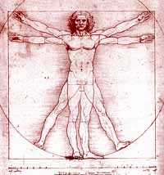
Bio 211- Anatomy and Physiology I
Today’s topics
Sense organs

Slide 2
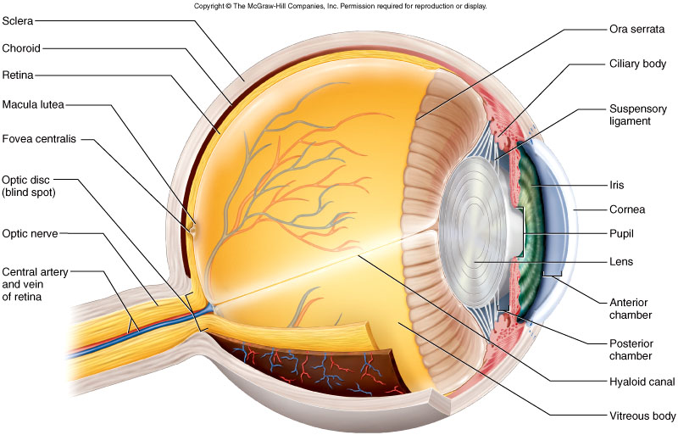
Anatomy of the eye
3 layers of tissue make up the eye
Fibrous layer – Sclera (white of the eye) and cornea (clear portion) where light passes through
Vascular layer –
Choroid – pigmented, very vascular layer
Ciliary body – thickened portion of the choroid that supports the lens and iris as well as produces fluid known as aqueous humor
Iris – pigmented tissue that controls amount of light entering eye. Smooth muscle attached to iris controls diameter of opening
Ora serrata – scalloped edge where the the retina fuses with the ciliary body
3. Inner layer – retina (neural portion of the eye) and part of the optic nerve

Slide 3
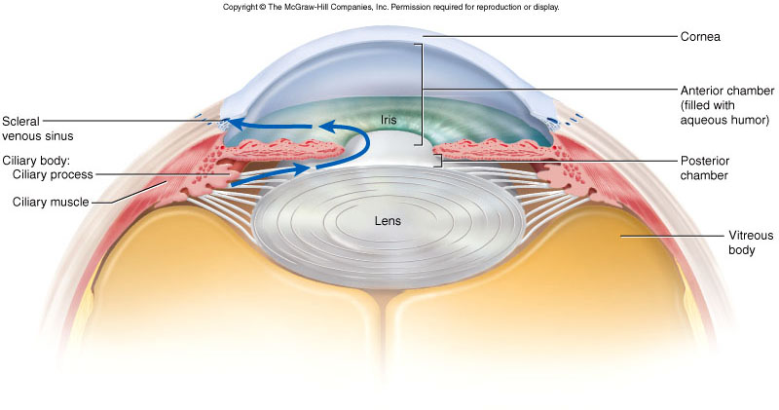
Eye anatomy
Optical components – parts of the eye that transmit, refract, and focus light as it passes through the eye
Cornea – clear portion of the sclera (most anterior), mostly tightly packed collagen and nearly clear squamous epithelial cells
Aqueous humor – fluid in the anterior and posterior chambers, secreted by ciliary body and reabsorbed into blood stream by scleral venous sinus (canal of Schlemm)
Structural defects can lead to GLAUCOMA
Lens – composed of crystalline proteins and epithelial cells, helps focus light onto the retina
Suspended by suspensory ligaments attached to ciliary body, allows for changes in shape of lens
Age, diabetes, UV damage, smoking can cause lens to become cloudy leading to CATARACTS
Vitreous body – large body behind the lens that is filled with a transparent jelly
Lens and cornea are not particularly cellular (mostly protein fibers) and can be transplanted much more easily than most other tissues or organs of the body

Slide 5
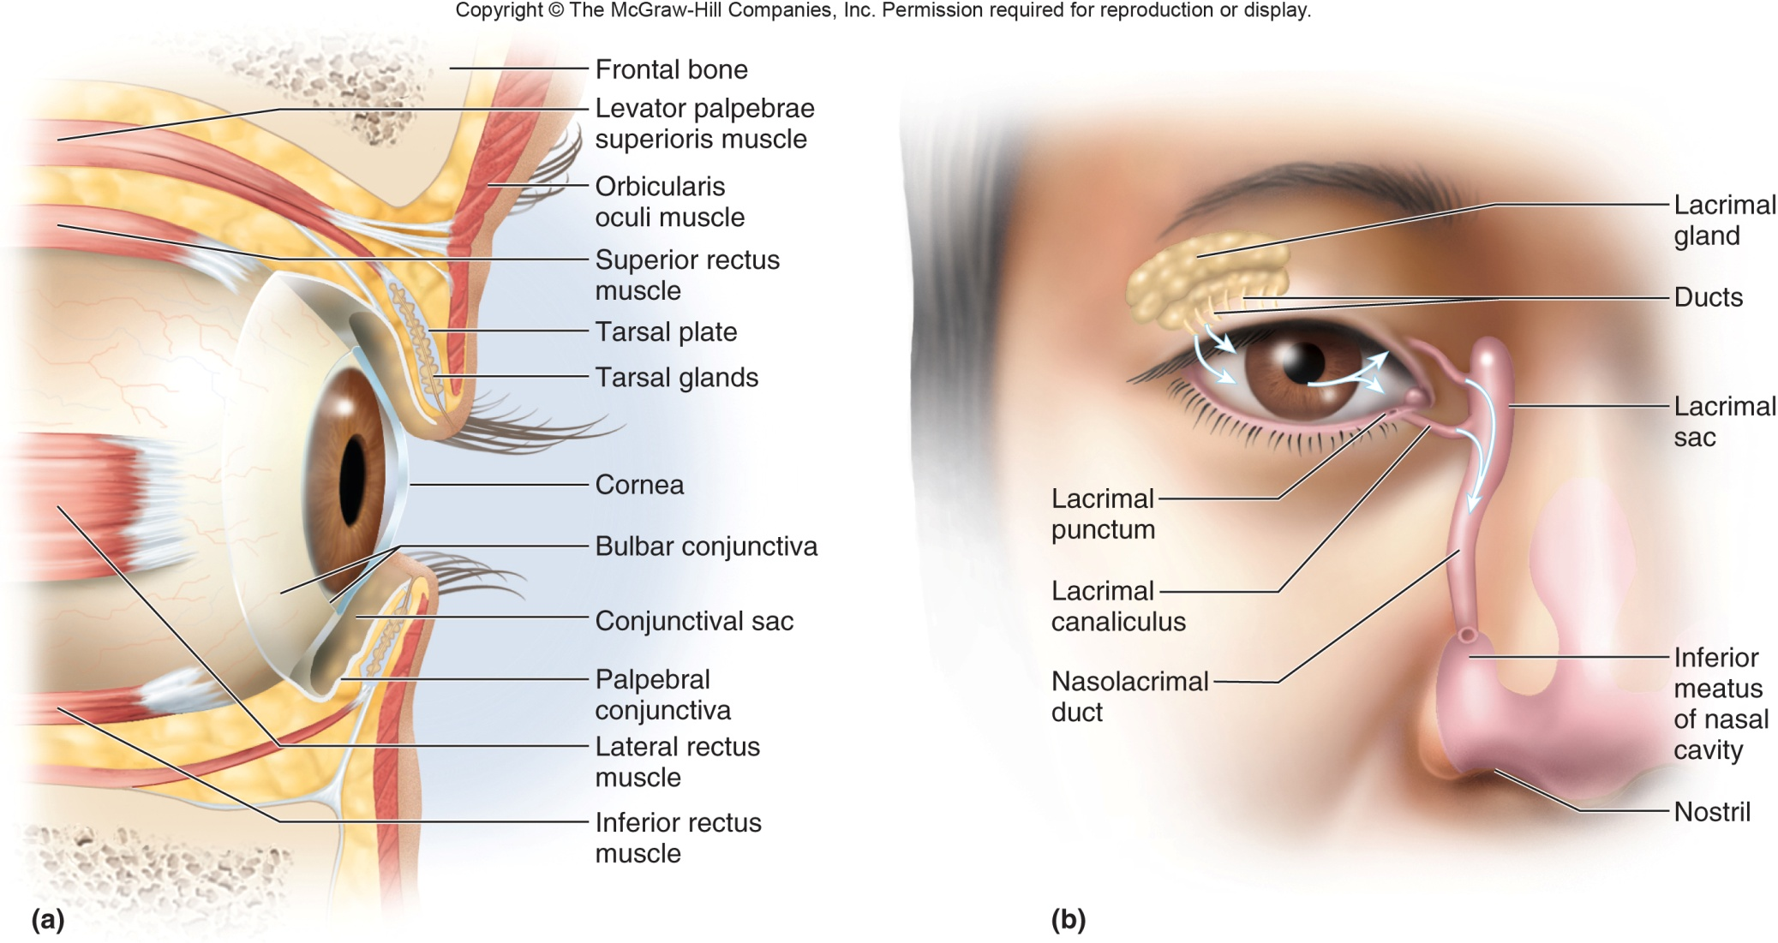
Accessory Eye Structures

Slide 6
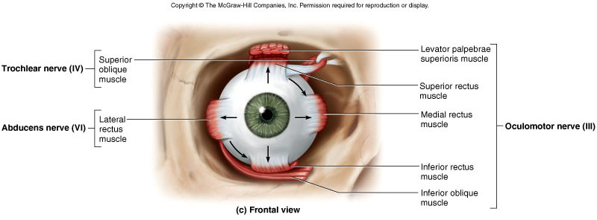
Extrinsic muscles of the eye
Series of 6 muscles attach the sclera of the eye to the orbit wall
Allow movement of the eye within the orbit
4 RECTUS muscles (superior, inferior, lateral medial) move eyeball in straight lines up, down, left and right
2 OBLIQUE (superior and inferior oblique) muscles produce more complex movements as well as slight rotation of the eyeball
Allows us to look “out and up” (lateral/superior) or “down and in” (medial/inferior)
CN IV (trochlear nerve) = superior oblique (tendon passes through the TROCHLEA)
CN VI (abducens nerve) = lateral rectus… abducts the eye
CN III (oculomotor nerve) = the other 4
(LR₆SO₄)₃

Slide 7
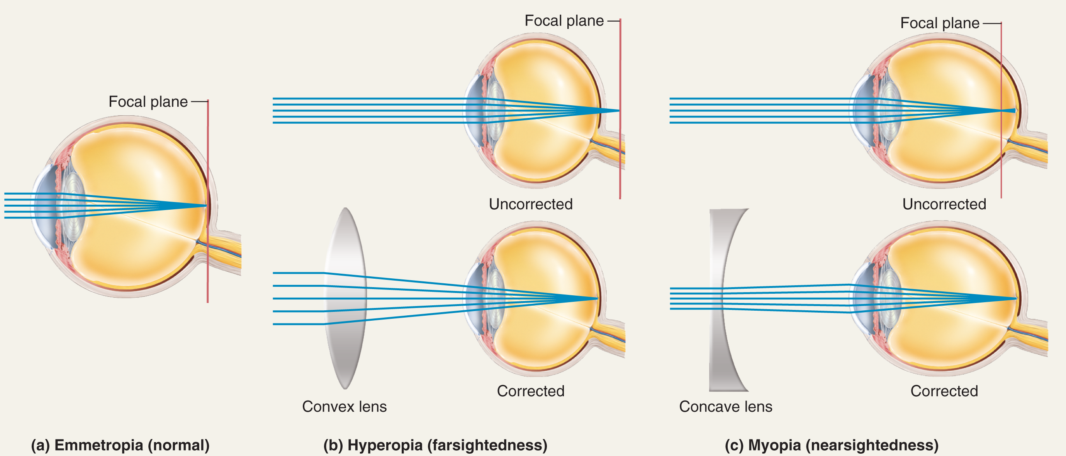
To see an image clearly, light reflected from that image must be focused directly on the retina
As light passes through the eye, it is refracted (bent) by the cornea, aqueous humor, lens, and vitreous humor and focused on the retina
Refraction by cornea, aqueous humor, etc is constant, but refraction CAN be changed by adjusting the shape of the lens (ACCOMODATION)
Loss of the ability to change the shape of the lens is called PRESBYOPIA (comes with old age)
Myopia – (nearsightedness)
Light is refracted too much by the cornea or the eyeball is too long causing light to focus IN FRONT of the retina
Hyperopia – (farsightedness)
Light is not refracted enough by the cornea or the eyeball is too short causing light to focus BEHIND the retina.

Slide 8
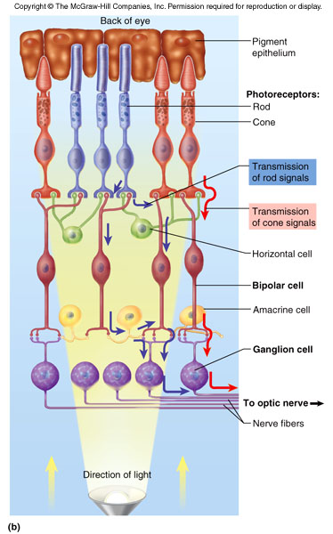
The physiology of vision
In order for us to “see” an image light stimulates neurons in the retina which transmits those signal through the optic nerve to the visual processing centers of the brain
Components of the retina
Pigmented epithelium – dark cells that absorb excess light not absorbed by photoreceptors. Prevents excess light from scattering throughout the eye
Photoreceptors – specialized cells that absorb light and generate a chemical/electrical signal
Rods – responsible for “night vision”. Allows you to see white, black, shades of gray. Rods are able to be stimulated by very low intensity light
Cones – responsible for “day vision” and color vision. Must be exposed by fairly bright light to be stimulated.
3 types – blue, green, and red cones are stimulated by light of different wavelengths. Signals from these cells to the brain allow us to “see” color
Bipolar cells – Receive signals from rods and cones and pass them on to the ganglion cells
Ganglion cells – Receive signals from the bipolar cells. Axons of the ganglion cells combine to form the optic nerve

Slide 9
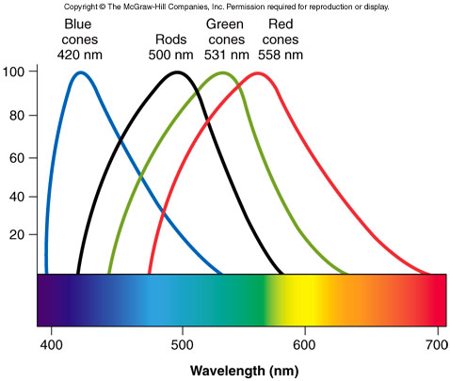
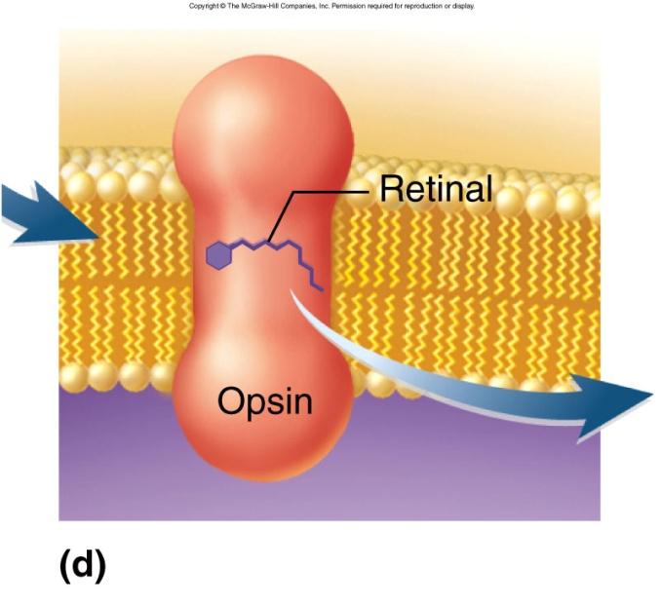
Rod cells and the 3 types of cone cells all absorb light at a particular wavelength
Pigment proteins within the cells determine what wavelength light will be absorbed
The pigment in rod cells is known as RHODOPSIN
The pigment in cone cells is known PHOTOPSIN – 3 types, one for each of the types of cone cells
Rhodopsin and photopsin are both composed of a molecule of cis-RETINAL (a form of Vit. A) and a protein called an OPSIN

Slide 10
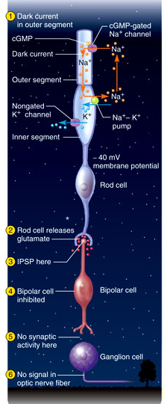
Generation of visual signals
In an unstimulated photoreceptor (like in a dark room) ligand gated Na+ channels remain open due to the presence of cGMP (the ligand)
Na+ constantly flows in and then is pumped back out by Na+/K+ ATPase
Think of a bucket with holes in it being filled with water-as long as you keep adding water, water will keep leaking out
As long as Na+ is flowing into/out of the cell the photoreceptor will release glutamate (an inhibitory neurotransmitter) that INHIBITS the bipolar cell
No visual signals are generated

Slide 11
Energy from a photon of light catalyzes the conversion of cis-retinal to trans-retinal
Trans-retinal dissociates from opsin
The opsin protein triggers degradation of cGMP
Interruption of that Na+ flow causes the photoreceptor to stop releasing glutamate

Slide 12
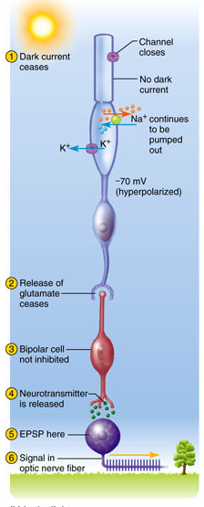
Generation of visual signals
When glutamate release is stopped, the bipolar cell is no longer inhibited and it sends a signal to the ganglion cell
The ganglion cell then transmits the signal to the appropriate areas of the brain
Axons of ganglion cells form the OPTIC NERVE (CN II)

Slide 13
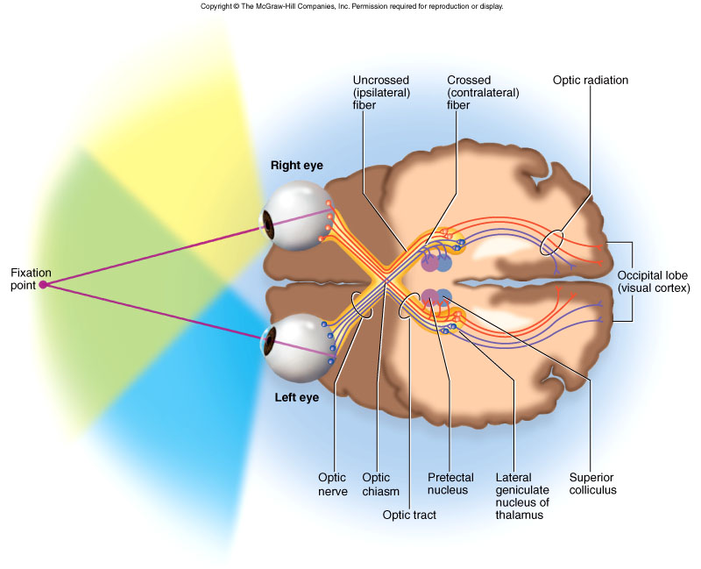
Visual Pathways
As the axons of the ganglion cells leave the retina and form the optic nerve (CN II), some of the nerve fibers cross and form the OPTIC CHIASMA
The medial ½ of the optic nerve decussates and travels to the opposite side of the brain (CONTRALATERAL)
Lateral ½ of the nerve fibers stay on the same side (IPSILATERAL)
After the fibers cross at the optic chiasma they are referred to as OPTIC TRACTS
The optic tracts travel to the thalamus where the fibers synapse with another neuron that then travels to the visual association areas in the occipital lobe of the cerebral cortex
NOTE that images in your LEFT field of view are reflected onto the lateral part of your right retina (nerve fibers will travel to right side of brain) and the medial part of your left retina (fibers cross at optic chiasm and go to right side of brain)
So…. Left field of vision is processed by right side of brain and vice versa

Slide 14
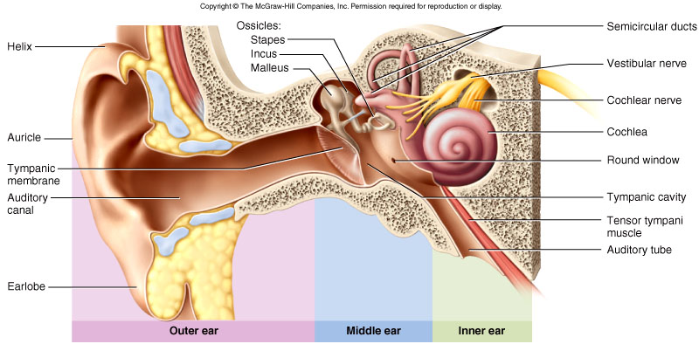
Hearing
In its simplest terms, sound can be referred to as the disruption or vibration of air molecules that is detected by the human auditory system
The ear is divided into 3 anatomical zones
Outer ear – pinna (for directing sound into the auditory canal), auditory canal
Middle ear – located WITHIN the temporal bone
Tympanic membrane (ear drum) – marks the beginning of the middle ear, vibrates freely in response to sound waves. Sensory innervation from vagus and trigeminal make tympanic membrane very sensitive to pain (don’t stick Q-tips in here!!)
Eustachian tube (auditory tube)- connects the middle ear with the back of the throat. Allows equalization of pressure on both sides of the tympanic membrane.
Auditory ossicles – 3 tiny bones that transmit vibrations from tympanic membrane to inner ear
Malleus, incus, stapes
Two VERY tiny muscles (stapedius and tensor tympani) in the middle ear attach to the stapes and limit its movement in response to very loud sounds

Slide 15
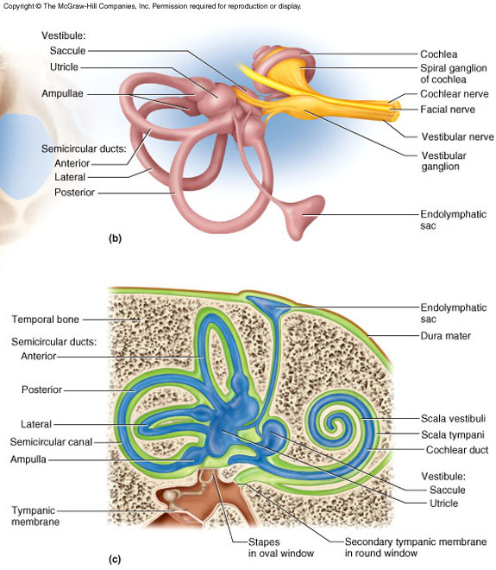
Inner ear
2 main components
Vestibule – organ responsible for sensing equilibrium
Cochlea – the organ of hearing
Inner ear is housed within a maze of bone located in temporal bone – BONY LABYRINTH
Bony labyrinth is lined by MEMBRANOUS LABYRINTH
PERILYMPH – cushioning fluid located between bony and membranous labyrinth
ENDOLYMPH – Fluid found within the membranous labyrinth

Slide 16
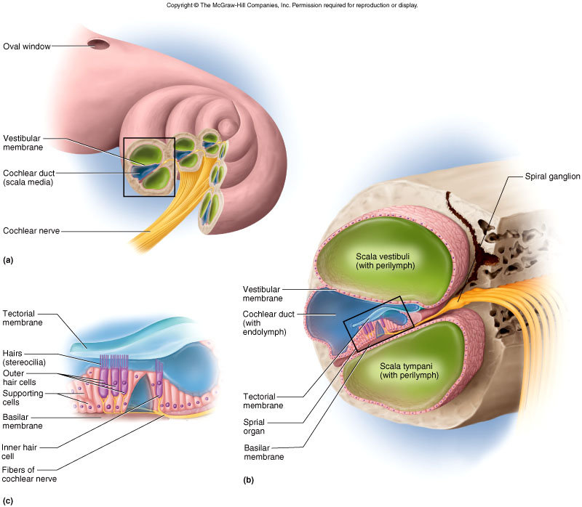
Cochlea
Cochlea is the spiral shaped organ of hearing
3 chambers: scala vestibuli (upper chamber), cochlear duct (middle chamber), scala tympani (lower chamber)
Spiral organ of corti rests on the basilar membrane
Spiral organ of corti is a collection of sensory cells (HAIR CELLS) covered by a gelatinous TECTORIAL MEMBRANE that translates mechanical vibrations into nerve impulses

Slide 17
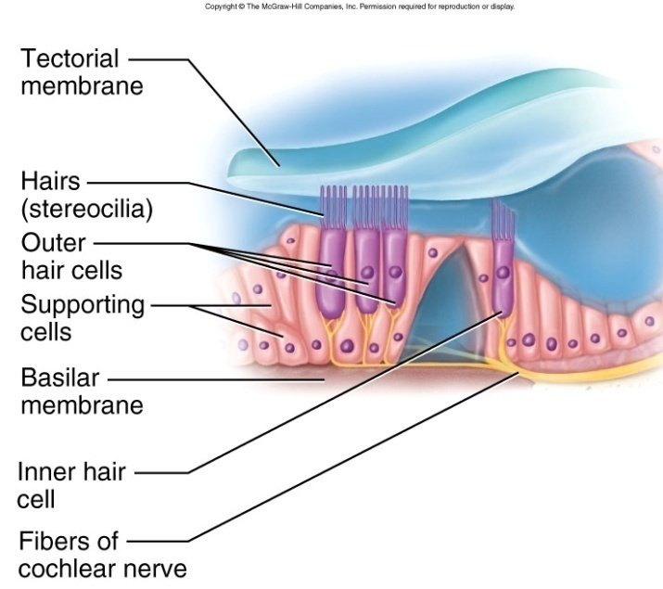
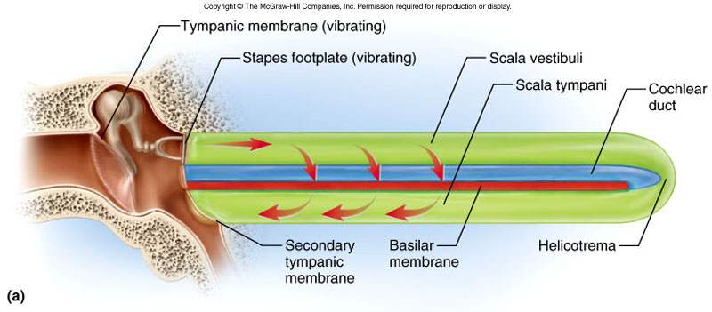
Mechanism of hearing
In order to hear a sound, mechanical vibrations are transmitted from the air, to the fluids of the inner ear, and ultimately result in the movement of hair cells that trigger a nerve impulse
Air movement causes vibration of the tympanic membrane which causes the ossicles of the middle ear to move
The stapes vibrates and causes a wave in the perilymph of the scala vestibuli→this creates a wave in the periplymph of the cochlear duct
The wave of perilymph in the cochlear duct causes the hair cells of the spiral organ of corti to bounce up against the tectorial membrane above it
Bending of the hair cells triggers a nerve impulse that travels through the COCHLEAR NERVE (1/2 of the vestibulocochlear nerve –CNVIII)

Slide 18
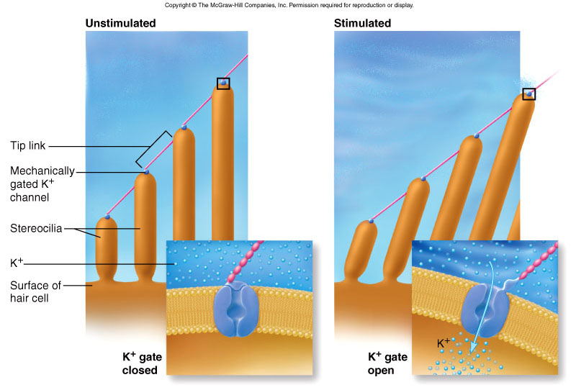
Generation of action potentials
As waves are created in the endolymph and perilymph, hair cells on the basilar membrane are pushed up against the stationary tectorial membrane, causing them to bend slightly
This movement causes the opening of K+ channels on the hair cells triggering an action potential that is transmitted through the cochlear nerve and eventually on to the primary auditory cortex of the brain

Slide 19
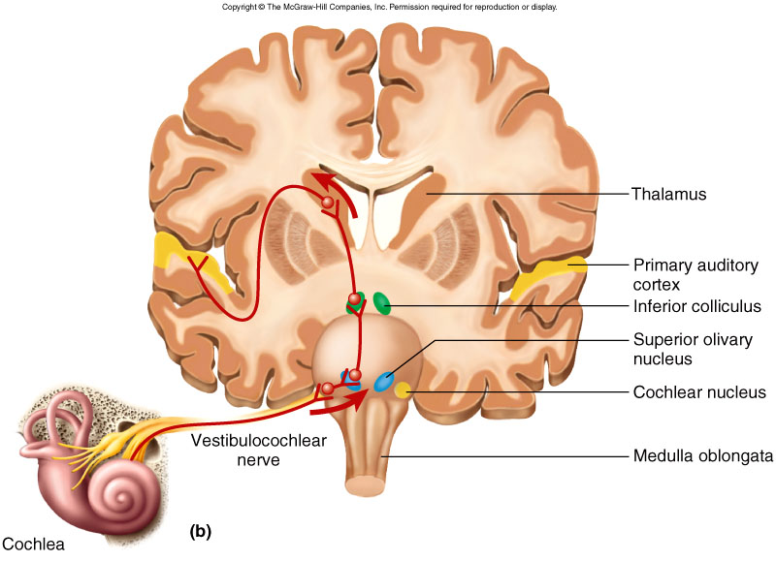
Auditory pathways
Afferent nerve fibers carry information from cochlear nerve and pass it through the pons, midbrain, thalamus on way to the PRIMARY AUDITORY CORTEX in the temporal lobe of the cerebrum.

