Slide 1
Writing Assignment
This project is worth 50 points
Choose ANY topic as long as it is related to:
Human disease
Human Anatomy
Human Physiology
Patient care/treatment
Ex.: Pancreatic Cancer, Embryonic development of the heart, risks/benefits of a particular disease treatment, etc…
Paper must be:
At least 1 ½ pages long (not including bibliography)
Single spaced
Font size no smaller than 12pt (handwritten papers not accepted)
Margins must be no larger than 1 inch on all sides
Must cite at least 3 primary sources!!!
Must be EDITED – need to have a classmate review your paper and GIVE WRITTEN COMMENTS ON ROUGH DRAFT! Editor must sign the paper at the bottom
Hand in both edited copy (with comments) and final draft, AND COPIES OF SOURCES on day of Final Exam!!!!!!

Slide 2
Primary sources
When do you need to cite a source??
Any time you make a statement in your paper that describes new research or defines something that is not considered COMMON KNOWLEDGE to your AUDIENCE
Example:
“Cigarette smoking contributes to the incidence of heart disease and lung cancer” – No need to cite a source for this
“Cigarette smoking causes an increase in oxygen free radicals in lung cells leading to altered function of the p53 oncogene.” – This you would need to cite
What are primary sources??
A primary source is the ORIGINAL source of publication for that data
Can be a published book, but more commonly is an article from a SCHOLARLY JOURNAL
Time, Newsweek, Scientific American are NOT scholarly journals
Scholarly journals contain original research that is PEER REVIEWED (examined and evaluated by several other scientists)
Websites like WebMD, sites for American Cancer Society, American Heart Association ARE NOT peer-reviewed primary sources.
You can use/cite this information but it wouldn’t be one of the 3 primary sources

Slide 3
How do we cite sources??
In order to cite something in a paper, you need two things :
1. An internal citation. This is accomplished by including a note at the end of a sentence that gives a quick reference as to where the information is found. For example, at the end of a sentence you would include the authors last name and the year the article or book was published.
“Oxygen free radicals produced by the mitochondria contribute to the neuronal toxicity seen in amyotrophic lateral sclerosis (Zimmerman, 2007).”
2. A bibliography. This is a complete list of the sources that you’ve cited in your paper. The bibliography should be sorted in alphabetical order based on the last name of the author.
Zimmerman, MC; Oberley, LW, Flanagan, SW. Mutant SOD1-induced neuronal toxicity is mediated by increased mitochondrial superoxide levels. J Neurochem. 2007 Aug; 102(3):609-18.
Authors names (last name, first initial)
Title of book or article
Title of Journal
Date of Publication
Volume, issue, and page number

Slide 4
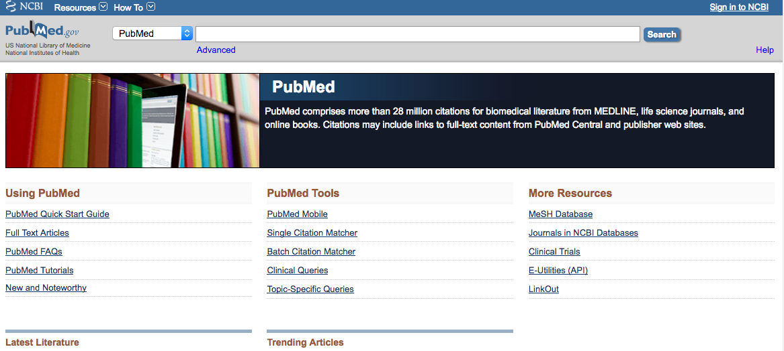
Where do I find primary sources??
The #1 resource for finding peer-reviewed literature on any biomedical topic is PubMed
http://www.ncbi.nlm.nih.gov/PubMed

Slide 5
Primary Sources
You must use a minimum of 3 primary sources in your paper
Additional sources are OK even if they are not technically primary sources
YOU STILL NEED TO CITE THESE THOUGH!
In addition, you must provide me with copies of these primary sources
Photocopy of the book cover, photocopy or reprint of the first page of the article
You will need to turn in 3 things when your paper is due:
Final draft of your paper (typed and proofread)
Edited rough draft signed by the person who edited it
Copies of the primary sources

Slide 6
PubMed / ProQuest Nursing
Many articles are available FREE online
However, some require a journal subscription (library has many)
If library does not have a subscription, you can request that article through INTERLIBRARY LOAN
Plan ahead since it may take a few days to get it
Writing Assignment Website
http://libdata.winona.edu/winona/page.phtml?page_id=239

Slide 7
Tips and Suggestions
Pick a topic that is interesting to you and narrow enough in scope
Consider your audience to be other professionals in your field
Nurses
Physical educators
Athletic trainers, etc…
Read as many papers as you can to start thinking and writing like a professional
Avoid “quotes”
Avoid writing in the first person
Avoid personal “opinion” and commentary
JUST THE FACTS!!!
Get started EARLY!!!

Slide 8
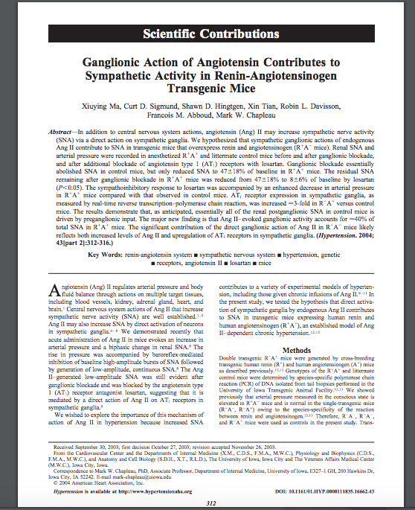
This is what I am asking you to download, print off, and turn in to me

Slide 9
Not this…... this is just a screenshot of the database

