Slide 1
Graduate STUDIES in STATISTICS & BIOSTATISTICS
Who? What? When? Where? Why?

Slide 2
Who?
Those who want to know more about the field.
Those who want to have better job description and more autonomy.
Those who want a higher starting salary.
BS: median $40’s MS: median $60’s
PhD: median $80’s
Those who enjoy college, studying, etc.

Slide 3
What?
Biostatistics vs. Statistics
Biostatistics – statistical methods applied to health related problems.
Statistics – more broad-based methodology applied to a wider variety of areas.

Slide 4
What?
Biostatistics vs. Statistics
Biostatistics – there is critical shortage of biostatisticians, demand is high!
Statistics – they can get biostatistics jobs and other jobs as well. Demand is also high!

Slide 5
What?
Biostatistics vs. Statistics
Biostatistics – less theoretical/mathematical
Statistics – more theoretical/mathematical
However, neither is without a great deal of mathematical rigor!

Slide 6
What?
Courses should I be taking while at WSU?
Stat 210 – Statistics Math 210 – Foundations of Mathematics
Math 305 – Probability Stat 255 – Data Mgmt. Using SAS
Stat 450 & 460 – Mathematical Statistics I & II
Stat 360, 365 – Regression & Expt. Design
Calculus I, II, and Multivariable Calculus
Math 130 and Math 340 – Linear and Adv. Linear Algebra
Advanced Calculus
CS 234 or some other programming course
Other statistics electives

Slide 7
What?
Courses will I be taking in graduate school?
Mathematical Statistics (whole year)
Linear Models (regression and ANOVA)
Statistical Computing (SAS probably)
Lots of electives specific to your interest and program type.
Ph.D. Level -
Real Analysis, Measure/Probability Theory,
Even more mathematical statistics!

Slide 8
What?
What will I be doing besides taking classes and studying?
Let our graduate student panelists answer this one.
Teaching or research assistantship

Slide 9
When? October/November
Take the GRE
Many schools require this and some screen on this more than others.
Make sure you know the requirements for the programs you are interested in.
Letters of Recommendation
Application Letter – “Why do you want to study statistics?”
Resume

Slide 10
When? December - January
Most schools have application deadlines starting in December and running through February.
Plan ahead, identify your potential school choices early so you know when their deadlines are!

Slide 11
Where?
Univ. of Washington – Biostats (3)
Univ. of Michigan – Biostats (1)
Kansas State Univ. – Statistics (4)
Virginia Commonwealth - Biostat (3)
North Carolina State – Statistics (2)
Medical Coll. of Wisc. - Biostats (2)
The Ohio State Univ. - Statistics (3)
Univ. of Minnesota – Statistics (1)
Univ. of Minnesota – Biostatistics (2)
Colorado State Univ. – Statistics (2)
Montana State Univ. – Statistics (1)
Clemson – Statistics (1)
Iowa State University – Statistics (7)
Western Mich. Univ. – Statistics (7)
Univ. of Nebraska – Statistics (1)
The number of WSU graduates is in parentheses. Five of these students have earned or are in the process of earning their doctorates.

Slide 12
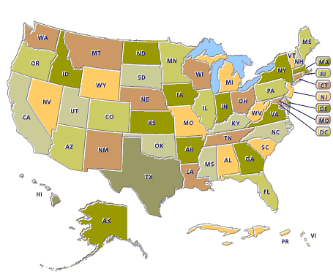
Where? Look at map, pick area you want to be.

Slide 13
Why?
Graduate school is fun!
You get to avoid real life and paying back student loans for at least two more years.
Job opportunities, descriptions and salaries improve considerably.

Slide 14
Links
Graduate School List
http://www.sci.csueastbay.edu/~mwatnik/statlist/
http://www.amstat.org/education/SODS/index.cfm?fuseaction=main
Graduate School Rankings (questionable)
http://www.stat.ucla.edu/program/ranking.php
How to apply to graduate school
http://www.amstat.org/profession/mentoring/pdfs/MClayton.pdf
GRE
http://www.ets.org/gre/

