Slide 1
ASA REU Experience at Winona State University
WINona STATe Statistics REU [WINSTATS-REU]
PI: Silas Bergen
Presenter: Chris Malone
Contributors: Brant Deppa,Tisha Hooks,Chris Malone

Slide 2
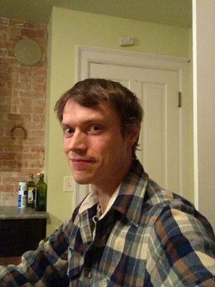
Silas
½ of the Bergen Family

Slide 3
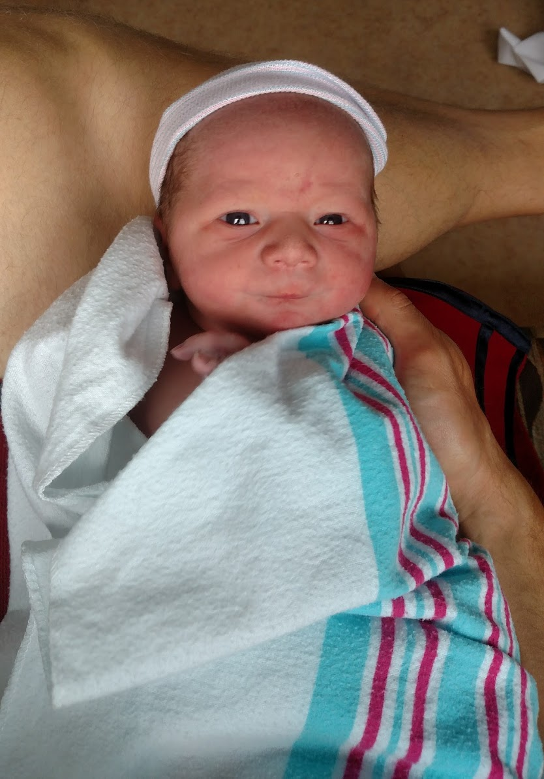
Silas
Ira
½ of the Bergen Family
Note: Pics not to scale

Slide 4
Silas
½ of the Bergen Family
Ira

Slide 5
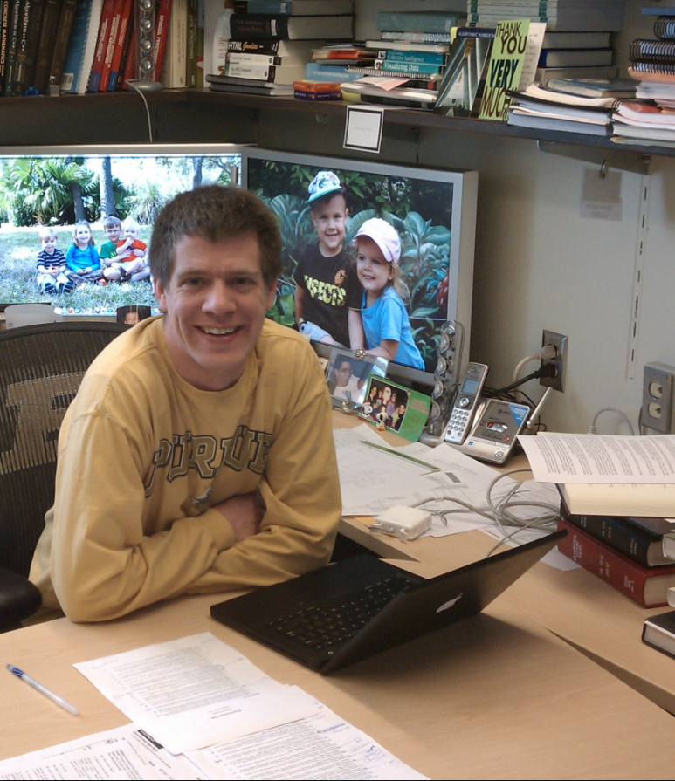
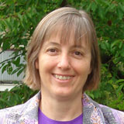
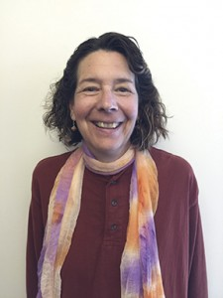
Background
Mark Ward
Purdue Univ
Jessica Utts
[Past] ASA President
Donna Lalonde
ASA Staff
$$$

Slide 6
Purpose
> Dedicated REUs in Statistics
> Serves as 1-year pilot program for 3 schools x 3 years
> Encourage schools to apply for their own NSF funding for future REUs
Background

Slide 7
2016
2017
2018
Background

Slide 8
2016
2017
2018
American Univ
Virginia Tech
Lamar Univ
Background

Slide 9
2016
2017
2018
American Univ
Virginia Tech
Lamar Univ
Emory Univ
Oregon State
Winona State
Background

Slide 10
2016
2017
2018
American Univ
Virginia Tech
Lamar Univ
Emory Univ
Oregon State
Winona State
<your school> http://bit.ly/ ASAREU2018Application
reu@amstat.org
Deadline: August 16, 2017
Background

Slide 11
2016
2017
2018
American Univ
Virginia Tech
Lamar Univ
Emory Univ
Oregon State
Winona State
<your school> http://bit.ly/ ASAREU2018Application
reu@amstat.org
Deadline: August 16, 2017
Background
Year in Review
August 2016 Application Due

Slide 12
2016
2017
2018
Late Fall 2016 Review applicants & extend offers
American Univ
Virginia Tech
Lamar Univ
Emory Univ
Oregon State
Winona State
<your school> http://bit.ly/ ASAREU2018Application
reu@amstat.org
Deadline: August 16, 2017
Background
Year in Review
Early Fall 2016 Promotion & Recruiting
August 2016 Application Due

Slide 13
2016
2017
2018
Late Fall 2016 Review applicants & extend offers
American Univ
Virginia Tech
Lamar Univ
Emory Univ
Oregon State
Winona State
<your school> http://bit.ly/ ASAREU2018Application
reu@amstat.org
Deadline: August 16, 2017
Spring 2017 Project Development with Collaborators
Background
Year in Review
Early Fall 2016 Promotion & Recruiting
August 2016 Application Due
Summer 2017 Complete Research

Slide 14
- Application sent directly to ASA
- Simple/straight-forward process
2016
2017
2018
Late Fall 2016 Reviews applicants & extend offers
American Univ
Virginia Tech
Lamar Univ
Emory Univ
Oregon State
Winona State
<your school> http://bit.ly/ ASAREU2018Application
reu@amstat.org
Deadline: August 16, 2017
Spring 2017 Project Development with Collaborators
Background
Year in Review
Application
Early Fall 2016 Promotion & Recruiting
August 2016 Application Due
Summer 2017 Complete Research

Slide 15
- Application sent directly to ASA
- Simple/straight-forward process
- Defined Components
- Project Description
- Unit (Department) Support
- Previous Undergraduate Research Experience
- Description of Research Environment
- Participant Recruitment Strategy
2016
2017
2018
Late Fall 2016 Reviews applicants & extend offers
American Univ
Virginia Tech
Lamar Univ
Emory Univ
Oregon State
Winona State
<your school> http://bit.ly/ ASAREU2018Application
reu@amstat.org
Deadline: August 16, 2017
Spring 2017 Project Development with Collaborators
Background
Year in Review
Application
Early Fall 2016 Promotion & Recruiting
August 2016 Application Due
Summer 2017 Complete Research

Slide 16
- Application sent directly to ASA
- Simple/straight-forward process
- Defined Components
- Project Description
- Unit (Department) Support
- Previous Undergraduate Research Experience
- Description of Research Environment
- Participant Recruitment Strategy
WINSTATS-REU application ≈ 5 pages
2016
2017
2018
Late Fall 2016 Reviews applicants & extend offers
American Univ
Virginia Tech
Lamar Univ
Emory Univ
Oregon State
Winona State
<your school> http://bit.ly/ ASAREU2018Application
reu@amstat.org
Deadline: August 16, 2017
Spring 2017 Project Development with Collaborators
Background
Year in Review
Application
Early Fall 2016 Promotion & Recruiting
August 2016 Application Due
Summer 2017 Complete Research

Slide 17
Application sent directly to ASA
Simple & straight-forward process
Defined Components
- Project Description
- Unit (Department) Support
- Previous Undergraduate Research Experience
- Description of Research Environment
Participant Recruitment Strategy
WINSTAT-REU application ≈ 5 pages
- US Citizen / permanent resident
- Currently enrolled as a SO/JR/SR
2016
2017
2018
Late Fall 2016 Reviews applicants & extend offers
American Univ
Virginia Tech
Lamar Univ
Emory Univ
Oregon State
Winona State
<your school> http://bit.ly/ ASAREU2018Application
reu@amstat.org
Deadline: August 16, 2017
Spring 2017 Project Development with Collaborators
Background
Year in Review
Application
Add’l Details
Early Fall 2016 Promotion & Recruiting
August 2016 Application Due
Summer 2017 Complete Research

Slide 18
Application sent directly to ASA
Simple & straight-forward process
Defined Components
- Project Description
- Unit (Department) Support
- Previous Undergraduate Research Experience
- Description of Research Environment
Participant Recruitment Strategy
WINSTAT-REU application ≈ 5 pages
- US Citizen / permanent resident
- Currently enrolled as a SO/JR/SR
- 10 week experience
- varying backgrounds/experiences
in students may need to be rectified (selected coursework)
2016
2017
2018
Late Fall 2016 Reviews applicants & extend offers
American Univ
Virginia Tech
Lamar Univ
Emory Univ
Oregon State
Winona State
<your school> http://bit.ly/ ASAREU2018Application
reu@amstat.org
Deadline: August 16, 2017
Spring 2017 Project Development with Collaborators
Background
Year in Review
Application
Add’l Details
Early Fall 2016 Promotion & Recruiting
August 2016 Application Due
Summer 2017 Complete Research

Slide 19
Application sent directly to ASA
Simple & straight-forward process
Defined Components
- Project Description
- Unit (Department) Support
- Previous Undergraduate Research Experience
- Description of Research Environment
Participant Recruitment Strategy
WINSTAT-REU application ≈ 5 pages
2016
2017
2018
Late Fall 2016 Reviews applicants & extend offers
American Univ
Virginia Tech
Lamar Univ
Emory Univ
Oregon State
Winona State
<your school> http://bit.ly/ ASAREU2018Application
reu@amstat.org
Deadline: August 16, 2017
Spring 2017 Project Development with Collaborators
Learning
- Mayo Clinic
Optum / UHG
Be the Match
Greater MSP
Grad school visit
Background
Year in Review
Application
Weekly Schedule
Early Fall 2016 Promotion & Recruiting
Professional Development
Research
August 2016 Application Due
Summer 2017 Complete Research

Slide 20
Application sent directly to ASA
Simple & straight-forward process
Defined Components
- Project Description
- Unit (Department) Support
- Previous Undergraduate Research Experience
- Description of Research Environment
Participant Recruitment Strategy
WINSTAT-REU application ≈ 5 pages
- US Citizen / permanent resident
- Currently enrolled as a SO/JR/SR
- 10 week experience
- varying backgrounds/experiences
in students may need to be rectified (selected coursework)
- Student stipend = $8,000
- Students cover living expenses
2016
2017
2018
Late Fall 2016 Reviews applicants & extend offers
American Univ
Virginia Tech
Lamar Univ
Emory Univ
Oregon State
Winona State
<your school> http://bit.ly/ ASAREU2018Application
reu@amstat.org
Deadline: August 16, 2017
Spring 2017 Project Development with Collaborators
Background
Year in Review
Application
Add’l Details
Budget
Early Fall 2016 Promotion & Recruiting
August 2016 Application Due
Summer 2017 Complete Research

Slide 21
Application sent directly to ASA
Simple & straight-forward process
Defined Components
- Project Description
- Unit (Department) Support
- Previous Undergraduate Research Experience
- Description of Research Environment
Participant Recruitment Strategy
WINSTAT-REU application ≈ 5 pages
- US Citizen / permanent resident
- Currently enrolled as a SO/JR/SR
- 10 week experience
- varying backgrounds/experiences
in students may need to be rectified (selected coursework)
- Student stipend = $8,000
- Students cover living expenses
- Limited faculty support (summer)
2016
2017
2018
Late Fall 2016 Reviews applicants & extend offers
American Univ
Virginia Tech
Lamar Univ
Emory Univ
Oregon State
Winona State
<your school> http://bit.ly/ ASAREU2018Application
reu@amstat.org
Deadline: August 16, 2017
Spring 2017 Project Development with Collaborators
Background
Year in Review
Application
Add’l Details
Budget
Early Fall 2016 Promotion & Recruiting
August 2016 Application Due
Summer 2017 Complete Research

Slide 22
Application sent directly to ASA
Simple & straight-forward process
Defined Components
- Project Description
- Unit (Department) Support
- Previous Undergraduate Research Experience
- Description of Research Environment
Participant Recruitment Strategy
WINSTAT-REU application ≈ 5 pages
- US Citizen / permanent resident
- Currently enrolled as a SO/JR/SR
- 10 week experience
- varying backgrounds/experiences
in students may need to be rectified (selected coursework)
- Student stipend = $8,000
- Students cover living expenses
- Limited faculty support (summer)
- Add’l funding for professional development (≈$6k for WINSTATS)
2016
2017
2018
Late Fall 2016 Reviews applicants & extend offers
American Univ
Virginia Tech
Lamar Univ
Emory Univ
Oregon State
Winona State
<your school> http://bit.ly/ ASAREU2018Application
reu@amstat.org
Deadline: August 16, 2017
Spring 2017 Project Development with Collaborators
Background
Year in Review
Application
Add’l Details
Budget
Early Fall 2016 Promotion & Recruiting
August 2016 Application Due
Summer 2017 Complete Research

Slide 23
Application sent directly to ASA
Simple & straight-forward process
Defined Components
- Project Description
- Unit (Department) Support
- Previous Undergraduate Research Experience
- Description of Research Environment
Participant Recruitment Strategy
WINSTAT-REU application ≈ 5 pages
- US Citizen / permanent resident
- Currently enrolled as a SO/JR/SR
- 10 week experience
- varying backgrounds/experiences
in students may need to be rectified (selected coursework)
- Student stipend = $8,000
- Students cover living expenses
- Limited faculty support (summer)
- Add’l funding for professional development (≈$6k for WINSTATS)
2016
2017
2018
Late Fall 2016 Reviews applicants & extend offers
American Univ
Virginia Tech
Lamar Univ
Emory Univ
Oregon State
Winona State
<your school> http://bit.ly/ ASAREU2018Application
reu@amstat.org
Deadline: August 16, 2017
Spring 2017 Project Development with Collaborators
Background
Year in Review
Application
Add’l Details
Budget
Collaborators
Early Fall 2016 Promotion & Recruiting
August 2016 Application Due
Summer 2017 Complete Research

Slide 24
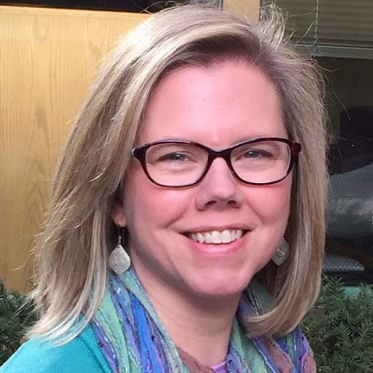
Application sent directly to ASA
Simple & straight-forward process
Defined Components
- Project Description
- Unit (Department) Support
- Previous Undergraduate Research Experience
- Description of Research Environment
Participant Recruitment Strategy
WINSTAT-REU application ≈ 5 pages
- US Citizen / permanent resident
- Currently enrolled as a SO/JR/SR
- 10 week experience
- varying backgrounds/experiences
in students may need to be rectified (selected coursework)
- Student stipend = $8,000
- Students cover living expenses
- Limited faculty support (summer)
- Add’l funding for professional development (≈$6k for WINSTATS)
2016
2017
2018
Late Fall 2016 Reviews applicants & extend offers
American Univ
Virginia Tech
Lamar Univ
Emory Univ
Oregon State
Winona State
<your school> http://bit.ly/ ASAREU2018Application
reu@amstat.org
Deadline: August 16, 2017
Spring 2017 Project Development with Collaborators
Background
Year in Review
Application
Add’l Details
Budget
Collaborators
Early Fall 2016 Promotion & Recruiting
August 2016 Application Due
Summer 2017 Complete Research
Lara Cleveland
Rodrigo Lovaton Davila
Kristen Jeffers

Slide 25
Application sent directly to ASA
Simple & straight-forward process
Defined Components
- Project Description
- Unit (Department) Support
- Previous Undergraduate Research Experience
- Description of Research Environment
Participant Recruitment Strategy
WINSTAT-REU application ≈ 5 pages
- US Citizen / permanent resident
- Currently enrolled as a SO/JR/SR
- 10 week experience
- varying backgrounds/experiences
in students may need to be rectified (selected coursework)
- Student stipend = $8,000
- Students cover living expenses
- Limited faculty support (summer)
- Add’l funding for professional development (≈$6k for WINSTATS)
2016
2017
2018
Late Fall 2016 Reviews applicants & extend offers
American Univ
Virginia Tech
Lamar Univ
Emory Univ
Oregon State
Winona State
<your school> http://bit.ly/ ASAREU2018Application
reu@amstat.org
Deadline: August 16, 2017
Spring 2017 Project Development with Collaborators
Background
Year in Review
Application
Add’l Details
Budget
Collaborators
“85 countries – 301 censuses – 672 million person records”
Early Fall 2016 Promotion & Recruiting
August 2016 Application Due
Summer 2017 Complete Research
Lara Cleveland
Rodrigo Lovaton Davila
Kristen Jeffers

Slide 26
Application sent directly to ASA
Simple & straight-forward process
Defined Components
- Project Description
- Unit (Department) Support
- Previous Undergraduate Research Experience
- Description of Research Environment
Participant Recruitment Strategy
WINSTAT-REU application ≈ 5 pages
- US Citizen / permanent resident
- Currently enrolled as a SO/JR/SR
- 10 week experience
- varying backgrounds/experiences
in students may need to be rectified (selected coursework)
- Student stipend = $8,000
- Students cover living expenses
- Limited faculty support (summer)
- Add’l funding for professional development (≈$6k for WINSTATS)
2016
2017
2018
Late Fall 2016 Reviews applicants & extend offers
“85 countries – 301 censuses – 672 million person records”
American Univ
Virginia Tech
Lamar Univ
Emory Univ
Oregon State
Winona State
<your school> http://bit.ly/ ASAREU2018Application
reu@amstat.org
Deadline: August 16, 2017
Spring 2017 Project Development with Collaborators
Project #1
Project #2
Background
Year in Review
Application
Add’l Details
Budget
Collaborators
Projects
“85 countries – 301 censuses – 672 million person records”
Early Fall 2016 Promotion & Recruiting
August 2016 Application Due
Summer 2017 Complete Research
Lara Cleveland
Rodrigo Lovaton- Davila
Kristen Jeffers

Slide 27
Application sent directly to ASA
Simple & straight-forward process
Defined Components
- Project Description
- Unit (Department) Support
- Previous Undergraduate Research Experience
- Description of Research Environment
Participant Recruitment Strategy
WINSTAT-REU application ≈ 5 pages
- US Citizen / permanent resident
- Currently enrolled as a SO/JR/SR
- 10 week experience
- varying backgrounds/experiences
in students may need to be rectified (selected coursework)
- Student stipend = $8,000
- Students cover living expenses
- Limited faculty support (summer)
- Add’l funding for professional development (≈$6k for WINSTATS)
2016
2017
2018
Late Fall 2016 Reviews applicants & extend offers
“85 countries – 301 censuses – 672 million person records”
American Univ
Virginia Tech
Lamar Univ
Emory Univ
Oregon State
Winona State
<your school> http://bit.ly/ ASAREU2018Application
reu@amstat.org
Deadline: August 16, 2017
Spring 2017 Project Development with Collaborators
Project #1
Project #2
Investigation of a
universal measure
of household wealth
Study relationships
between new measures and
other indicators of
wealth
Background
Year in Review
Application
Add’l Details
Budget
Collaborators
Projects
“85 countries – 301 censuses – 672 million person records”
Early Fall 2016 Promotion & Recruiting
August 2016 Application Due
Summer 2017 Complete Research
Lara Cleveland
Rodrigo Lovaton- Davila
Kristen Jeffers

Slide 28
Application sent directly to ASA
Simple & straight-forward process
Defined Components
- Project Description
- Unit (Department) Support
- Previous Undergraduate Research Experience
- Description of Research Environment
Participant Recruitment Strategy
WINSTAT-REU application ≈ 5 pages
- US Citizen / permanent resident
- Currently enrolled as a SO/JR/SR
- 10 week experience
- varying backgrounds/experiences
in students may need to be rectified (selected coursework)
- Student stipend = $8,000
- Students cover living expenses
- Limited faculty support (summer)
- Add’l funding for professional development (≈$6k for WINSTATS)
2016
2017
2018
Late Fall 2016 Reviews applicants & extend offers
“85 countries – 301 censuses – 672 million person records”
American Univ
Virginia Tech
Lamar Univ
Emory Univ
Oregon State
Winona State
<your school> http://bit.ly/ ASAREU2018Application
reu@amstat.org
Deadline: August 16, 2017
Spring 2017 Project Development with Collaborators
Project #1
Project #2
Investigation of a
universal measure
of household wealth
Study relationships
between new measures and
other indicators of
wealth
Construct various visualizations using IPUMS-I data sources
- Study relationship btw employment and native/ foreign born
Background
Year in Review
Application
Add’l Details
Budget
Collaborators
Projects
“85 countries – 301 censuses – 672 million person records”
Early Fall 2016 Promotion & Recruiting
August 2016 Application Due
Summer 2017 Complete Research
Lara Cleveland
Rodrigo Lovaton- Davila
Kristen Jeffers

Slide 29
Application sent directly to ASA
Simple & straight-forward process
Defined Components
- Project Description
- Unit (Department) Support
- Previous Undergraduate Research Experience
- Description of Research Environment
Participant Recruitment Strategy
WINSTAT-REU application ≈ 5 pages
- US Citizen / permanent resident
- Currently enrolled as a SO/JR/SR
- 10 week experience
- varying backgrounds/experiences
in students may need to be rectified (selected coursework)
- Student stipend = $8,000
- Students cover living expenses
- Limited faculty support (summer)
- Add’l funding for professional development (≈$6k for WINSTATS)
2016
2017
2018
Late Fall 2016 Reviews applicants & extend offers
“85 countries – 301 censuses – 672 million person records”
American Univ
Virginia Tech
Lamar Univ
Emory Univ
Oregon State
Winona State
<your school> http://bit.ly/ ASAREU2018Application
reu@amstat.org
Deadline: August 16, 2017
Spring 2017 Project Development with Collaborators
Project #1
Project #2
Investigation of a
universal measure
of household wealth
Study relationships
between new measures and
other indicators of
wealth
Construct various visualizations using IPUMS-I data sources
Study relationship between employment and
native/foreign born
Background
Year in Review
Application
Add’l Details
Budget
Collaborators
Projects
“85 countries – 301 censuses – 672 million person records”
Early Fall 2016 Promotion & Recruiting
August 2016 Application Due
Summer 2017 Complete Research
Lara Cleveland
Rodrigo Lovaton- Davila
Kristen Jeffers

Slide 30
Application sent directly to ASA
Simple & straight-forward process
Defined Components
- Project Description
- Unit (Department) Support
- Previous Undergraduate Research Experience
- Description of Research Environment
Participant Recruitment Strategy
WINSTAT-REU application ≈ 5 pages
- US Citizen / permanent resident
- Currently enrolled as a SO/JR/SR
- 10 week experience
- varying backgrounds/experiences
in students may need to be rectified (selected coursework)
- Student stipend = $8,000
- Students cover living expenses
- Limited faculty support (summer)
- Add’l funding for professional development (≈$6k for WINSTATS)
2016
2017
2018
Late Fall 2016 Reviews applicants & extend offers
“85 countries – 301 censuses – 672 million person records”
American Univ
Virginia Tech
Lamar Univ
Emory Univ
Oregon State
Winona State
<your school> http://bit.ly/ ASAREU2018Application
reu@amstat.org
Deadline: August 16, 2017
- [Experiential] learning experience
- Fast-paced / challenging work
- Building relationships
- Exposure to career opportunities
Spring 2017 Project Development with Collaborators
Project #1
Project #2
Investigation of a
universal measure
of household wealth
Study relationships
between new measures and
other indicators of
wealth
Construct various visualizations using IPUMS-I data sources
- Study relationship btw employment and native/ foreign born
Background
Year in Review
Application
Add’l Details
Budget
Collaborators
Projects
Student Feedback
“85 countries – 301 censuses – 672 million person records”
Early Fall 2016 Promotion & Recruiting
- Disbursement of funds
- Division of work / “stuck” with project
August 2016 Application Due
Summer 2017 Complete Research
Lara Cleveland
Rodrigo Lovaton- Davila
Kristen Jeffers

Slide 31
Application sent directly to ASA
Simple & straight-forward process
Defined Components
- Project Description
- Unit (Department) Support
- Previous Undergraduate Research Experience
- Description of Research Environment
Participant Recruitment Strategy
WINSTAT-REU application ≈ 5 pages
- US Citizen / permanent resident
- Currently enrolled as a SO/JR/SR
- 10 week experience
- varying backgrounds/experiences
in students may need to be rectified (selected coursework)
- Student stipend = $8,000
- Students cover living expenses
- Limited faculty support (summer)
- Add’l funding for professional development (≈$6k for WINSTATS)
2016
2017
2018
Late Fall 2016 Reviews applicants & extend offers
“85 countries – 301 censuses – 672 million person records”
American Univ
Virginia Tech
Lamar Univ
Emory Univ
Oregon State
Winona State
<your school> http://bit.ly/ ASAREU2018Application
reu@amstat.org
Deadline: August 16, 2017
- Working with highly motivated students
- Develop collaborative relationships
- Professional development component is necessary
Spring 2017 Project Development with Collaborators
Project #1
Project #2
Investigation of a
universal measure
of household wealth
Study relationships
between new measures and
other indicators of
wealth
Construct various visualizations using IPUMS-I data sources
- Study relationship btw employment and native/ foreign born
Background
Year in Review
Application
Add’l Details
Budget
Collaborators
Projects
Faculty Feedback
“85 countries – 301 censuses – 672 million person records”
Early Fall 2016 Promotion & Recruiting
- Atypical funding / disbursement
- Support of many is necessary
August 2016 Application Due
Summer 2017 Complete Research
Lara Cleveland
Rodrigo Lovaton- Davila
Kristen Jeffers

Slide 32
2018 Application
http://bit.ly/ASAREU2018Application
reu@amstat.org
Email: cmalone@winona.edu
WINSTATS-REU: www.winstats-reu.info

