Slide 1
An Undergraduate Course in Statistical Consulting and Communication
Tisha Hooks (thooks@winona.edu) Christopher Malone (cmalone@winona.edu)

Slide 2
WSU Statistical Consulting Center
Winona State University (WSU) is primarily an undergraduate university with approximately 8,000 students
WSU Statistical Consulting Center was created in 2007 in order to
Coordinate statistical consulting efforts on campus
Address substantial increase in demand for assistance with undergraduate research projects
Purpose of the Consulting Center:
Promote collaboration
Educate both faculty and students
Enhance research

Slide 3
WSU Statistical Consulting Center, cont.
Each academic year, the Center is managed by a faculty member who also teaches the course during the fall.
In the fall, projects are completed by students in the course.
Students are hired to staff the center in the spring.

Slide 4
Motivation for our Statistical Consulting Course
Helps us meet consulting needs on campus
Provides training in statistical consulting
Prepares students to staff the consulting center
Well-aligned with the ASA-endorsed curriculum guidelines for undergraduate statistics programs which call us to
Emphasize real data and authentic applications
Encourage synthesis of theory, methods, and applications
Offer frequent opportunities to develop communication skills
Addresses Higgins’ call (1999) to “give greater prominence to the important, nonmathematical things we do as statisticians”
Develops skills in oral communication, written communication, collaboration, and teamwork

Slide 5
Overview of our Statistical Consulting Course
Who are the students?
What are the prerequisites?
What are the learning outcomes?
Class size is usually about 10 students
Any introductory statistics course
Completion of either a regression or design course
The course enhances a student’s ability to communicate with both clients and other statisticians
Most students are statistics majors
Students learn the skills required of a successful consultant and also become aware of issues statisticians encounter when consulting
Students gain experience in analyzing data and writing summary reports

Slide 6
The First Six Weeks – Course Content
Discuss the process of consulting
Students become aware of client expectations and the role of a consultant
Participate in mock consulting sessions
Students learn how to ask good questions and refine their listening skills
Students practice with mock clients and receive feedback from this client, the instructor, and their peers
Mock clients are typically past clients, other instructors, or myself
Students learn qualities of an effective consultant

Slide 7
The First Six Weeks – Course Assignments
Interact with experienced statistical consultants
Students interview experienced statistical consultants
“The Practice of Statistics…” by William G. Hunter
If possible, students observe consulting sessions
“Some General Remarks on Consulting …” by Cuthbert Daniel
“The Impertinent Questioner…” by Willliam Lurie
“Ethical Guidelines for Statistical Practice” from the ASA
Selected readings from Statistical Consulting… by Janice Derr
Write reflections on relevant reading assignments
Analyze data, write summaries, and present to mock clients
Mock projects give a brief review of common statistical techniques
Feedback is essential!

Slide 8
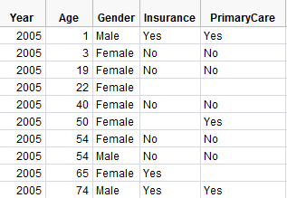
The First Six Weeks – Examples of Mock Projects
Analysis of Survey Data
Client provides the raw data sheets and a list of research questions the students must address
Students review a variety of statistical methods in the analysis

Slide 9
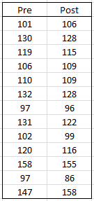
The First Six Weeks – Examples of Mock Projects
Analysis of Pre-Post Data on Glucose Levels
Students analyze data and get results that are non-significant
Students are forced to deal with an unethical request

Slide 10
The First Six Weeks – Examples of Mock Projects
Analysis of Pre-Post Data on Glucose Levels
Students analyze data and get results that are non-significant
Students are forced to deal with an unethical request

Slide 11
Course Content for the Remainder of the Semester
Interact with actual clients (with client permission)
Internal clients have been from the Department of Biology, Nursing, Business Administration, and Social Work
Clients meet with students during class time, if possible
Students choose appropriate methods for analyzing the data and provide both a written report and an oral presentation of the results to the instructor, their peers, and the client
Analyze data, write summaries, and present to clients
Projects are assigned to a team of 2-3 students
Class time is devoted to meeting with clients, discussing projects, and working on projects
External clients have included the Minnesota Academy of the Sciences and the Minnesota Deputy Registrar’s Association

Slide 12
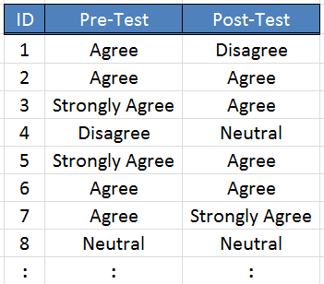
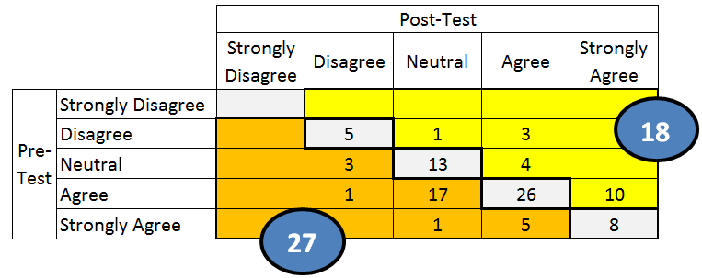
Examples of Projects Encountered by our Students
Client: Department of Nursing
Objective: Measure the effect of an intervention
Outcomes:
The client did a preliminary analysis by converting the 5-point Likert scale outcomes to numeric values so that differences could be computed
A student consultant investigated alternatives to this naïve approach
A table was used to contrast pre/post outcomes using the original scales
Bowker’s test, a test of symmetry, was used to confirm the effect of the intervention

Slide 13
Examples of Projects Encountered by our Students
Client: Department of Business Administration
Objective: Compare two teaching approaches while adjusting for GPA
Outcomes:
Using GPA as a covariate, students found no evidence that scores were higher on the concept map questions.
Not surprisingly, there was statistical evidence that the average score increased as GPA increased.

Slide 14
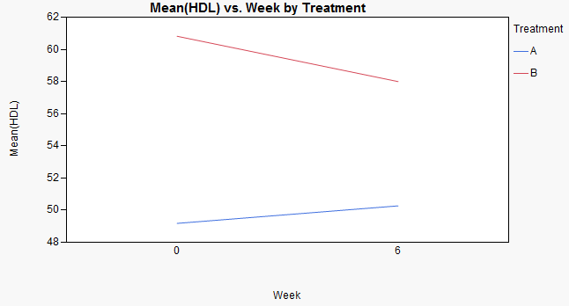
Examples of Projects Encountered by our Students
Client: Department of Biology
Objective: Examine the effect of eating pistachios on HDL
Outcomes:
There was no evidence for a difference across treatment groups in the change in HDL
Student conducted post hoc power analysis and discussed this with the client

Slide 15
Student Evaluations of the Course
Responses to “which word best describes your overall evaluation of the course?”
Results collected over three semesters from two different instructors
Students have commented that they enjoyed
“doing stuff that mattered”’
”the application of statistics to help others”
“seeing how other people need and use statistics”
“figuring out what to do with actual raw data”
“implementing skills attained in other classes”
“learning what tests to use where”
“getting experience that is similar to the kind of work I’ll be doing after school”

Slide 16
Some Challenges We Face
Project Management
Demand for statistical consulting fluctuates
Background Knowledge
Some projects require advanced techniques (e.g., multivariate analyses or logistic regression) that must be taught to students
A potential solution is to assign these projects to students with a background in these courses (or to exceptional learners)
A solution for having too few projects is to solicit a list of suitable projects from clients in advance

Slide 17
Advantages of our Consulting Course
Students leave with improved skills in data analysis and communication
Exceptional students leave ready to work in our consulting center and gain unparalleled experience as undergraduates
Positive Impact on Students
Course is well-aligned with ASA-endorsed guidelines for undergraduate programs in statistics
Positive Impact on our Curriculum

Slide 18
References
American Statistical Association. Curriculum Guidelines for Undergraduate Programs in Statistical Science. Retrieved May 6, 2012, from http://www.amstat.org/education/curriculumguidelines.cfm.
American Statistical Association. (1999). Ethical Guidelines for Statistical Practice. Retrieved May 6, 2012, from http://www.amstat.org/about/ethicalguidelines.cfm.
Boomer, KB, Rogness, N., Jersky, B. (2007). Statistical Consulting Courses for Undergraduates: Fortune or Folly? Journal of Statistics Education, 15(3).
Daniel, Cuthbert. (1969). Some General Remarks on Consulting in Statistics. Technometrics, 11(2): 241-245.
Derr, Janice. (2000). Statistical Consulting: A Guide to Effective Communication. Pacific Grove, CA: Brooks/Cole.
Higgins, James. (1999). Nonmathematical Statistics: A New Direction for the Undergraduate Discipline. The American Statistician, 53(1): 1-6.
Hunter, William. (1981). The Practice of Statistics: The Real World Is an Idea Whose Time Has Come. The American Statistician, 35(2): 72-76.
Lurie, William. (1958). The Impertinent Questioner: The Scientist’s Guide to the Statistician’s Mind. American Scientist, 46(1): 57-61.

Slide 19
My contact information
Tisha Hooks (thooks@winona.edu)

