Slide 1
Performing a Literature Review Step 1 – The Search
Goal
Outline of this Lecture
Identify all journal articles, and sometimes textbooks, related to a topic.
See what has and hasn’t been done.
Should be the first step in research.
Identify (possibly) interesting articles
Database Search
Backward Search
Forward Search
Google
Getting a copy of an article
“Find at S” button and Science Direct
Google
ILL

Slide 2
Identify Interesting Articles
We want to find all articles of interest.
Overwhelmed with articles?
Narrow your search!!!
Be sure to always be weeding out articles.

Slide 3
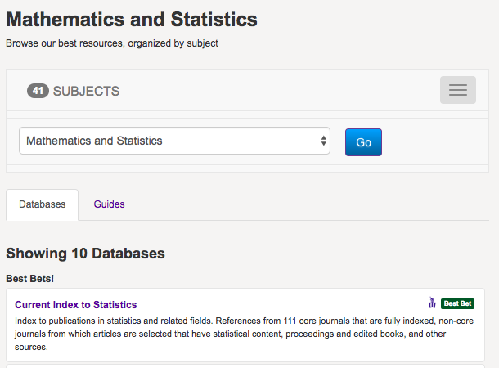
Journal Databases @ WSU
Go to the library
Database tab
Math & Stats

Slide 4
Example Search
The instructor will point out databases available at WSU.
Example: Use Current Index of Statistics to search for fiducial and gamma distribution.

Slide 5
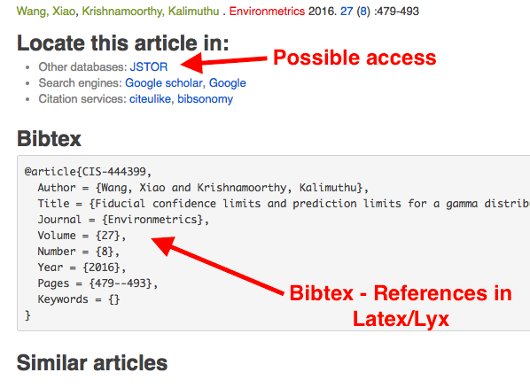
Results

Slide 6
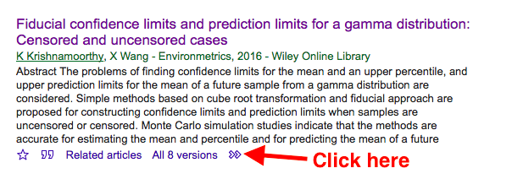
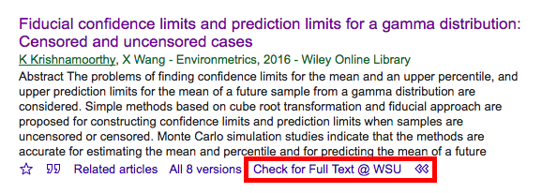
Google Scholar → Find it @ WSU

Slide 7
Google Scholar → Direct Link to pdf

Slide 8
Backward and Forward Parts of a Citation
Time
Backward Citation
Forward Citation
Older Article
Citation
Newer Article

Slide 9
Identify Interesting Articles Backward Search
Time
Referenced Article
Referenced Article
Referenced Article
Good Article
Referenced Article
Referenced Article
Goal: Find Articles referenced by … articles referenced by
…. articles referenced by … a particular article.

Slide 10
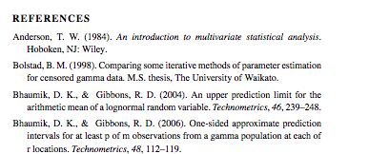
Example - Backward Search
Check the references!
.
.
.
Foundational Articles
.
.
.
Good review of the topic

Slide 11
Identify Interesting Articles Forward Search
Time
References Article A
Good Article
A
References Article A
References Article A
Goal: Find more recent articles that reference an interesting article

Slide 12
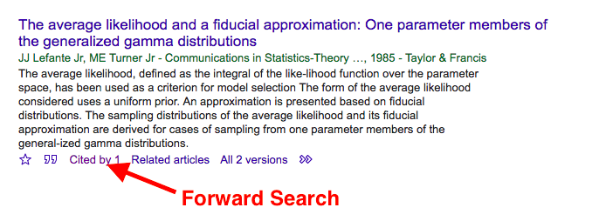
Identify Interesting Articles Forward Search
Strategy: Do a forward search from an early seminal paper.
Use Google Scholar

Slide 13
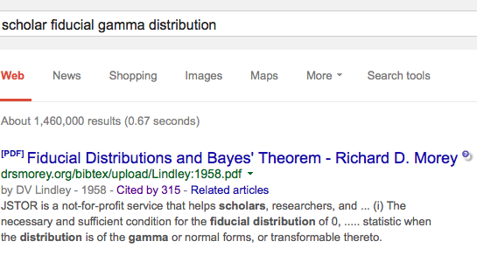
Example – Forward Search Google Scholar

Slide 14
Identify Interesting Articles Google
Googling a topic is a powerful method
Standard Warning: Unreliable and information needs to be verified!
Truth: An invaluable tool that you should take full advantage of
But still verify!

Slide 15
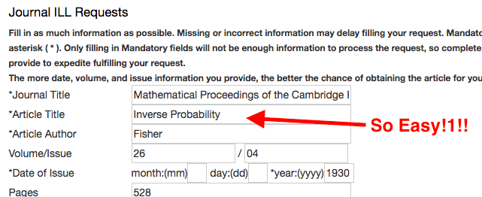
Getting a Copy of an Article
pdf available
Google Scholar/Science Direct.
“Check Full Text - WSU” button
Available online
Interlibrary loan
Find Journal @ WSU library
Google the exact name of the article
A pdf is sometimes available

Slide 16
One More Tool
Wikipedia is a good place to start
Good overview of many topics
Often with references
Don’t discount a well-written blog as a place to find ideas

