Slide 1
Creating Effective Visual Aids
This presentation contains excerpts
from the following set of slides:
Giving an effective presentation:
Using Powerpoint and structuring a scientific talk
Susan McConnell
Department of Biological Sciences
Stanford University

Slide 2
What do you think of the following slide?

Slide 3
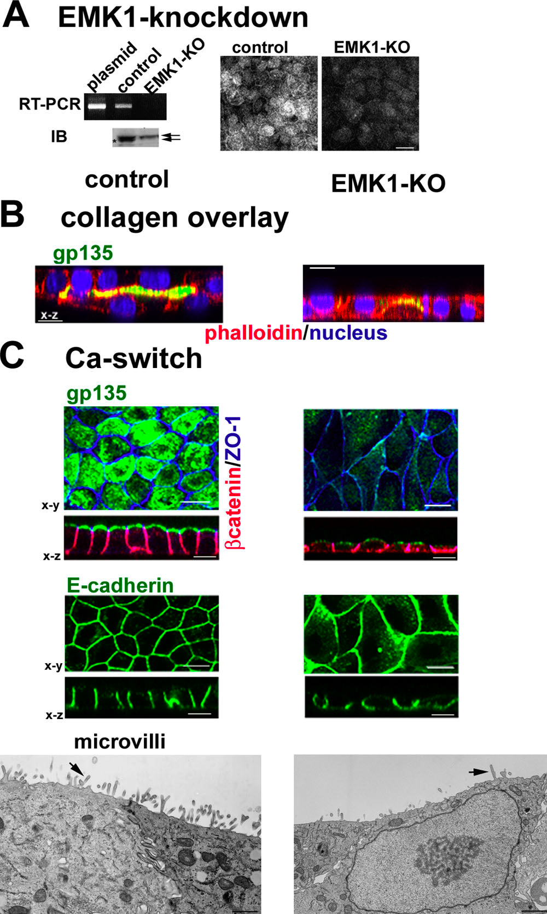
Emk1 knockdown inhibits lumen formation in MDCK cells:
RT-PCR: EMK1 is effectively knocked down in MDCK cells 24 hours after transfection with P-SUPER (control) or P-SUPER-siEMK1 plasmid; knockdown confirmed on the right with antibodies to EMK1.
Collagen overlay assay: cells cultured 24 h on collagen I before being overlaid with additional collagen on the apical surface, analyzed 24 h later. Note the lack of lumen in EMK1-KO cultures.
Ca switch: control or EMK1-KO cells were plated in low Ca medium 24 h upon transfection with pSUPER or pSUPER-KO. After 12 h, cultures were switched to normal medium for 24 h. Transmission EM of cells sectioned perpendicular to the substratum shows lack of microvilli in EMK1-KO cells.

Slide 4
Is this better?

Slide 5
Emk1 knockdown inhibits lumen formation in MDCK cells

Slide 6
Not much.

Slide 7
Powerpoint basics:

Slide 8
Powerpoint basics:
1. What font to use

Slide 9
Powerpoint basics:
1. What font to use
Use a Sans Serif font:

Slide 10
Powerpoint basics:
1. What font to use
Use a Sans Serif font:
This font is Arial.
This font is Comic Sans.
This font is Trebuchet.

Slide 11
Powerpoint basics:
1. What font to use
Use a Sans Serif font:
This font is Arial.
This font is Comic Sans.
This font is Trebuchet.
Serif fonts take longer to read…

Slide 12
Powerpoint basics:
1. What font to use
Use a Sans Serif font:
This font is Arial.
This font is Comic Sans.
This font is Trebuchet.
Serif fonts take longer to read…
This font is Times New Roman.
This font is Courier.
This font is Didot.

Slide 13
Powerpoint basics:
1. What font to use
Some fonts look super in boldface:

Slide 14
Powerpoint basics:
1. What font to use
Some fonts look super in boldface:
Arial vs. Arial bold
Comic Sans vs. Comic Sans bold
Trebuchet vs. Trebuchet bold

Slide 15
Powerpoint basics:
1. What font to use
Type size should be 18 points or larger:
18 point
20 point
24 point
28 point
36 point
* References can be in 14 point font

Slide 16
Powerpoint basics:
1. What font to use
AVOID USING ALL CAPITAL LETTERS BECAUSE IT’S REALLY HARD TO READ!

Slide 17
Powerpoint basics:
2. Color

Slide 18
Powerpoint basics:
2. Color
Dark letters against a light background work.

Slide 19
Powerpoint basics:
2. Color
Light letters against a dark background also work.

Slide 20
Powerpoint basics:
2. Color
Many experts feel that a dark blue or black background works best for talks in a large room.

Slide 21
Powerpoint basics:
2. Color
Dark letters against a light background are best for smaller rooms and for teaching.

Slide 22
Powerpoint basics:
2. Color
Avoid red-green combinations because a large fraction of the human population is red-green colorblind.
Lots of people can’t read this –
and even if they could, it makes your eyes hurt.

Slide 23

Powerpoint basics:
2. Color
Other color combinations can be equally bad.

Slide 24

Powerpoint basics:
2. Color
View your slides in grayscale to ensure that there is adequate color contrast in each slide.

Slide 25
Powerpoint basics:
3. Layout

Slide 26
Powerpoint basics:
3. Layout
Every slide should have a heading.
Sentences are preferred if it’s possible
to make a statement.

Slide 27
Powerpoint basics:
3. Layout
Limit text blocks to no more than two lines each.

Slide 28
Powerpoint basics:
3. Layout
The reason for limiting text blocks to two lines is that when the text block goes on and on forever, people in the audience are going to have to make a huge effort to read the text, which will preclude them from paying attention to what you are saying. Every time you lose their focus, your presentation suffers!

Slide 29
Powerpoint basics:
3. Layout
Lists should contain no more than 3 items:
• Item 1
• Item 2
• Item 3

Slide 30
Powerpoint basics:
3. Layout
It is often effective to “unveil” your list one by one:
• Item 1
• Item 2
• Item 3

Slide 31
Powerpoint basics:
3. Layout
Avoid sublists!
• Item 1
  Item 1a
  Item 1b
  Item 1c
• Item 2
- Item 2a
- Item 2b
• Item 3

Slide 32
Powerpoint basics:
3. Layout
Be generous with empty space.

Slide 33

Powerpoint basics:
3. Layout
If you try to cram too much into a slide, and place things too close to the sides, they can get cut off if you’re using a poor projector. In any case, the slide looks all cluttered and junky.

Slide 34
Powerpoint basics:
4. Style

Slide 35
Powerpoint basics:
4. Style
Try your best to include a
simple image on every slide.

Slide 36
Powerpoint basics:
4. Style
Limit the number of items on each slide.
Each slide should make just one or two points!

Slide 37
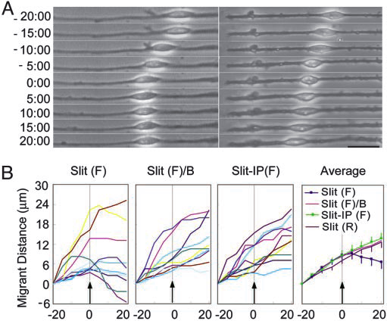

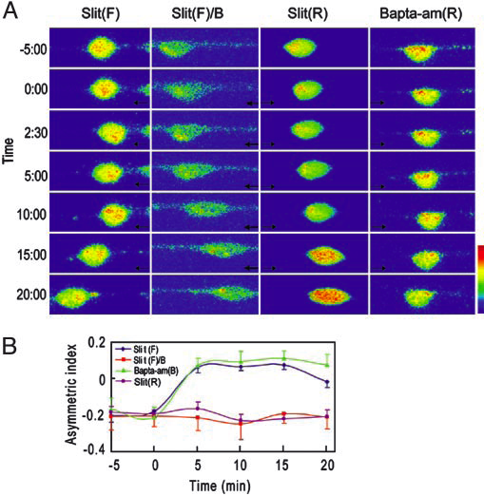
Powerpoint basics:
4. Style
This is just too much. Arrrgh!

Slide 38
Powerpoint basics:
4. Style
Here is a simple rule for showing figures and images:
If you’re not going to take the time
to explain it, get rid of it.

Slide 39
Powerpoint basics:
4. Style
Avoid fancy transitions between slides
unless you have a good reason.

Slide 40
Powerpoint basics:
4. Style
Don’t try to show too many slides.
Often, less is more.

