Slide 1
Using Real vs Simulated Data in an Introductory Statistics Course
Christopher J. Malone
Kansas State University
Notes:
Thank them for staying until the last time period
Give the web address for download
Mention contact information on handout

Slide 2
Lit Review
Caldwell (1983), “Combining Real and Generated Data in Lab Exercises to Demonstrate Problems in Inference”, Proceedings of the Section on Statistics Education
“Limiting lab exercises to the analysis of real data is a analogous to practicing dart-throwing by concentrating on one’s form without being able to see how close each dart comes to the bullseye.”
Gives several examples of real/simulated data exercises
Notes:
Caldwell concentrated on issues solely related to inference
Without direct experience of “hits and misses”, learning is compromised and little confidence is gained

Slide 3
Lit Review
Halley (1991), “Teaching Social Statistics with Simulated Data”. Teaching Sociology
Real data contains missing codes…leads to unnecessary confusion
…interesting and significant relationships often disappear when providing unique data sets with real data
Notes:
Gives three reasons to use simulated data

Slide 4
Real/Simulated
What does Real data bring to the classroom?
Self-motivating
Students can use preconceived judgments to “complete” an analysis (subjective analysis + analytical analysis)
Students get a feel for real problems inherent in real data
?Obviously?, more realistic

Slide 5
Real/Simulated
What does simulated (realistic) data bring to the classroom?
More easily provide individualized data sets
Easily investigate the purpose, concept, and behavior of a statistical procedure
Avoid many of the pre-analysis issues
Verify a statistical procedure
Time management issues

Slide 6
Real/Simulated
Best Solution ???
Real
+
Simulated
Notes:
Bring up the fact that when using simulated data or individualized data sets results should be communicated to all individuals!

Slide 7
Existing Systems
Previous Work…
Gitlow & Oppenheim (1982), Stat City
Halley (1991), “Teaching Social Statistics with Simulated Data”. GENSTAT system
Chang et all (1992), “Teaching Survey Sampling Using Simulation”, SURVEY
Schwarz (1997), “StatVillage: An On-Line Hypothetical City Based on Real Data for Use in an Introductory Class in Survey Sampling”
Notes:
Stat City, Understanding Statistics through Realistic Application, Authors = Howard Gitlow, Rosa Oppenheim, 1982 & 1986, publisher IRWIN Homewood IL
Fred Halley, (1991) Teaching Sociology, 1991 Vol. 19, p518-525
Ted Chang , Sharon Lohr, Grapham McLaren, (1992), The American Statistician Vol. 46, No. 3
Carl Schwartz, (1997) Journal of Statistics Education, Vol 5, No. 2

Slide 8
Existing Systems
Gitlow & Oppenheim (1982), Stat City
Objectives:
1. …complete statistical problems…totality of statistical studies, from inception through memorandum
unified statistical problems…
Used at the undergraduate and graduate levels
Wide variety of problems (ex. telephone bills, Tax Assessor’s Office, territorial shopping behavior)
Students’ response: “extremely enthusiastic “
Notes:
The database is already existing
No software was provided to extract data sets (1982…)
Contains 27 variables, names, dwelling information, many variables on “average monthly expense…”
Give “questioner” used to collect data

Slide 9
Existing Systems
Halley (1991), “Teaching Social Statistics with Simulated Data”. GENSTAT system
Used to assist instructors in the creation of sample data for demonstration, homework, lab work, and testing
Very flexible (specify variables name, parameters, etc)
Emphasis placed on individualized data sets
Creates a file of data and provides a complete solution
Notes:
Socware Inc 1789 Colby Street, Brockport NY 14420, about $80.
For use by instructors, answer sheet will be provided!

Slide 10
Existing Systems
Chang et all (1992), “Teaching Survey Sampling Using Simulation”, SURVEY
Used in introductory and advanced survey courses
Simulates samples drawn from a hypothetical county
Specific purpose, Cablevision Company
Costs, non-response issues are incorporated
Students’ response: “gave a feeling of realism to the class”
Notes:
Program written in FORTRAN ☹
Simulates individuals from Stephens County, Variable = average price that residents would be willing to pay to have cable television & profile of households most willing to subscribe to cable.
Cablevision company has commissioned this survey to help with its pricing and programming decisions…
Cost does not appear to be used, give guidelines for cost, but that is it!
Non-response is used…
Used as a theme for an entire semester…
Use homework problems out of textbooks and SURVEY

Slide 11
Existing Systems
Schwarz (1997), “StatVillage: An On-Line Hypothetical City Based on Real Data for Use in an Introductory Class in Survey Sampling”
Two main selling points:
1. Accessibility (World Wide Web)
2. Based on actual census records
Multiple variables, single location (Vancouver BC)
Mention “easily modify”, not sure to what extent???
Notes:
Used in a introductory sampling course and a one-term introductory course
Demographic variables, income variables, dwelling characteristics, characteristics of household dwellers
1024 dwelling, some problems with too small
Instructors can modify the format or use different data, non-responses can be added by editing the raw data file, map used for data collection can be changed.

Slide 12
Existing Systems
Grades:
 | Stat City | GENSTAT | SURVEY | StatVillage
Individualized Data Sets | A | A | A | A
Overall Flexibility | D | A | D | C
Overall Accessibility | D | C | D | A
Change Population? | F | A | D | C
Uses Real Data? | F | D | D | A
Solutions Provided | F | A | F | F
“Best” Solution ??
Combine GENSTAT and StatVillage

Slide 13
Examples
Personal Example #1 (GENSTAT)
Multiple linear regression ( indicators/ interaction/non-constant variance/outliers)
Modeling used car prices based on mileage, age, and domestic/foreign
Each group gets data from a variety of models
Parameter estimates are specified (by the instructor) so that students may start in the same spot, but may end in a very different spot
Might have to “sufficientize” the data for grading purposes
Must communicate “important” issues that arise within groups across groups!!

Slide 14
Examples
Personal Example #2 (StatVillage)
Selling prices of homes in local area over the past 3 years
Each group gets a particular “area” or a random sample from the entire database
Students visit the database once for simple linear regression and return for multiple linear regression (same observations used the second time for comparison purposes)
Must communicate “important” issues that arise within groups across groups!!

Slide 15
Examples
Personal Example #3 (StatVillage +, -Real)
Planet X
Students are asked to visit the planet to obtain data for all “missions” (projects)
Data are “different” than here on earth (wanted relationships to be unknown)
Students pose research questions, gather relevant variables, write briefings, missing values included,…
Side-effects (Good/Bad, you decide…)
Students never see real data
Prevents subjective analysis
Students results are not verified
Must communicate “important” issues that arise within groups across groups!!

Slide 16
Survey
Very Simple Survey
Students (Spring 2001 semester):
87 respondents
second semester introductory business statistics
Faculty & GTAs (May 2001):
9 respondents
Teach a variety of classes (undergraduate & graduate)

Slide 17
Survey
Is there a difference between real data and realistic data? (Students)
20% said yes
“Realistic means it was generated, but probably reflects the ‘norm’”
“I like the real data because everything doesn’t come out all clean and nice feeling”

Slide 18
Survey
Is there a difference between real data and realistic data? (Faculty & GTAs)
“Yes” by all
“Real data often obscures the purpose…“
“Context is what matters…”
“I like real data much more”

Slide 19
Survey
Additional Questions (1=Low, 5=High)
A. How important is it for you to create your own question of interest?
B. How important is it to use real data?
C. How important is it to use realistic data?
D. How important is it that all students have the same data set?
E. How important is it that all students do the same analyses?
F. How important is individualism/ownership?

Slide 20
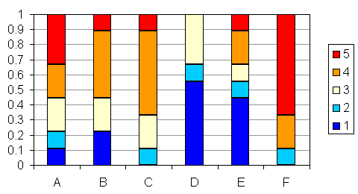
Survey
Results -- Students

Slide 21
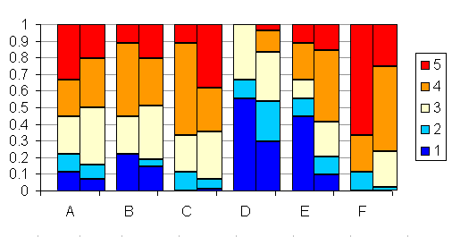
Survey
Results -- Students/Faculty
Students
Faculty

Slide 22
Future work…
Create a web-based interface so that students can easily get samples of real data or simulated data
Instructors provide the file (Excel, say) and samples are obtained through the web
Automate a procedure for verification of results
Problems with groups need to be communicated across groups – very important for learning!
Notes:
Comment:
It is easy enough to take samples directly from Excel, put then students “see” the population and might comment on why we don’t use the entire population instead of the sample you have given them…

