Slide 1
Finding an Appropriate Balance Between Simulation-based and Traditional Methods in the Teaching of Statistical Inference
Christopher Malone (cmalone@winona.edu)
Tisha Hooks (thooks@winona.edu)
Winona State University

Slide 2
Background
1994
2012

Slide 3
Background
1994
2012
Graduate Teaching Position
“Welcome to teaching, here is the book, just cover the material”

Slide 4
Background
1994
1995
2012
First use of simulation
- Visual proof of CLT
- Justify the correctness of a standard error
- Understanding the robustness of the t-test

Slide 5
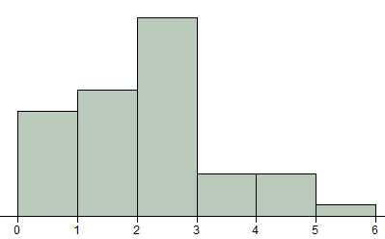
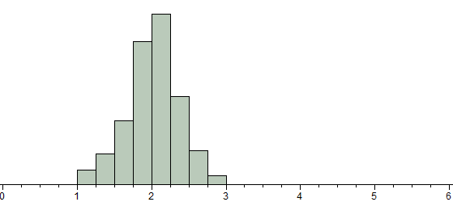
Background
1994
1995
2012

Slide 6
Background
1994
1998
2012
Purchased laptop for instruction
- Simulation became interactive
- Still doing Proof, Correctness, Robustness

Slide 7
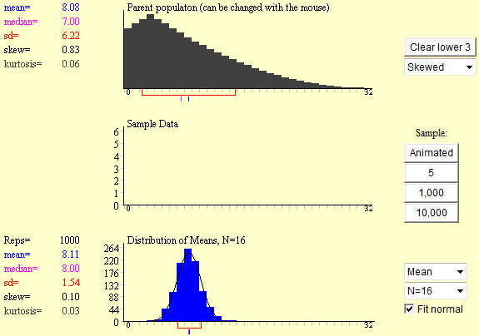
Background
1994
1998
2012

Slide 8
Background
1994
2002
2012
Started at Winona State University
- Every student had a laptop

Slide 9
Background
1994
2002
2012
Started at Winona State University - Every student had a laptop
However,
- Need for simulation faded as I was no longer concerned about Proof, Correctness, Robustness

Slide 10
Background
1994
2005
2012
Moved to current ordering of topics - Single Categorical: One Group
- Single Categorical: Several Groups
- Two Categorical: Understanding Relationships

Slide 11
Background
1994
2005
2012
Moved to current ordering of topics - Single Categorical: One Group
- Single Categorical: Several Groups
- Two Categorical: Understanding Relationships - Single Numerical: (One Group) Paired
- Single Numerical: Two Groups
- Single Numerical: Several Groups - Two Numerical: Understanding Relationships

Slide 12
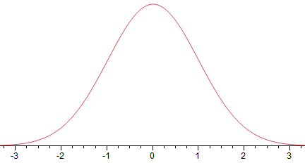
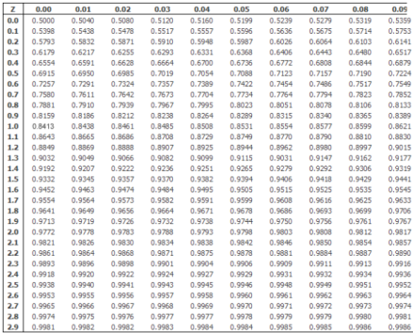
Background
1994
2005
2012
Moved to current ordering of topics - Single Categorical: One Group

Slide 13
Background
1994
2005
2012
Moved to current ordering of topics - Single Categorical: One Group
- Overly simplified requirements for inference
i) Obtain repeated (null) outcomes ii) Evaluate evidence

Slide 14
Background
1994
2010
2012
Introduction to Tinkerplots® 2.0

Slide 15
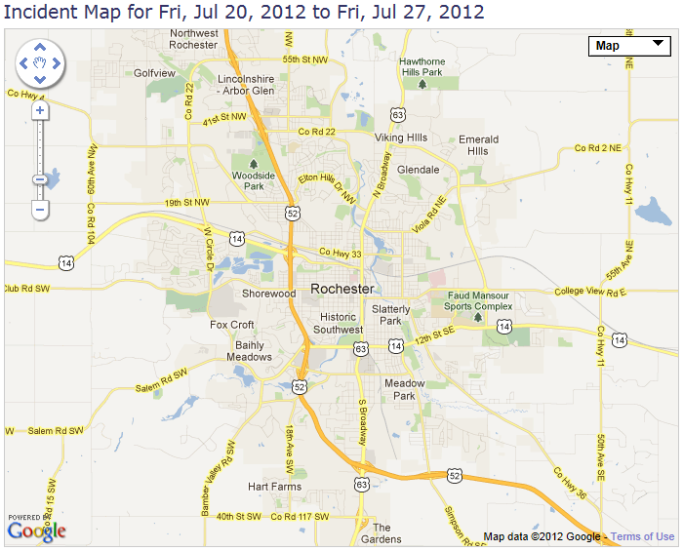
Examples
121 total
incidents

Slide 16
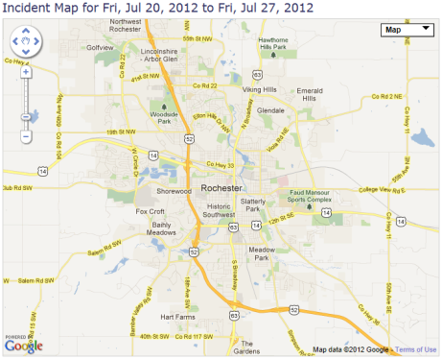
Examples
Does my precinct (Precinct #1) have more crime than it’s fair share?

Slide 17
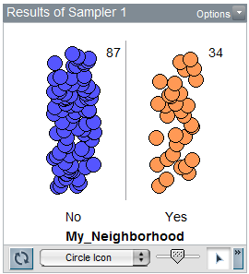
Examples
Fair share
#1
121
Not #1

Slide 18
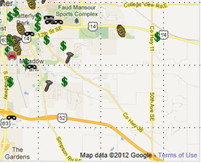
Examples
36 crimes
in Precinct #1
this week

Slide 19
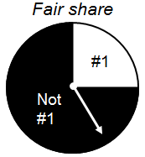
Examples
Methods of evaluating evidence
- Is 36 an outlier? [critical value]

Slide 20
Examples
Methods of evaluating evidence
- Is 36 an outlier? [critical value]
- How likely is it to see 36 or more crimes? [p-value]

Slide 21
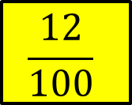
Examples
Methods of evaluating evidence
- Is 36 an outlier? [critical value]
- How likely is it to see 36 or more crimes? [p-value]
$$\frac{12}{100}$$

Slide 22
Examples
Methods of evaluating evidence
- Is 36 an outlier? [critical value]
- How likely is it to see 36 or more crimes? [p-value]
Or is it $\frac{4}{100}$ ?

Slide 23
Examples
Methods of evaluating evidence
- Is 36 an outlier? [critical value]
- How likely is it to see 36 or more crimes? [p-value]
Or is it 13.8%?

Slide 24
Examples
Methods of evaluating evidence
- Is 36 an outlier? [critical value]
- How likely is it to see 36 or more crimes? [p-value]
It is 13.6%.
via binomial exact test

Slide 25
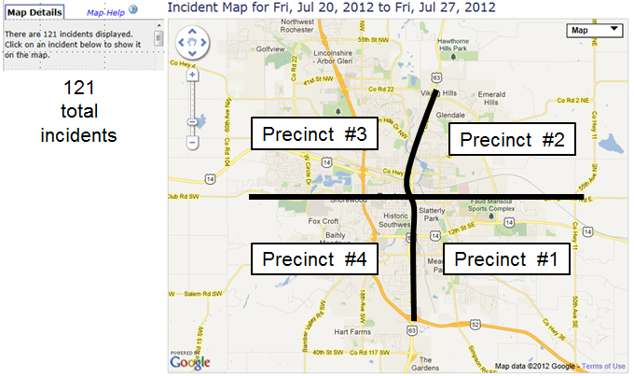
Examples
Slightly Modified Question: Are crimes equally dispersed?
#4
#1
#3
#2

Slide 26
Examples
Slightly Modified Question: Are crimes equally dispersed?
#4
#1
#3
#2
Note: This modification results in a major change in the methodological approach to the analysis

Slide 27
Examples
Precinct
Is ____ an outlier?
#1
36
#2
24
#3
39
#4
22

Slide 28
Examples
Precinct
Is ____ an outlier?
#1
36
#2
24
#3
39
#4
22

Slide 29
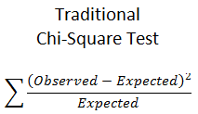
Examples
Precinct
Is ____ an outlier?
#1
36
#2
24
#3
39
#4
22

Slide 30
Balance
Categorical
Numerical
1 Group
Several
Groups
Two Variables
1 Group
Several
Groups
Two Variables
Time

Slide 31
Balance
Categorical
Numerical
Simulation-based
1 Group
Several
Groups
Two Variables
1 Group
Several
Groups
Two Variables
Traditional
Methods
Time

Slide 32
Balance
Categorical
Numerical
Simulation-based
1 Group
Several
Groups
Two Variables
1 Group
Several
Groups
Two Variables
Traditional
Methods
Time

Slide 33
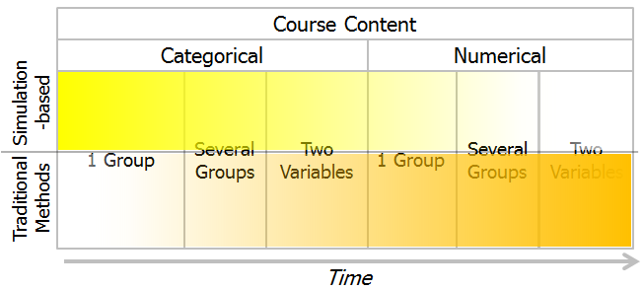
Balance
Simulation-based methods are used to - Get to inference early and often

Slide 34
Balance
Simulation-based methods are used to - Get to inference early and often
- Develop core concepts of statistical inference
Testing: Logic of inference (null model) Random variation over repeated samples
Evaluate evidence (p-value)
CI: Likely outcomes over repeated samples (MOE)

Slide 35
Balance
Simulation-based methods are reduced over time
- Added value of their conceptual understanding is reduced
- Students seek out the short-cut method
- Not enough time to cover all the material
- Need to serve the client disciplines

Slide 36
Balance
Simulation-based methods are not
- The only approach presented

Slide 37
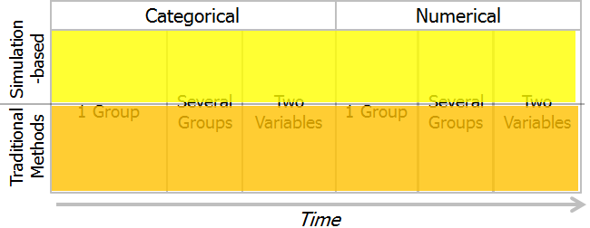
Balance
Simulation-based methods are not
- The only approach presented
- Treated as alternatives to traditional methods

Slide 38
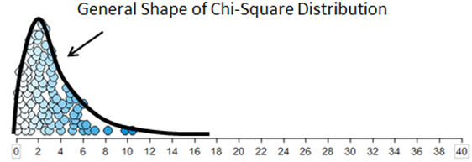
Balance
Simulation-based methods are not
- The only approach presented
- Treated as alternatives to traditional methods
- Used to verify the distributional properties of a statistic (evolved since 1995)

Slide 39
Balance
Categorical
Numerical
Simulation-based
1 Group
Several
Groups
Two Variables
1 Group
Several
Groups
Two Variables
Traditional
Methods
Time
Finding an appropriate balance between simulation-based and traditional methods is the most important unresolved issue regarding the teaching of statistical inference.

Slide 40
Discussions
Thank You!
Questions & ≈Answers
Christopher Malone (cmalone@winona.edu)
Tisha Hooks (thooks@winona.edu)
Winona State University

