Slide 1
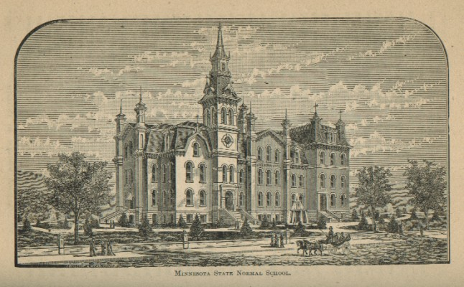
The Complete Statistician: Modernizing the Undergraduate Curriculum
Chris Malone
Winona State Teachers’ College
Winona, Minn. 55987

Slide 2
The Complete Statistician: Modernizing the Undergraduate Curriculum
Chris Malone
cmalone@winona.edu

Slide 3
Intro
The Complete Statistician: Modernizing the Undergraduate Curriculum
Changing the font is woefully insufficient, i.e. need much more than cosmetic changes
Chris Malone
cmalone@winona.edu

Slide 4
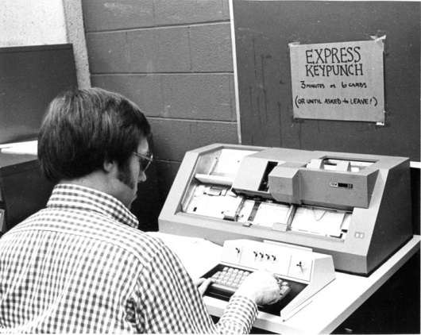
Intro
Updating Computing

Slide 5
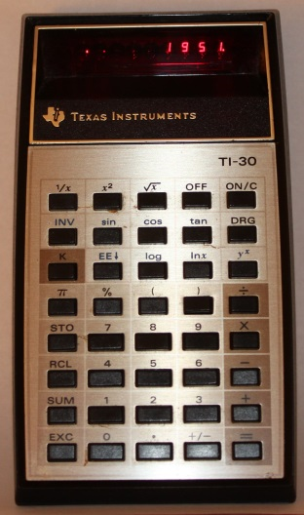
Intro
Updating Computing

Slide 6
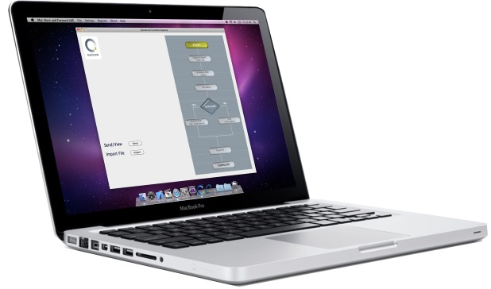
Intro
Updating Computing

Slide 7
Intro
Updating Computing
Updating computing far exceeds “cutting out the calculations” or
teaching computing in “a class”

Slide 8
Obstacles
Blog / Listserv: High school teacher was requesting information regarding undergraduate statistics programs

Slide 9
Obstacles
Blog / Listserv: High school teacher was requesting information regarding undergraduate statistics programs
A response from a colleague who will remain nameless:
“I think most statisticians would suggest getting an undergraduate degree in math or some other quantitative field. … An undergraduate degree in statistics is not really optimal for graduate study in stat at most institutions. “

Slide 10
Obstacles
Blog / Listserv: High school teacher was requesting information regarding undergraduate statistics programs
A response from a colleague who will remain nameless:
“I think most statisticians would suggest getting an undergraduate degree in math or some other quantitative field. … An undergraduate degree in statistics is not really optimal for graduate study in stat at most institutions. “
Saayyyy whaaaat?

Slide 11
Obstacles
Blog / Listserv: High school teacher was requesting information regarding undergraduate statistics programs
A response from a colleague who will remain nameless:
“I think most statisticians would suggest getting an undergraduate degree in math or some other quantitative field. … An undergraduate degree in statistics is not really optimal for graduate study in stat at most institutions. “
Saayyyy whaaaat?
Do other disciplines that use math say this?

Slide 12
Obstacles
Mini-me
concept

Slide 13
Obstacles
Mini-me
concept
Audience
Undergraduate vs. Graduate Enrollments, 5:1 ratio

Slide 14
Obstacles
Mini-me
concept
Audience
Undergraduate vs. Graduate Enrollments, 5:1 ratio

Slide 15
What about degrees in other fields?
Degrees
Bachelors
Masters
PhD

Slide 16
What about degrees in other fields?
Degrees
Bachelors
Masters
PhD

Slide 17
What about degrees in other fields?
Degrees
Bachelors
Masters
PhD

Slide 18
What about degrees in other fields?
Degrees
Bachelors
Masters
PhD

Slide 19
What about degrees in other fields?
Degrees
Bachelors
Masters
PhD
McKinsey Report estimates a shortage of
140,00 – 190,000 people with deep analytical skills

Slide 20
What about degrees in other fields?
Degrees
Bachelors
Masters
PhD
McKinsey Report estimates a shortage of
140,00 – 190,000 people with deep analytical skills

Slide 21
What about degrees in other fields?
Degrees
Bachelors
Masters
PhD
McKinsey Report estimates a shortage of
140,00 – 190,000 people with deep analytical skills

Slide 22
What about degrees in other fields?
Degrees
Bachelors
Masters
PhD
McKinsey Report estimates a shortage of
140,00 – 190,000 people with deep analytical skills

Slide 23
Existing
Math (20)
Core (21)
Electives (12)
Computing (3)
Linear Algebra
Stat I and II
Study Design
Data Management
Calculus I
Modeling I and II
Consulting
Calculus II
Probability
Modern Methods
Calculus III
Math/Stat I and II
Multivariate
Proof
Capstone
Biostatistics
etc.

Slide 24
Existing
Math (20)
Core (21)
Electives (12)
Computing (3)
Linear Algebra
Stat I and II
Study Design
Data Management
Calculus I
Modeling I and II
Consulting
Calculus II
Probability
Modern Methods
Calculus III
Math/Stat I and II
Multivariate
Proof
Capstone
Biostatistics
etc.

Slide 25
> Study #1: Spring 2011 – Summer 2012
> Survey and personal interviews
> Interviewed over 19 representatives with varying backgrounds from healthcare, manufacturing, retail, and product distribution sectors of industry.
> Survey of individuals (n ≈ 35) from academia and industry ranked a total of 10 program level outcomes separately for employment (E) and graduate school (G)
Study #1

Slide 26
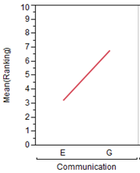
Technical and non-technical communication
Statistical methodology in an application
Less Important
Study #1
More Important
Outcomes preferred for employment

Slide 27
Technical and non-technical communication
Statistical methodology in an application
Understanding of probability and statistical inference.
Less Important
Study #1
More Important
Outcomes preferred for employment
Outcome preferred for grad schools

Slide 28
> Study #2: Fall 2012 – Summer 2013
> Thorough review of n=131 data science/analytics job postings.
> Required skills were summarized into three main themes
- Content knowledge
- Computing skills
- Professional skills
Study #2

Slide 29
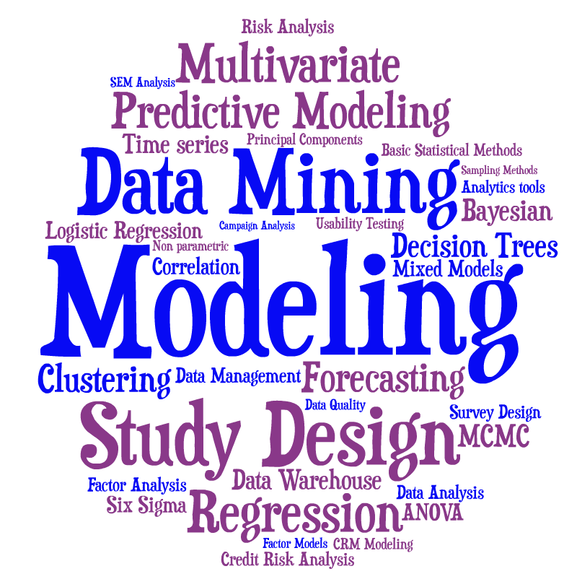
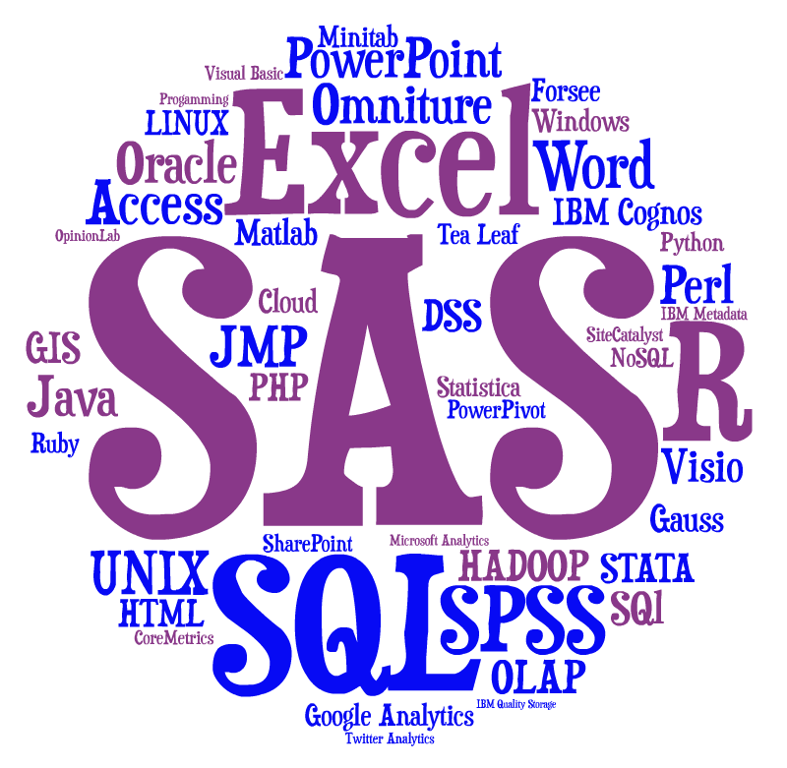
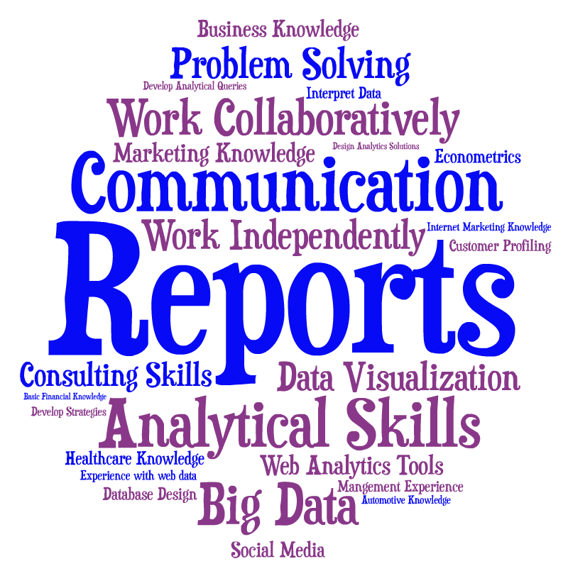
Study #2

Slide 30
> Study #2, con’t > Review of existing data science programs (n=114) - 6 programs offer some level of training for undergraduates - None of these 6 were rooted in statistics - Required number of statistics courses ranged from 1 - 4
Study #2

Slide 31
> Study #2, con’t > Review of existing data science programs (n=114) - 6 programs offer some level of training for undergraduates - None of these 6 were rooted in statistics - Required number of statistics courses ranged from 1 - 4
Study #2

Slide 32
Computer
Science
Statistics
Study #2

Slide 33
Computer
Science
Statistics
Study #2
Statistics
Computer
Science

Slide 34
Data Science
Math (20)
Core (21)
Electives (12)
Computing (3)
Linear Algebra
Stat I and II
Study Design
Data Management
Calculus I
Modeling I and II
Consulting
Calculus II
Probability
Modern Methods
Calculus III
Math/Stat I and II
Multivariate
Proof
Capstone
Biostatistics
etc.

Slide 35
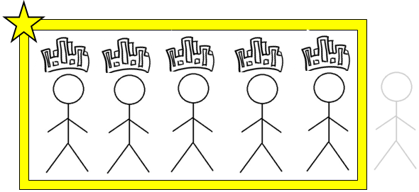
Data Science
Math (20)
Core (21)
Electives (12)
Computing (3)
Linear Algebra
Stat I and II
Study Design
Data Management
Calculus I
Modeling I and II
Consulting
Calculus II
Probability
Modern Methods
Calculus III
Math/Stat I and II
Multivariate
Proof
Capstone
Biostatistics
etc.

Slide 36
Data Science
Math (20)
Core (21)
Electives (12)
Computing (3)
Linear Algebra
Stat I and II
Study Design
Data Management
Calculus I
Modeling I and II
Consulting
Calculus II
Probability
Modern Methods
Calculus III
Multivariate
Proof
Capstone
Biostatistics
etc.

Slide 37
Data Science
Math (20)
Core (21)
Electives (12)
Computing (3)
Linear Algebra
Stat I and II
Study Design
Data Management
Calculus I
Modeling I and II
Consulting
Calculus II
Modern Methods
Calculus III
Multivariate
Proof
Capstone
Biostatistics
etc.

Slide 38
Data Science
Math (20)
Core (21)
Electives (12)
Computing (3)
Linear Algebra
Stat I and II
Study Design
Data Management
Calculus I
Modeling I and II
Consulting
Calculus II
Modern Methods
Calculus III
Multivariate
Capstone
Biostatistics
etc.

Slide 39
Data Science
Math (20)
Core (21)
Electives (12)
Computing (3)
Linear Algebra
Stat I and II
Study Design
Data Management
Modeling I and II
Consulting
Modern Methods
Multivariate
Capstone
Biostatistics
etc.

Slide 40
Data Science
Math (6)
Core (15)
Professional (9)
Computing (12)
Linear Algebra
Stat I and II
Research Prep
Algorithms I and II
Applied Calculus
Modeling I and II
Consulting
Data Visualization
Modern Methods
Capstone / Internship
Data Management
Interdisciplinary Component (12)
Business
Computer Science
Healthcare
Statistics

Slide 41
> We must value the undergraduate degree > The potential to “increase the pipeline” is tremendous; however, history suggests our existing curriculum may in fact hinder our ability to accomplish this goal. e.g. Read the 1950 ASA Presidential Address by Wilks or 1983 paper by Minton
Final Thoughts

Slide 42
> We must value the undergraduate degree > The potential to “increase the pipeline” is tremendous; however, history suggests our existing curriculum may in fact hinder our ability to accomplish this goal. e.g. Read the 1950 ASA Presidential Address by Wilks or 1983 paper by Minton
> Undergraduate curriculum should serve the masses, not the select few who decide to pursue graduate school
> Admission requirements for graduate programs may need to be more flexible e.g. first criteria often considered is their grade in the math/stat course
Final Thoughts

Slide 43
"Those who say it cannot be done, should not get in the way of those who are doing it." William Wallace
Thank You!
Final Thoughts
P. S. Winona State is hiring for August 2014. Help pass the word around – or better yet apply.

