Slide 1
Internship at Trane

Slide 2
Contents of the Internship
Converted existing analytics into R functions usable across multiple datasets
Partnered with cross functional teams to assess analytic needs
Worked with IT Architect team to assemble best in class analytic solution addressing real-time Big Data issues
30,000 properties, 15 min intervals, 300 telemetry
Acted as Data Scientist analyzing time series HVAC equipment Telemetry Data
Trained appropriate subject matter experts in use of R

Slide 4
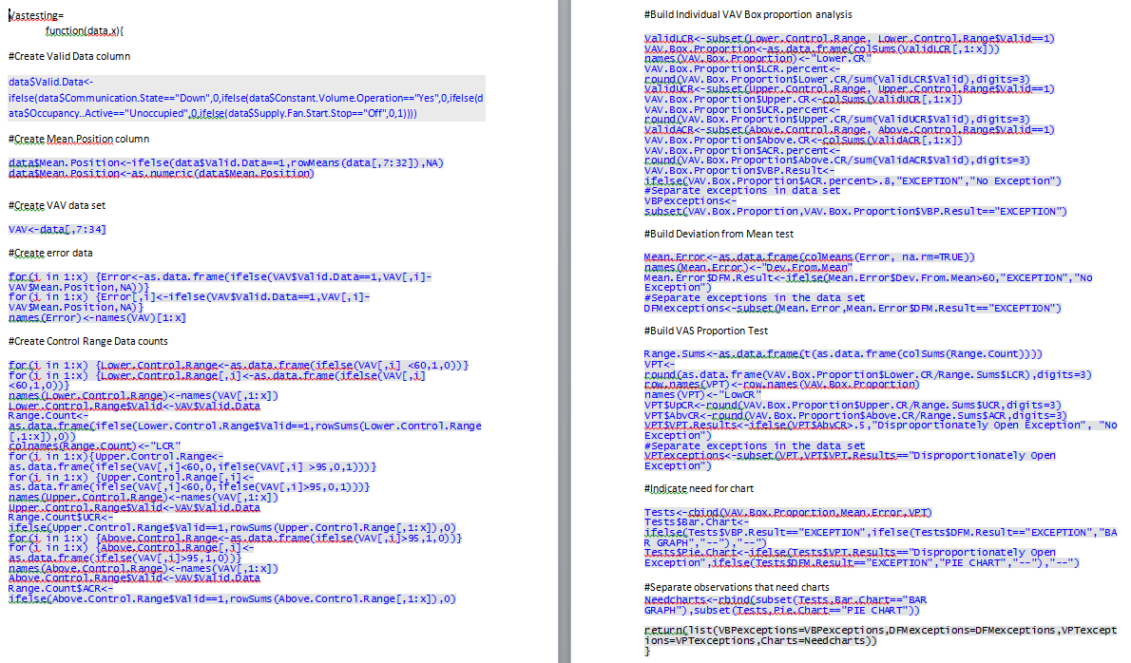

Slide 5
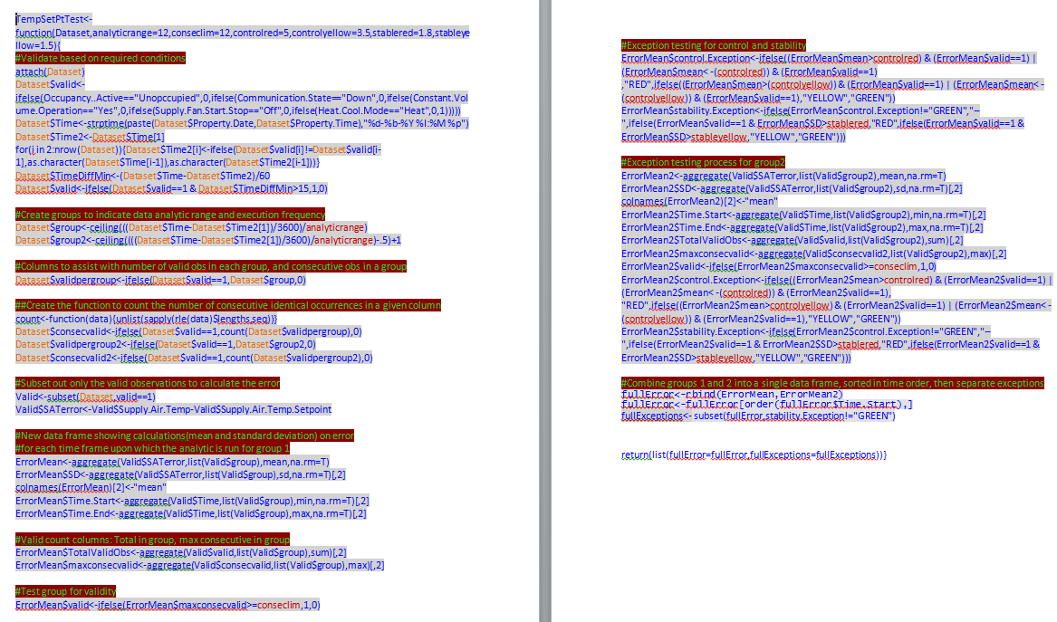

Slide 7
What I Learned
Good Meeting Habits
Take notes, lots of them
Level-setting
Establish how things are being understood by all involved at the beginning of a meeting or presentation
Time Management
There isn’t a predetermined “correct” answer

