Slide 1
Infinite sums
By Tim Ambrose

Slide 2
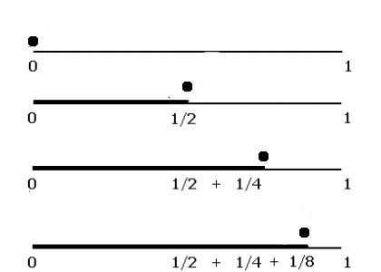
Zeno’s Paradox

Slide 3
What if each term was smaller than the last?

Slide 4
Harmonic series

Slide 5
Harmonic series

Slide 6
Harmonic series

Slide 7
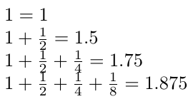
Zeno’s Paradox Revisited

Slide 8
Zeno’s Paradox Revisited

Slide 9
Zeno’s Paradox Revisited

Slide 10
Conclusion

