Slide 1
Fantasy Football
By: Carson Barnette

Slide 2
Fantasy Football
Fantasy football is a game based on the performance of NFL players
How do you play?
What does this have to do with stats?

Slide 3
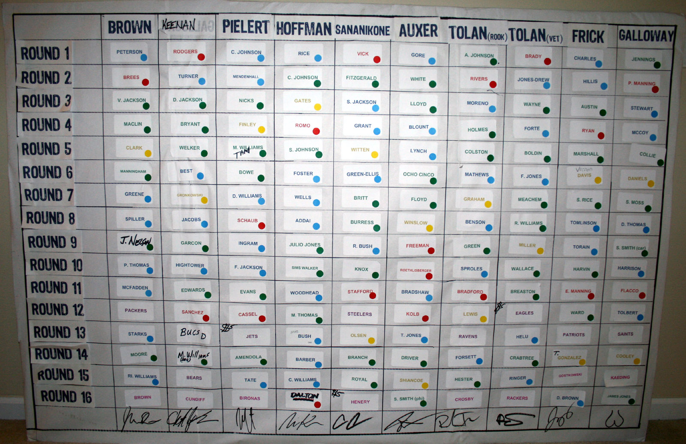
The Setup
Usually Fantasy Football leagues
consist of 8-16 people. Each person
drafts individual offensive players
and one defensive/special teams unit.
Scoring is then based on how well the player does. On the offensive side
yards and touchdowns correspond to points for your team. On the defensive
side fumble recoveries and interceptions add up to points and defensive
touchdowns score big in fantasy football.

Slide 4
How does it mix with stats?
Data was collected from espn.com
It is data for the last two years for each skill position player
The data will then be analyzed with R and JMP to find trends
Hopefully we find a statistical way to draft a fantasy football team that can win

