Slide 1
Brachistochrone
Joshua Blaskowski

Slide 2
Greek Words
Brachistos - The Shortest.
Chronos -Time, delay.

Slide 3
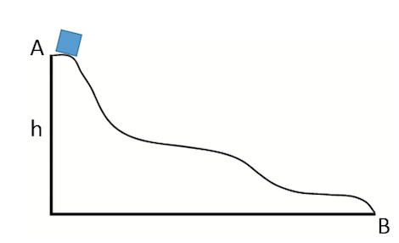
Brachistochrone
The problem is to find the curve that gives the shortest amount of time for a block of ice to slide from point A to point B

Slide 4
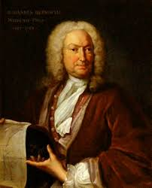
Johan Bernouli
Proposed the problem in June 1696
Newton, Jacob Bernoulli, Leibniz and L'Hôpital
Galilieo in 1638

Slide 5
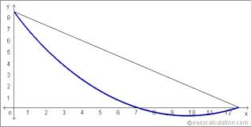
Johann Bernoulli
The problem he posed was the following:-
“Given two points A and B in a vertical plane, what is the curve traced out by a point acted on only by gravity, which starts at A and reaches B in the shortest time.”

Slide 6
Some of the solutions
Newton: Had received the problem at 4 p.m. and worked on it until he finished it 4 a.m. the next morning only taking 12 hours to solve the problem
Jakob Bernoulli: in attempt to outdo his brother he created a harder version of the problem which then became later known as the calculus of variations

Slide 7
Solution
Bernoulli showed that the solution to be one cycle of an upside down cycloid.
They found the slope of the curve by using calculus and optimal control.
Optimal Control: A mathematical optimization method for dealing with dynamical systems(I.e. a swinging pendulum, water flowing in a pipe, a ball rolling down a curb.)

Slide 8
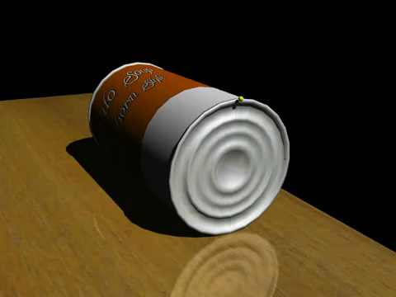
Upside down Cycloid

Slide 9
One segment of a cycloid

Slide 10
Work Cited
The Brachistochrone. Paul Kunkelhttp://whistleralley.com/brachistochrone/brachistochrone.htm
The Roller Coaster or Brachistochrone problem. Eric Hiobhttps://www.google.com/search?client=safari&rls=en&q=http://commons.bcit.ca/math/entertainment/coaster/index.html&ie=UTF-8&oe=UTF-8

