Slide 1
Effects of Competition on Aggression
Steven Christiansen

Slide 2
Introduction
Competition is a large part of everyday life
How does competition affect us?
Many studies have shown that competition leads to aggressive behavior
Why?

Slide 3
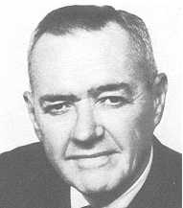
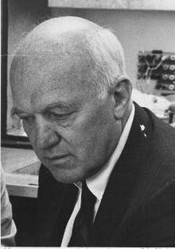
Previous Theory
Frustration-Aggression Hypothesis
John Dollard, Neil Miller (1939)
Frustration—something that keeps people away from their goals
Frustrations cause aggression
Competition is a frustration

Slide 4
Theory
Counterempathy
John Lanzetta, Basil Englis (1989)
Studied people playing games and found that players developed counterempathic emotions towards each other
i.e. players felt good when winning and bad when losing
Both theories help explain how competition can lead to aggressive behavior

Slide 5
Hypothesis
People who play a game competitively will behave more aggressively than people who do not
The outcomes of the game will affect behavior as well

