Slide 1
Pathways
Jacob koza

Slide 2
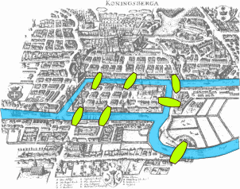
Graph theory
Adv. Calc. project
Trials and tribulations
Learning process

Slide 3
College Paths
Applying graph theory
Mathematica Coding
Shortest path

Slide 4
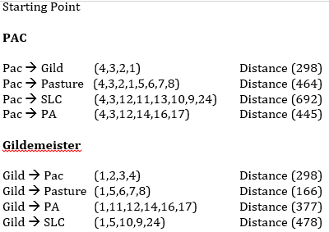
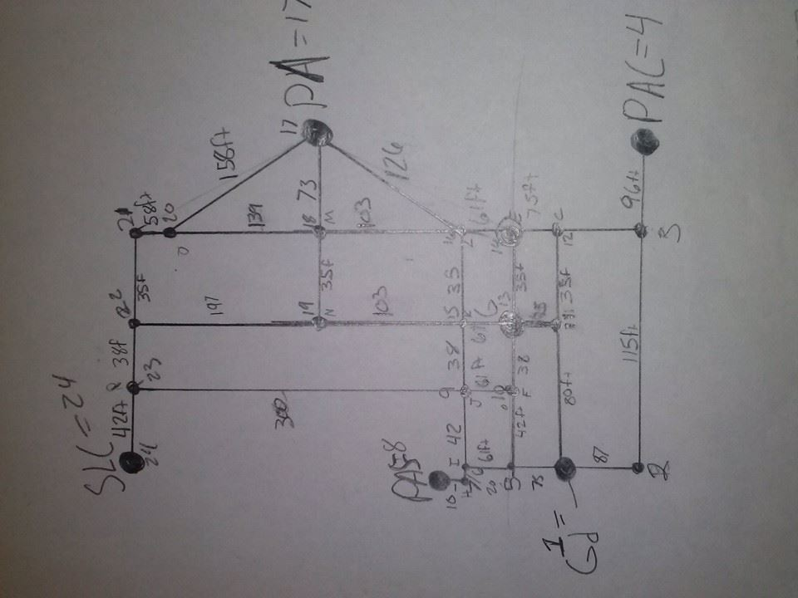
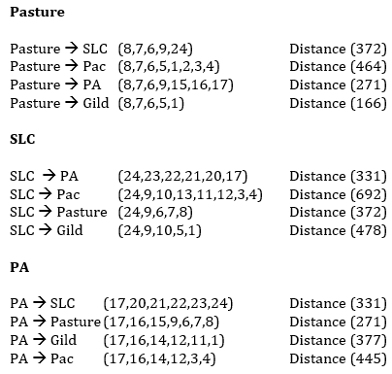
Data
Notice paths 18 and 19 are not used

Slide 5
Conclusion
Pathways
Possible applet

