Slide 1
Data Analysis
ENDURA® High-Performance Corrosion-Resistant 57-Inch Tunnel Fan
Raphael Mwangi.

Slide 2
Introduction
This data analysis involves collecting and analyzing data from CPI Binani Inc.
The program is called the Chore-Time shroud which the above named company molds thermoplastic fan shrouds for poultry farms.
The shrouds are molded and must pass certain specifications before they are sent out to be sold.
I will explain how we collect data and analyze the data to get the optimal specifications for a perfect shroud.

Slide 3
Visualization:
The picture on the left shows the final product already installed in a poultry farm.
My job is to make sure that the shrouds pass the specifications and hence get the go ahead to be installed in this farming industry.
The data is usually collected in the molding company, which in this case it is the CPI Binani Inc.
CPI Binani Inc. is located in Winona and has a potential of opening more branches across the country.

Slide 4
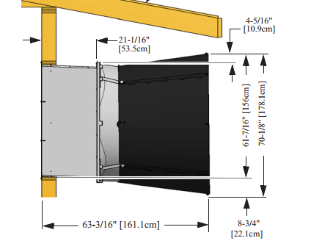
Specifications:
There are four critical specifications that the shroud must pass namely;
  The 6inch measurement
  The 2inch measurement
  The door gap
  The magnet strength

Slide 5
The 6 Inch Measurement
The 6 inch measurement is the measurement of the top part of the shroud.
This measurement is done to prevent the fan from hitting the shroud when it is rotation and at the same time be efficient.
The 6 inch measurement is supposed to be between 0mm and .200mm
If the measurements go out of this specifications, the shroud is scrapped.

Slide 6
The 2 Inch Specifications:
The 2 inch measurement is the measurement of the bottom part of the shroud.
This measurement is done to prevent the fan from hitting the shroud when it is rotation and at the same time be efficient.
The 2 inch measurement is supposed to be below 0mm
If the measurements go out of this specifications, the shroud is scrapped.

Slide 7
The Door Gap:
This measures the door gap between the shroud.
The less the gap the more desirable the shroud.
The reason for a small door gap is to prevent a lot of light from shinning into the poultry farm.

Slide 8
The magnet Strength:
This measures the amount of power it takes for the shroud doors to open when the fan is turned on.
The minimum strength is 5lbs for the magnets that hold the door from wind.

Slide 9
Conclusion
Once the specifications fall in place the shrouds are then shipped the customer.
Using my data analysis and a successful one for this matter, the company is able to hard lock their machines to make the best shrouds to send to their customers.

