Slide 1
PivotTables in Excel
Jananie Selvaratnam

Slide 2
What is PivotTable?
PivotTable is a data summarization tool found in data visualization program such as spreadsheets.
e.g. Microsoft Excel

Slide 3
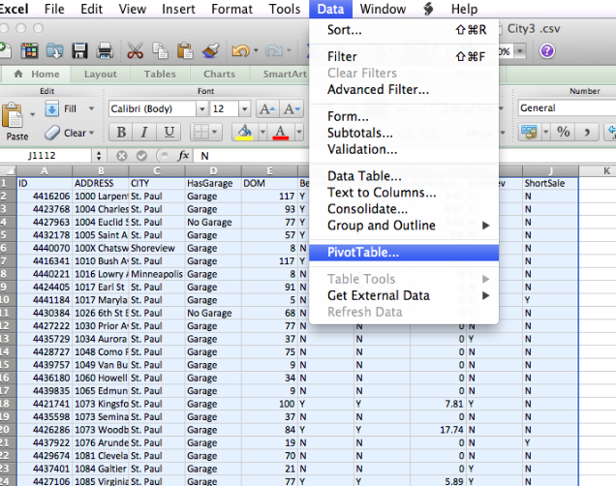
Getting started with PivotTable
PC : Highlight the data that you want to summarize → Select Insert → Select PivotTable or PivotChart.
Mac : Highlight the data that you want to summarize →Select Data → select “PivotTable”
Step 1

Slide 4
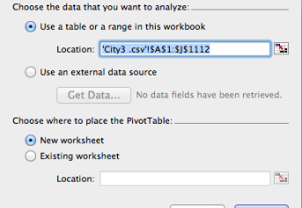
Step 2: In the Create PivotTable window, you want to specify the data that you want to analyze.
Select the data that you want to analyze
Select your worksheet where you want to place the PivotTable.

Slide 5
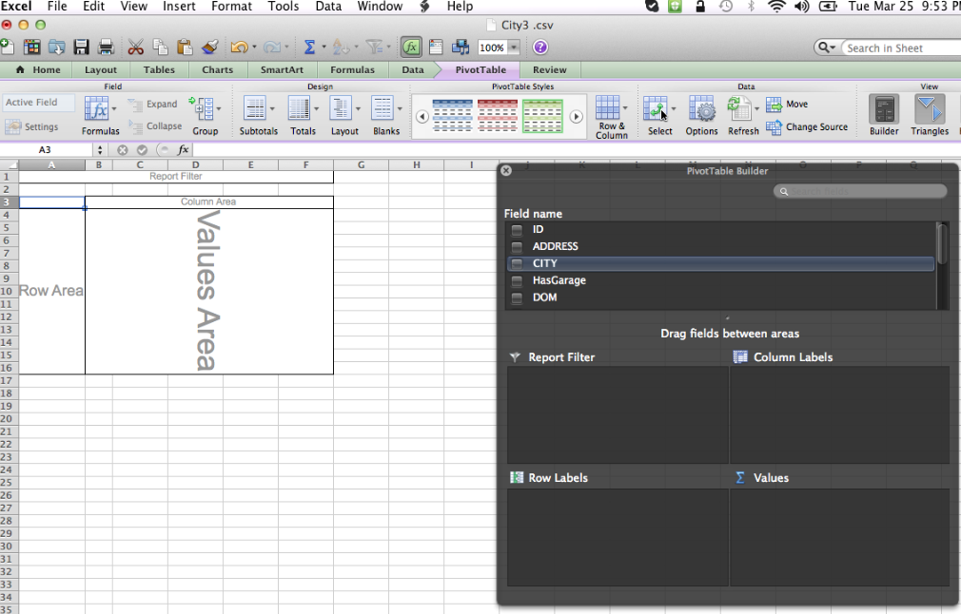
Step 3: shows the output area for the table
Create your table
Field Name

Slide 6
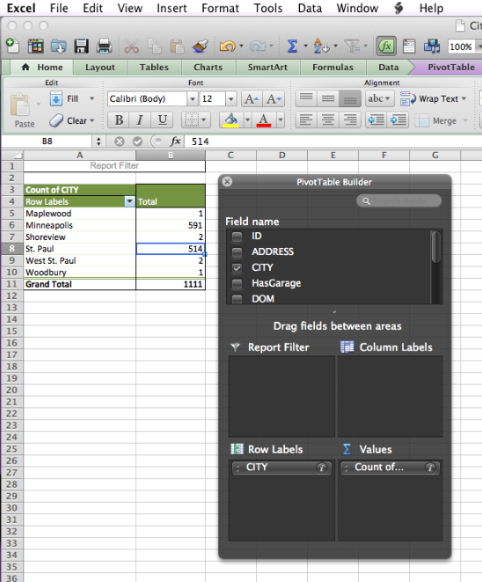
Step 4: to create table and chart, select your first variable of interest in the “Row Labels ” box.
Suppose if you are interested in variable “ CITY”, first place the CITY in “Row Labels” box . Next you must tell what you want to do with variable “CITY”.
Dragging the variable “CITY” into the Value box will create a count of “CITY”.
Row Labels
Values

Slide 7
END

