Slide 1
NHL Realignment and How it Impacts Minnesota
Dylan Abts

Slide 2
Minnesota’s Division (2000-2012)
Calgary
Colorado
Edmonton
Minnesota
Vancouver

Slide 3
Divisional Map (2012)

Slide 4
Realigned Divisional Map

Slide 5
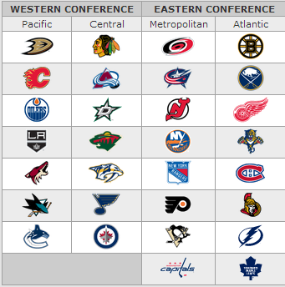
Realigned Divisions
Chicago
Colorado
Dallas
Minnesota
Nashville
St. Louis
Winnipeg

Slide 6
Minnesota’s Division 1967-1974

Slide 7
Minnesota’s Division 1974-93

Slide 8
The Future’s Past
Ideal for Rivalries
New and Old
Helps with Travel
Strong Competition

