Slide 1
Lengthening and Gripping Golf Clubs
By: Carson Barnette

Slide 2
Golf Season has Arrived
Notes:
With the masters last weekend and minus the snow today it is time to gear up for the start of golf season. But youre like me normal golf clubs are too short so I have to have them extended and then regripped.

Slide 3
Remove the old grip
Notes:
First we cutoff the grip that is currently on the club and scrape off all the tape underneath the grip. Next we measure out how much we need to lengthen the clubs by and cut the extender piece to that length

Slide 4
An extender piece
Notes:
This is an extender piece. Since my clubs are being extended an inch and a half this one piece will work for two club extensions. Measure and cut the extender piece and glue it into the end of the club.

Slide 5
Apply new piece of tape

Slide 6
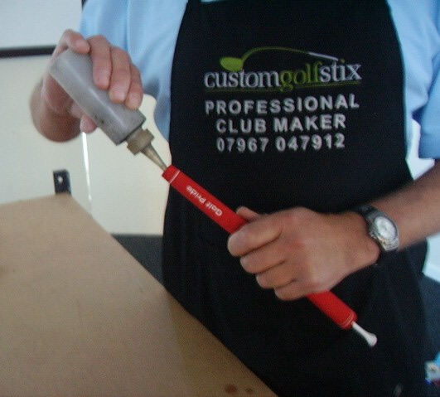
Re-gripping the extended club

Slide 7
Slide the new grip onto the club

Slide 8
Finished Product
Notes:
Beautiful rocketbladez tour edition with 1.5 inch extensions

