Slide 1
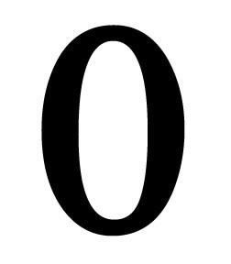
Zero
Joshua Blaskowski

Slide 2
The word zero
Arabic Safira “it was empty”
Sifr “zero” = “nothing”

Slide 3
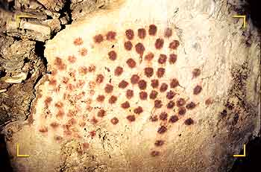
The beginning
The Prehistoric man counted
Seasons, members of tribe, dear killed
No need to count zero deer

Slide 4
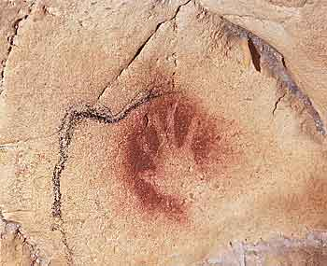
Base counting system
Base five counting system often used because of five fingers
Likely the reason for todays base ten counting system

Slide 5
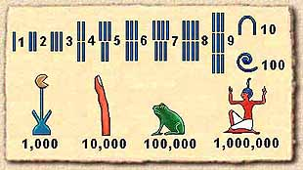
Symbols
Egyptians, Greeks, and Romans all used different symbols
Grouped together to form larger numbers
Zero was not necessary

Slide 6
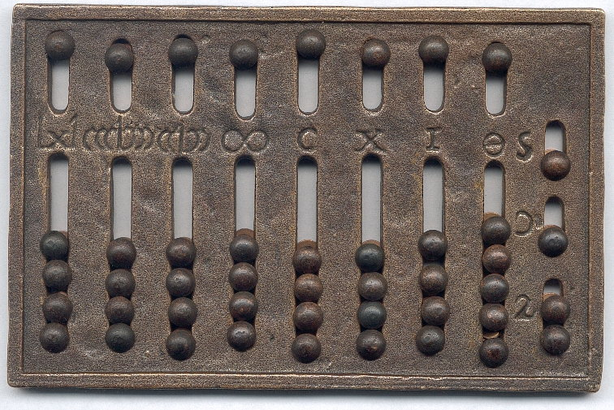
Babylonians
First to introduce a symbol for zero as placeholder
Base sixty
Abacus

Slide 7
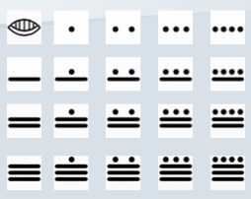
Ancient Mayans
First to give zero numerical value
Base twenty

Slide 8
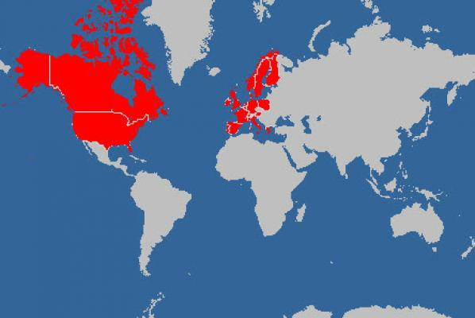
Western world
Last to accept concept of zero
Called Evil

Slide 9
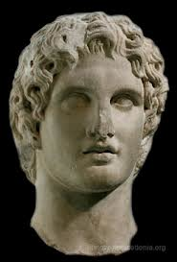
Alexander the Great
Base ten number system
Assigned zero as numerical value
The Negative Number
Current number system

Slide 10
Work cited
http://www.saxakali.com/historymam2.htm
http://www.mediatinker.com/blog/archives/008821.html
http://www.culture.gouv.fr/culture/arcnat/chauvet/en/
http://www.wga.hu/tours/sistina/index1.html

