Slide 1
By Meghan Burke

Slide 2
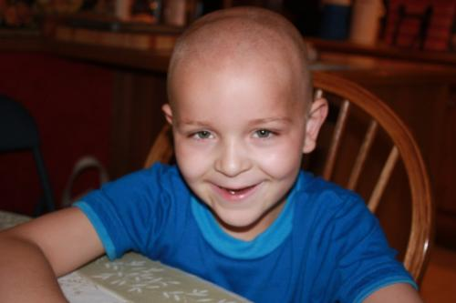
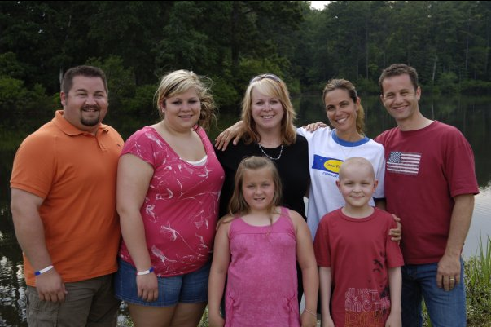
Jackson Schneider
Jackson and his family
Jackson Parker Schneider

Slide 3
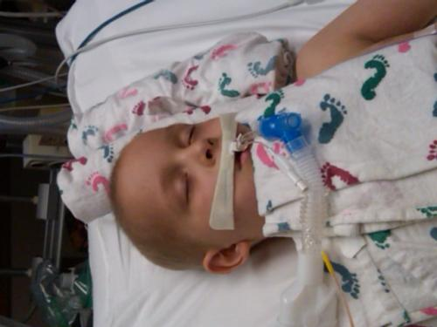
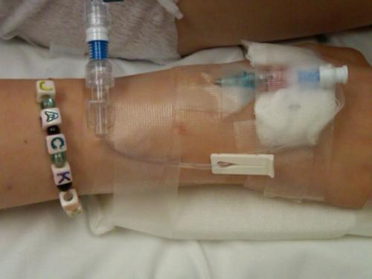
IV Neuroblastoma
Jackson in the hospital

Slide 4
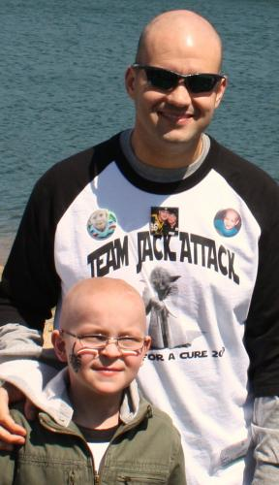
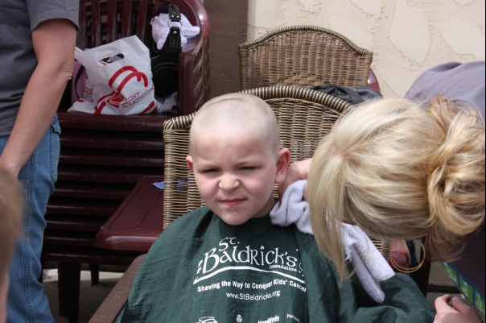
St. Baldrick’s
Jackson at a St. Baldrick’s
event in 2009

Slide 5
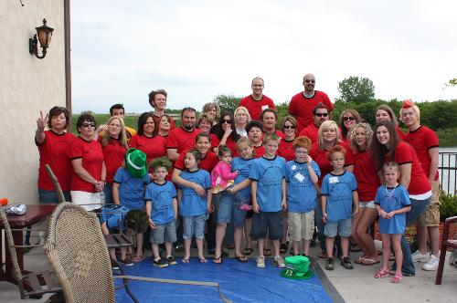
St. Baldrick’s
Team Jack Attack 2010

Slide 6
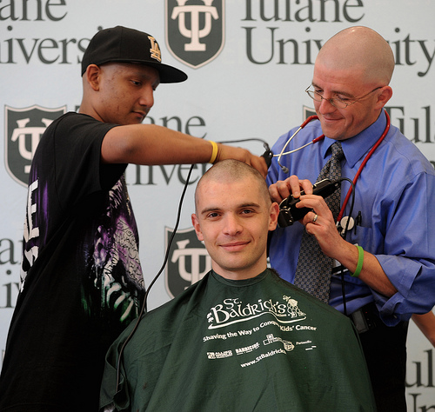
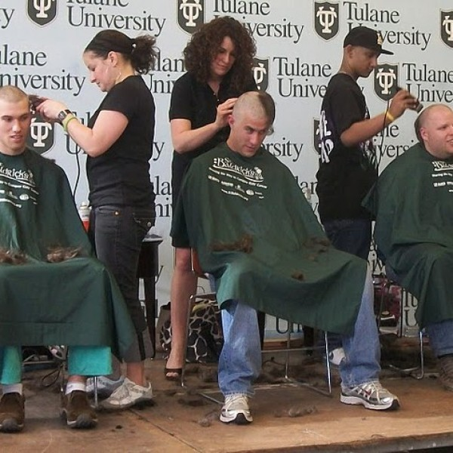
Tulane’s School of Medicine
Tulane Medical Students going bald at the St. Baldrick’s event.

Slide 7
Volunteer and/or Donate!
Ways to Volunteer:
Go to www.stbaldricks.org
Click “Get Involved” and scroll down to “Become a Volunteer”
Ways to Donate:
Go to www.stbaldricks.org
Click on “Make a Donation”
Or call (888) – 899 - BALD

Slide 8
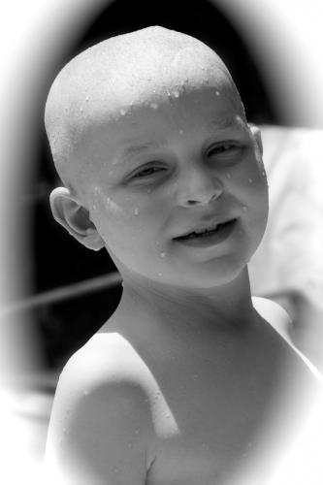
Jackson Schneider
November 6, 2000 – August 3, 2009

Slide 9
Make a Difference

Slide 10
References
http://blog.lib.umn.edu/admisfa/prospective/2011/02
http://www.stbaldricks.org/kids/
http://www.caringbridge.org/visit/jacksonschneider/photos
http://www.stbaldricks.org/teams/mypage/teamid/6819
Other photos provided by Jackson’s Family and Jay Olson

