Slide 1
Effects of Competition on Aggression: Experiment and Results
Steven Christiansen

Slide 2
Hypothesis
People who play a game competitively will behave more aggressively than people who do not
The outcomes of the game will affect behavior as well

Slide 3
Outline of Experiment
Have participants play games either competitively or non-competitively
Manipulate scores (so that winning, losing, and tying are due to random chance and not skill/other factors)
Measure Aggression

Slide 4
1st Game—Letters-to-Words

Slide 5
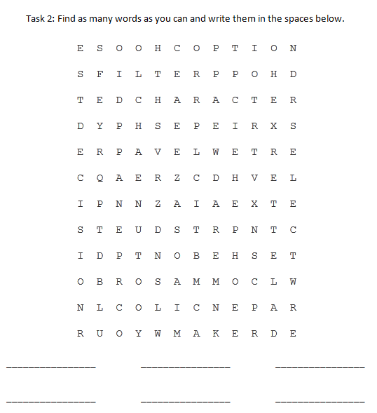
Second Game—Word Find

Slide 6
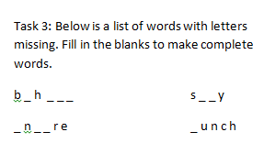
Third Game—Word Completion

Slide 7
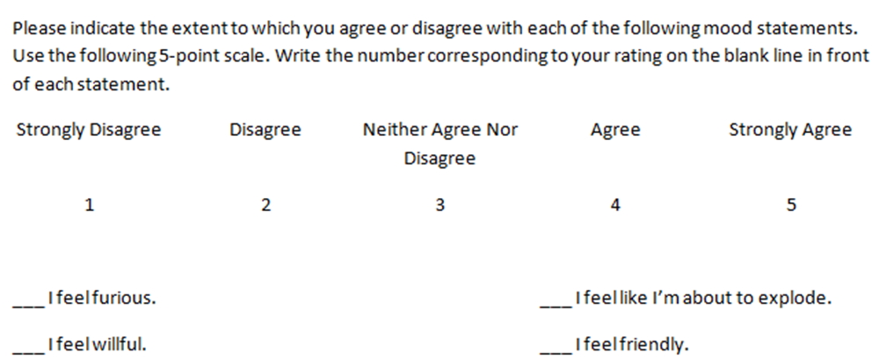
Measuring Aggression
Number of Aggressive words on Word Completion task / total words completed = Aggression Ratio Score
State Hostility Scale

Slide 8
Results
No significant differences between groups on Hostility Scale

Slide 9
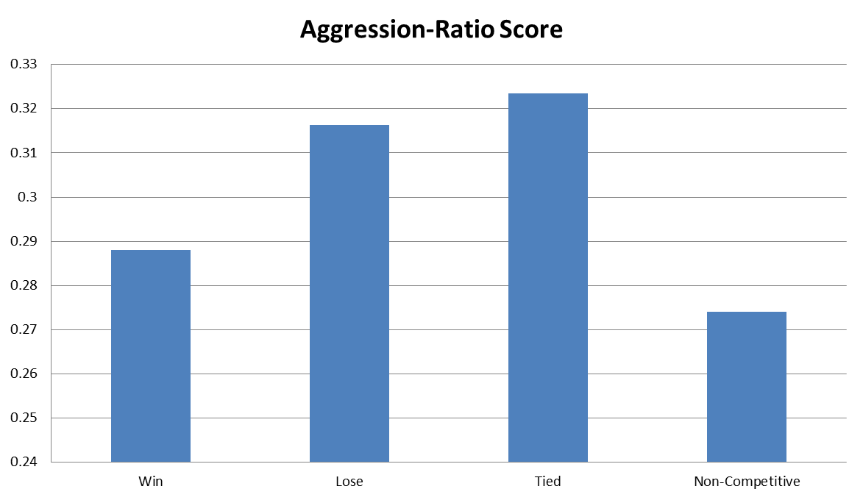
Results
Aggression Ratio Score—competitive conditions as a whole scored higher than the Non-Competitive condition, and Lose and Tied both scored higher than Win and Non-Competitive

Slide 10
Discussion
Competition was shown to increase aggression
However, participants did not believe that they were more aggressive after playing a game, despite what the Aggression-Ratio scores showed

