Slide 1
Topology
By: Jarek Esswein

Slide 2
Problem
Suppose that M is a 3-manifold without boundary. Show that the cartesian product M x [0,1] is a 4-manifold. Determine the boundary of M x [0,1].

Slide 3
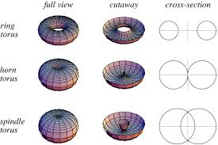
What is a manifold? What is a 4-manifold?
Possesses points with neighborhoods (an open space surrounding point) homeomorphic to R^4
Boundaries of 4-manifolds

Slide 4
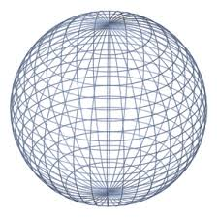
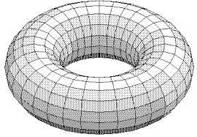
Cartesian Products
Much like Cartesian products in set theory
Every element or topological space is crossed with the other
Ex. The cartesian product of A circle (denoted S^(1)) with another circle would be a sphere

Slide 5
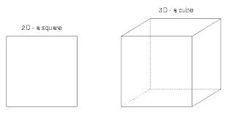
Computing Boundaries of Cartesian Products
Theorem δ(S x T)= δS x T U S x δT
δ denotes boundary
Much like the product rule of derivatives but with unions

Slide 6
Problem
δ(M^3 x [0,1])
=δM^3 x [0,1] U M^3 x δ[0,1]
=(empty set) x [0,1] U M^3 x ({0}U{1})
=M^3 U M^3

Slide 7
Conclusion
The Boundary of M^3 x [0,1]= M^3 U M^3
Since the boundary of the manifold is a 3-manifold this implies that the surface itself is a 4-manifold

