Slide 1
Predicting White Wine Quality Scores
Raphael Mwangi

Slide 2
Background
Tree-models are intuitive, easy to understand, and can be used as tools for more advanced algorithms to create highly accurate models
Tree-modeling requires practically no knowledge of statistics to understand

Slide 3
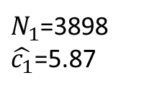
Basic Example
$N_{1}$=3898
$\hat{c_{1}}$=5.87
$$R_{1}$$
If Alcohol < 10.85
If Alcohol > 10.85
$N_{2}$=2465
$\hat{c_{2}}$=5.596
$$R_{2}$$
$N_{3}$=1433
$\hat{c_{3}}$=6.345
$$R_{3}$$
Terminology:
“Node” – denoted $R_{m}$ ,a circle in which observations are grouped into by a particular If Then statement
“$N_{m}$” = the number of observations in the $m^{th}$node “$R_{m}$”
$\hat{c_{m}}$= the average wine quality score of the N observations in the $m^{th}$node “$R_{m}$”.
$\hat{c_{m}}=ave(y_{i}|x_{i}∈R_{m})$

Slide 4
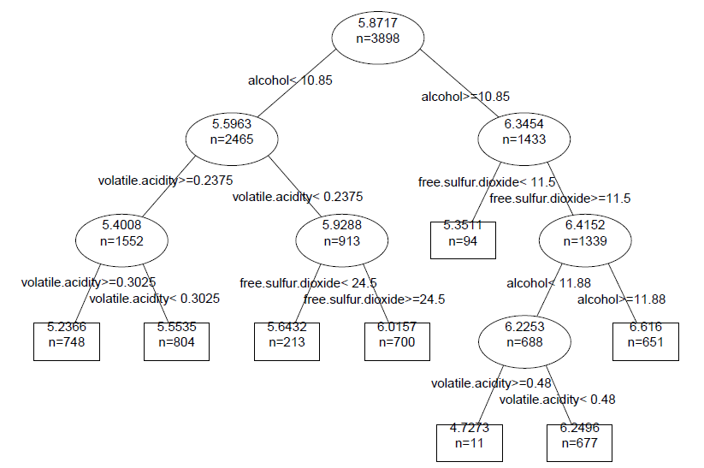
Actual Tree Model

Slide 5
Bagging
Bagging
Take a large number of samples, “B”, of size n from your dataset, with replacement (bootstrap samples)
Fit a tree model to each bootstrap sample.
When making predictions of y for specific values of x, average $\hat{y}$ from your “B” bootstrap samples for a more accurate prediction

Slide 6
Results of Single Tree Model vs. Bagged Tree Model
Each prediction we make will, on average, be:
0.77 points off from the true wine quality score for the Single Tree Model
0.75 points off from the true wine quality score for the Bagged Tree Model
Bagged model did slightly better

