Slide 1
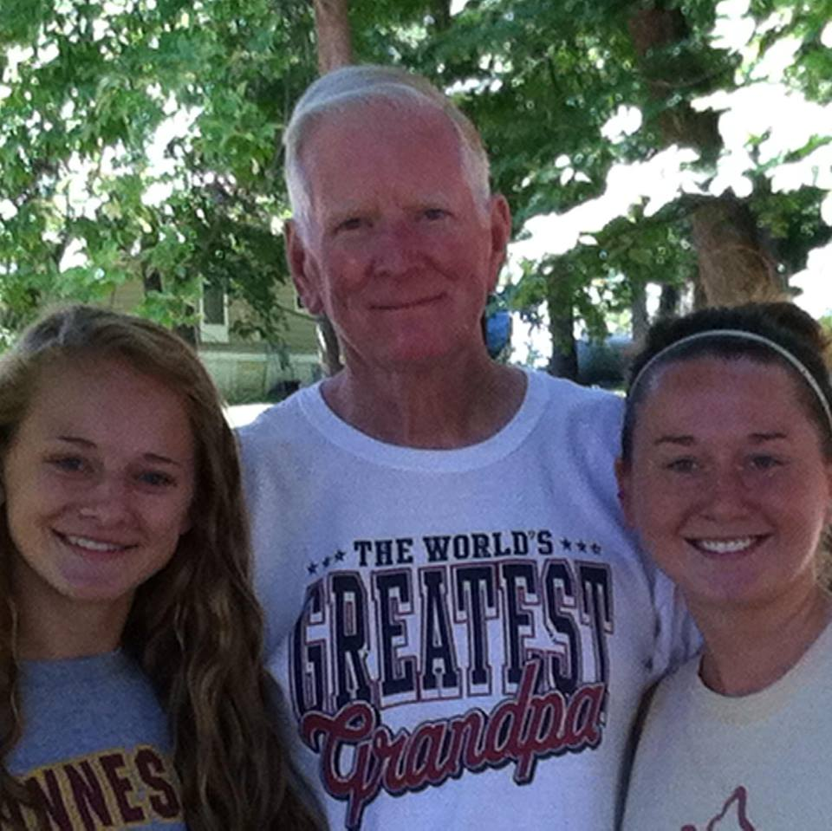
Robert Wendel Johnson “Bob”

Slide 2
History
Born March 5th 1935
Parkville, MN
Youngest of 3 boys
Spent 2 yrs. In the Marines
Received a degree in Mathematics

Slide 3
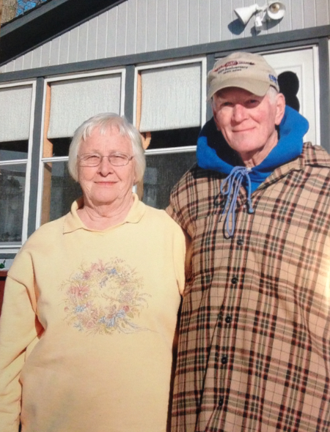
Bob & Bunny
Met in 7th grade Mountain Iron Middle School
Married 54 years
6 children Raised in Spring Lake Park
13 grandchildren
4 great grandchildren

Slide 4
Career
Wholesale Textile Company
Retired and moved to Mora, MN & Spent winters in Casa Grande, AZ
Maintenance at Ogilvie Schools
Other various jobs to keep him busy

Slide 5
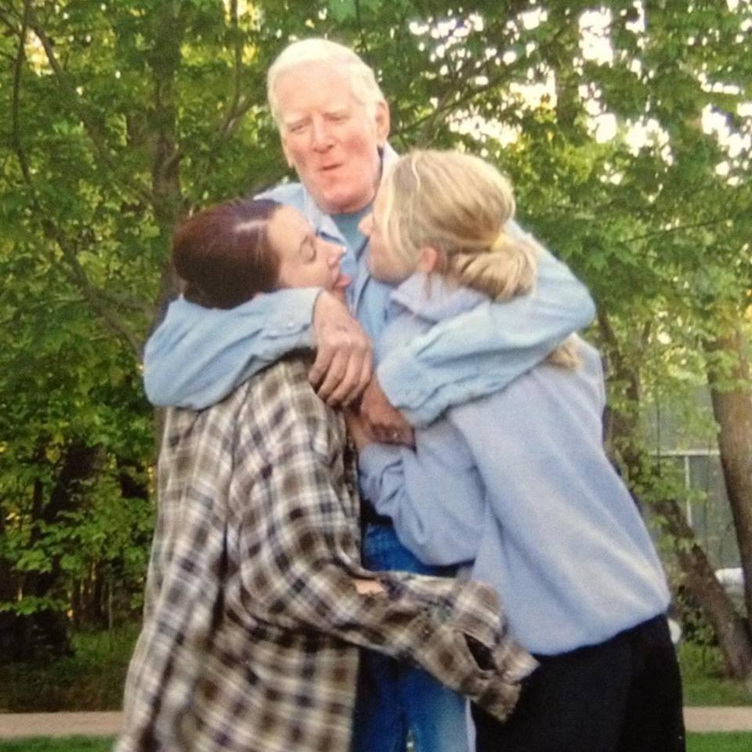
Grandpa Bob
Artistic
Lovable
Funny
Athletic
Loving
Kind

Slide 6
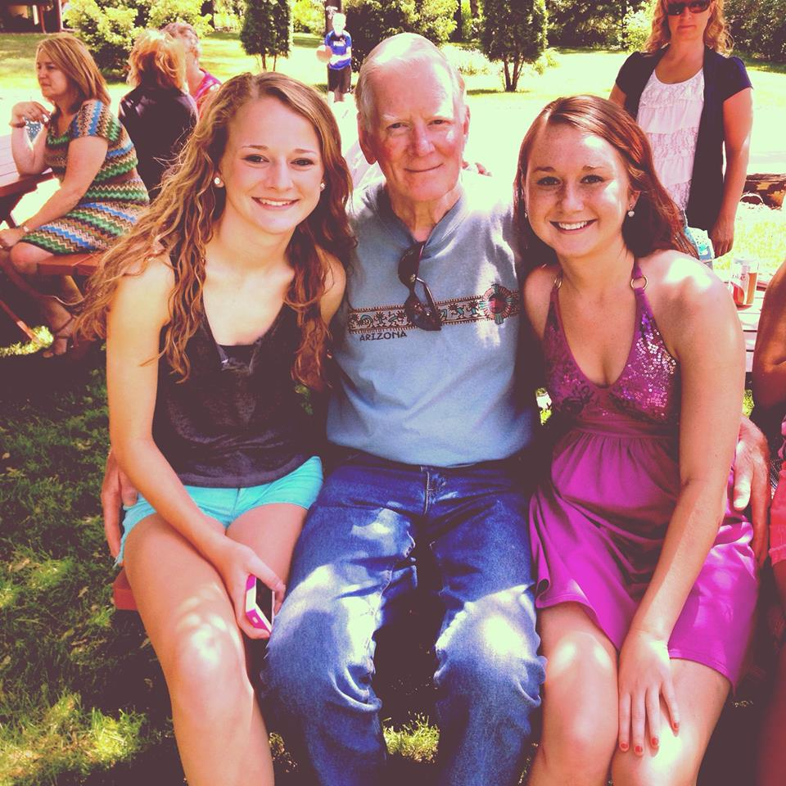
In Loving Memory
Passed unexpectedly on March 27th 2014
Role-model
Father
Husband
Friend
Grandfather
Great Grandfather
Brother

