Slide 1
MRC
Jananie Selvaratnam

Slide 2
Introduction
We are analyzing the slow breathing in COPD (Chronic Obstructive Pulmonary Disease) patients with clinically significant dyspnea.
This survey given to 19 patients who have slow breathing problem within COPD patents
Clinical has approached with a survey answering five statements description before the breathing (MRC base line) exercise and after the breathing exercise (MRC week 8).
Scores were recoded.

Slide 3
Survey
The survey is about if the patient agreeing with the statement, they have to respond circling “Yes” and if the patient is disagreeing respond “No”.
After this survey, patients are required to do the breathing exercise twice a day for 15 minutes.
After 8 weeks period time all the patients are required to do the survey again.
Check their breathing problem has cured or there is any improvements by doing the breathing exercise.
Record the scored of each patient.

Slide 4
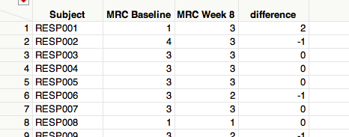
Methods
We did t-test to analyze how the breathing level has changed after the exercise.
T-test done using the JMP program.
Find the difference between MRC week 8 and MRC Baseline to do the t-test.

Slide 5
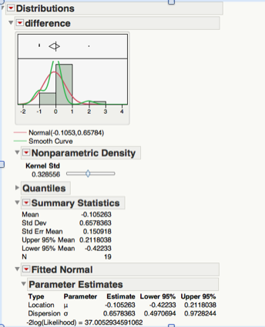
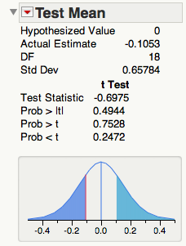
Methods
To do this t-test in JMP, choose Analyze → Distribution and select “difference” in Y column then click “ok” .
From the above test we can see the statistics summary of the results.

Slide 6
Conclusion
The p-value of this t-test result gives 0.4944. This tells us that there is no significant difference in the MRC differences.
After we have done the t-test for the COPD patients, the p-value tells that there is no differences between MRC week 8 and MRC baseline. Therefore there is no changes or improvement after the breathing exercise.

