Slide 1
R-squared
By: Carson Barnette
Notes:
The R² coefficient of determination is a statistical measure of how well the regression line approximates the real data points. In other words it is a line that we use to approximate the real data. By looking at a plot of the data points we can draw a line that approximates the data to a certain degree.

Slide 2
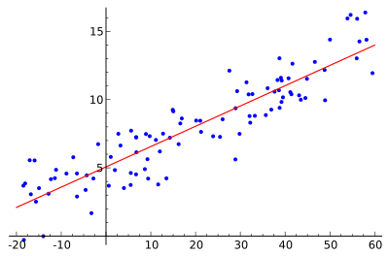
Notes:
In this example we see data points and the red line would be what we call the regression line. It is drawn as sort of a guess to how the points will land. So if I was asked what would happen for a data point with the x coordinate 30 I would guess y = about 9 but you might ask yourself is 9 is a good guess or not. So we need to see how well our line is fitting our model. This line looks like it is doing an ok job.

Slide 3
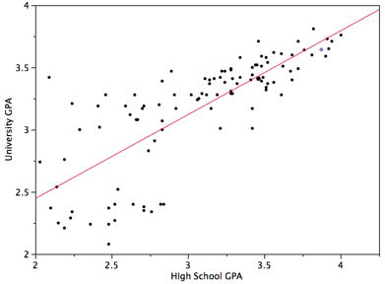
Notes:
But how well is this line doing? Some of these data points are pretty far away from the line of best fit. So we look for a way to measure how well our line is doing at approximating the data. And that is where the r^2 coefficient comes into play. The r^2 coefficient is a number between 0 and 1 that describes how well the line is approximating the data. 1 means that it is approximating it perfect and 0 means it is not appoximating the data at all

Slide 4
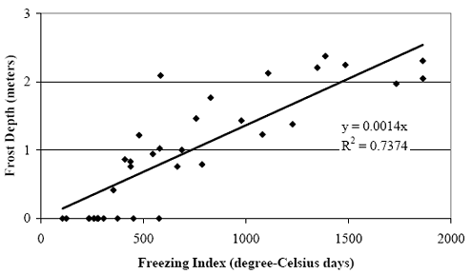

Slide 5
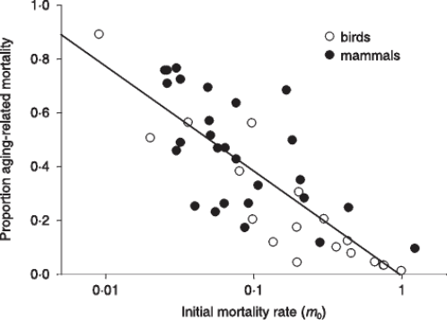

Slide 6
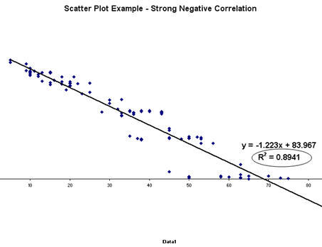

Slide 7
Thank you

