Slide 1
Integrals
Philip Robey

Slide 3
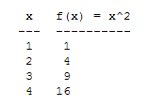

Slide 4
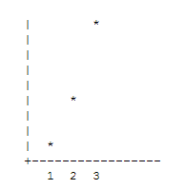

Slide 5
