Slide 1
Normality
By: Kristi Schmit

Slide 2
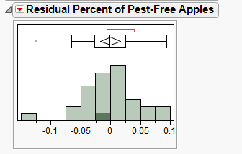
Notes:
The normality assumption does not appear to be met. The histogram is skewed to the right and doesn’t have the full bell-shaped curve that shows normality, and also the boxplot has an outlier and the right whisker is quite a bit larger than the left whisker.

Slide 3
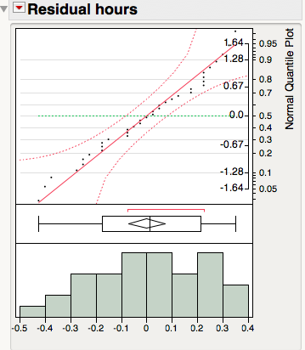
Notes:
There may be a slight departure from normality shown in the normal quantile plot, histogram, and boxplot above. Skewed left slightly However, I do not believe there is enough departure from normality to affect our results, but just to make sure we can also use JMP to formally test for non-normality.

Slide 4
Notes:
Since the normal probability plot is linear it indicates that the assumption of normality is valid.

Slide 5
Notes:
In the box plot we see no outliers and the distribution of the data is very symmetric. The histogram looks pretty symmetric. Thus concluding that the assumption of normality is reasonable, but because the number of cases in this data set is reasonably small these plots alone do not convey reliable enough information about the shape of the distribution. So we will construct a normal probability plot.
Since the normal probability plot displays a linear relationship it indicates that the assumption of normality is reasonable

Slide 6
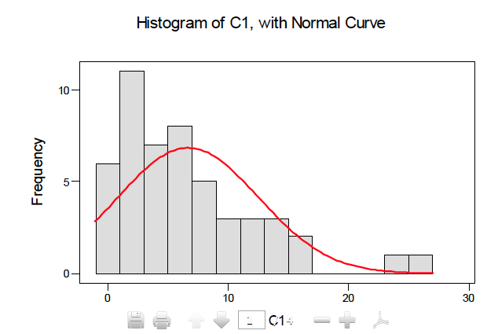
Notes:
In this case we see that the data set is skewed to the right, and looks more like an exponential distribution than a normal distribution.

Slide 7
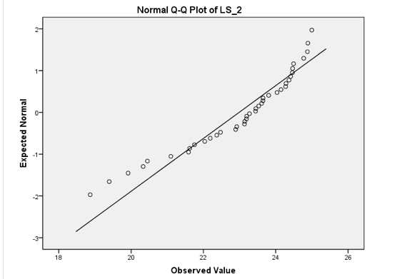
Notes:
Observed value and expected value plotted on graph. Left-Skewed, Definite curve in the plot. The values vary from a straight line so the data is not normally distributed.

