Slide 1
R ² - Coefficient of Determination
Jananie Selvaratnam

Slide 2
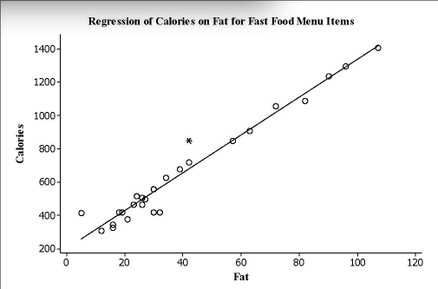
Linear Regression Line

Slide 3
Computing R²

Slide 4
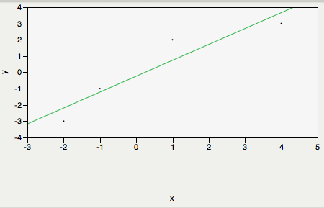
Example

Slide 5
Equations

