Slide 1
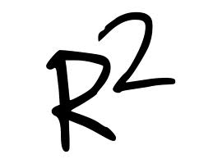
R-Squared
Kayla Thurk

Slide 2
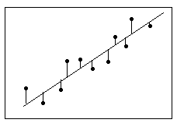

Slide 4
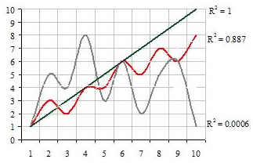

Slide 6
http://blog.minitab.com/blog/adventures-in-statistics/regression-analysis-how-do-i-interpret-r-squared-and-assess-the-goodness-of-fit

