Slide 1
Ammonia salt/ Barium Hydroxide demo
Did this reaction occur spontaneously?
Is the reaction exothermic or endothermic?
NH₄Cl + Ba(OH)₂ .8H₂O → BaCl₂ + 2NH₃ + 10H₂O

Slide 2
Entropy: Disorder/ Chaos
Entropy increasing is a spontaneous process
Molecules tend to move spontaneously to a state of maximum randomness
2nd law of Thermodynamics: Entropy of universe is increasing
Symbol ΔS
Sign convention ΔS+ when randomness increases
Sign convention ΔS- when randomness decreases

Slide 3
Which of the following are spontaneous processes?
In all spontaneous processes randomness is increasing
A) Heat flow from a cold object to a hot object
B) Diffusion of perfume molecules from one side of the room to the other
C) Decomposition of rust (Fe2O3.H2O) to iron metal, oxygen, and water
D) Burning wood
E) A ball rolling down a hill

Slide 4
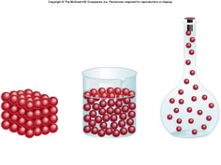
Effect of phase on Entropy

Slide 5
Predict the sign of ΔS in the system for each of the following:
CO₂(s) →CO₂(g) (sublimation of dry ice)
CaSO₄ (s) → CaO (s) + SO₃ (g)
N₂ (g) + 3H₂ (g) → 2NH₃ (g)
I₂ (s) → I₂ (aq) (dissolution of I₂ in water)

Slide 6
Probability
Why is disorder easier to achieve than order?
If I have 20 coins, what is the probability that all will be heads when I flip them?

Slide 7
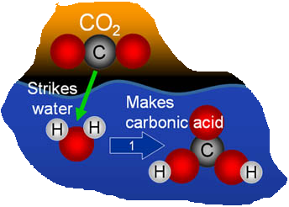
How does entropy change for this situation?
How would entropy change as a molecule goes from solid to liquid to gas?

Slide 8
Summary
There are two things which dictate whether a process occurs spontaneously
1) The enthalpy of the reaction (whether the reaction is exothermic or endothermic) DH
2) The entropy of the reaction: degree of disorder DH
Why did the reaction between the ammonia salt and barium hydroxide proceed? What evidence do you have for this?

Slide 9
Entropy and Temperature
What happens to molecular motion as a substance is heated?
As motion increases, randomness will increase
Under conditions of constant temperature and pressure:
ΔS_{surr} = -ΔH or ΔS_{sys} = ΔH T T sign convention:

Slide 10
Rubber Band Demonstration

Slide 11
Free Energy
What are the two processes that dictate whether a reaction is spontaneous?
ΔG = ΔH - TΔS

Slide 12
Effect of Gibb’s Free Energy on Entropy and Enthalpy Changes
Case | Result | ΔG
ΔS +, ΔH -
ΔS +, ΔH +
ΔS -, ΔH -
ΔS -, ΔH +

Slide 13
Example:
The enthalpy of fusion of NH₃ is 5.65kJ/mol and the entropy of fusion is 28.9J/K.mol. A) Will NH₃ spontaneously melt at 200K? B) What is the approximate melting point of NH₃?

Slide 14
State Functions
Gibb’s Free Energy, Entropy, and Enthalpy are all state functions
What is a state function? A state which is independent of the path taken to get there.
Is temperature a state function?
Is work a state function?

Slide 15
Calculating ΔG for reactions
Standard state of formation ΔG_{f}º = change in free energy that accompanies the formation of 1 mole of that substance from its constituent elements with all the reactants and products in their standard state (298K, 1 atm pressure).

Slide 16
Example
Consider the reaction:
Fe₂O₃ (s) + 3H₂ → 2Fe(s) + 3H₂O(g)
Use ΔG_{f}º values in appendix C to calculate ΔG_{o} for this reaction.
Is this reaction spontaneous?
The ΔH for this reaction is 100kJ. At what temp. is the reaction spontaneous? (Assume ΔH and ΔS do not depend upon temperature.)

Slide 17
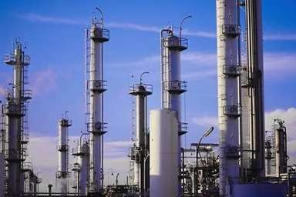
Example 2
You are a chemical engineer. Your plant wants to start making acetic acid. Which way is a better way (thermodynamically speaking) to produce acetic acid? Why? Use appendix C (p.1112 in 11th edition).
CH4 (g) + CO2 (g) → CH3COOH (l)
OR
CH3OH (g) + CO (g) → CH3COOH (l)

Slide 18
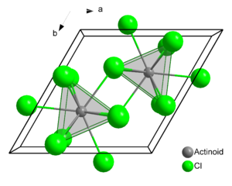
3rd Law of Thermodynamics
Entropy of a pure crystalline substance at absolute zero is zero. There is no molecular movement at absolute zero.

Slide 19
Free Energy and the Equilibrium Constant
ΔG = 0 at equilibrium
ΔG = ΔGº + RTlnQ
where: R = gas constant 8.314J/mol.K
T = absolute temperature
Q = reaction quotient @ any time
ΔG = Gibbs Free Energy @ any time
ΔGº = Standard state Gibb’s Free Energy

Slide 20
Example
Consider the reaction:
6H2(g) + P4(g) → 4PH3(g)
a)Using data from Appendix C, calculate ΔG⁰ at 298K. B) Calculate ΔG @ 298K if the reaction mixture consists of 8.0 atm of H2, 0.050 atm of P4 and 0.22 atm of PH3.

Slide 21
Free Energy and the Equilibrium Constant
ΔG⁰ = -RTlnK or K = e^{-ΔGo/RT}
K_{a} for HNO₂ is 4.5 x 10⁻⁴. Write the chemical equation for the equilibrium that corresponds to K_{a}. A. What is ΔGº for the dissociation of HNO₂ in aqueous solution? B. What is the value of ΔG at equilibrium? C. What is the value of ΔG when [H⁺] = 5.0 x 10⁻²M, [NO₂⁻] = 6.0 x 10⁻⁴M, and [HNO₂] = 0.20M?

