Slide 1
Chapter 17
Additional aspects of aqueous equilibria

Slide 2
Common Ion Effect
Whenever a weak electrolyte and a strong electrolyte contain a common ion, the weak electrolyte ionizes less than it would if it were alone in solution
LeChatlier’s Principle
Which one of these solutions would you expect would have the least H⁺?
2 M HCl
2 M Acetic Acid (HC₂H₃O₂) or
Solution with 2M Acetic acid and 2M sodium acetate?

Slide 3
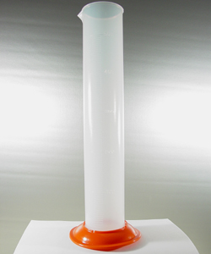
Demonstration
For the reaction
CaCO₃ + 2H⁺ → CO₂ + H₂O + Ca²⁺
Rate = k[H⁺]²
Predict which cylinder will react fastest
Cylinder #1 100mL of 2M HCl
Cylinder #2 100mL of 2M Acetic acid
Cylinder #3 100mL of 2M Acetic acid/ sodium acetate

Slide 4
Buffered solutions
Buffer is something which resists changes in pH. It does this because it contains significant amounts of an acid & its conjugate base or a base and its conjugate acid
The acid can neutralize excess base and the base can neutralize excess acid

