Slide 1
Chapter 19 Chemical thermodynamics

Slide 2
1st Law of Thermodynamics
Energy can be neither created nor destroyed
2nd Law of Thermodynamics: Entropy of the universe is increasing

Slide 3
If Keq > 1 reaction is product favored
If Keq < 1 reaction is reactant favored
Says nothing about how fast reaction occurs
Thermodynamics gives information about why a reaction is product or reactant favored

Slide 4
Entropy = Spontaneity
Spontaneous process: A process which takes place on its own without any external influences. The reverse of a spontaneous process is always a non-spontaneous process

Slide 5
Which of the following are spontaneous processes?
A) Heat flow from a cold object to a hot object
B) Diffusion of perfume molecules from one side of the room to the other
C) Decomposition of rust (Fe2O3.H2O) to iron metal, oxygen, and water
D) Burning wood
E) A ball rolling down a hill

Slide 6
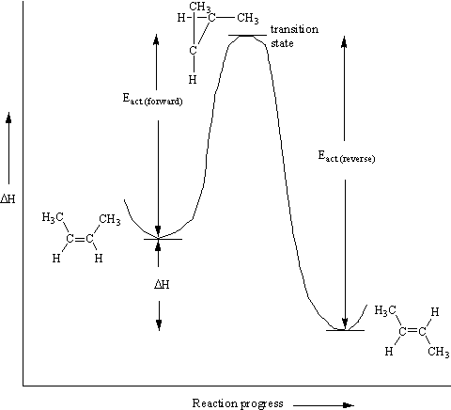
Energy Coordinate Diagram
The size of E_{act} dictates how fast the reaction will take place

