Slide 1
Detection Limits
Every analytical method has a limit of detection. This is the point where given the noise/ uncertainty in a measurement you cannot be sure that a measurement taken is significantly different from a measurement taken when there is no analyte present in the solution.

Slide 2
Detection Limit
Number, expressed in units of concentration that describes the lowest concentration level an analyst can determine to be statistically different from the blank.

Slide 3
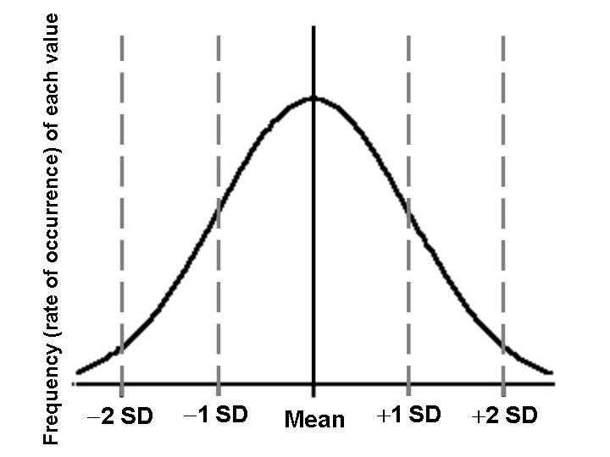
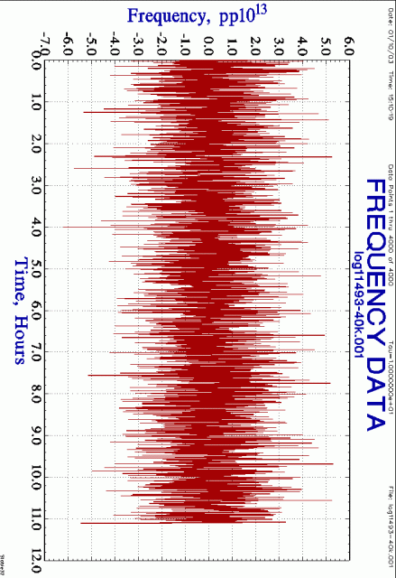
Detection limits are based upon the amount of noise
Will a large amount of noise increase or decrease your detection limit?

Slide 4
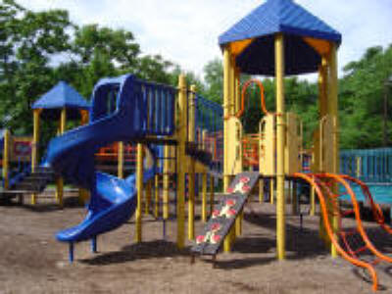
Type I Error: Concluding that an analyte is present when it is absent.
Type II Error: Concluding that an analyte is absent when it is present.
Which do you think is easier to avoid?
Type I

Slide 5
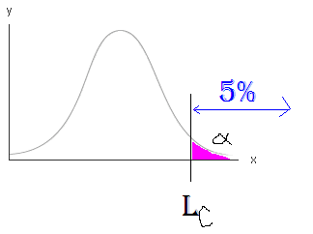
Levels of Detection Certainty
Decision limit: L_{c}
Point at which one may decide whether or not the result of an analysis indicates detection
L_{c} = kσ_{blank}
σ_{blank} = std. dev. of blank
k related to certainty of prediction
blank
This only addresses Type I errors: whether analysis indicates detection

Slide 6
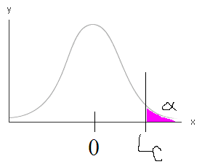
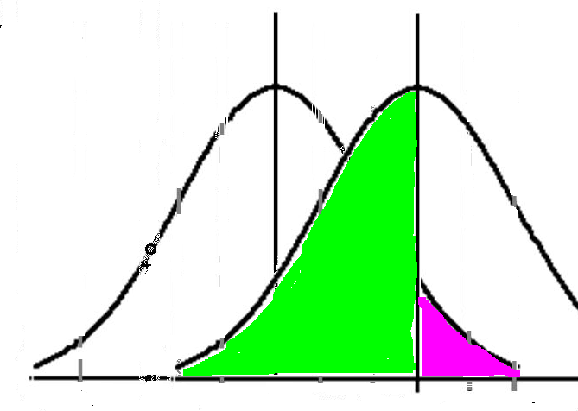
Decision limit L_{c}
blank
Selecting Lc for a chosen level of a sets the probability of a Type I error
However, suppose we actually have analyte present at concentration Lc
Then the probability β of a Type II error is actually 50%
i.e. 50% of the time we would incorrectly conclude that analyte is absent!
β
α
Analyte present at concentration Lc

Slide 7
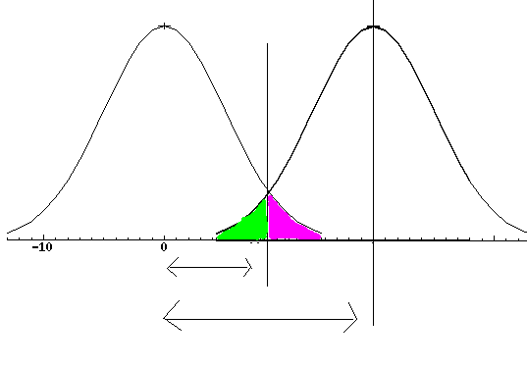
Detection Limit L_{D}
Lc
Addresses both Type I & II errors
Choose α to reflect willingness to accept Type I errors
Choose β to reflect willingness to accept Type II errors
blank
β
α
1.65σ_{b}
3.29σ_{b}
L_{D}

Slide 8
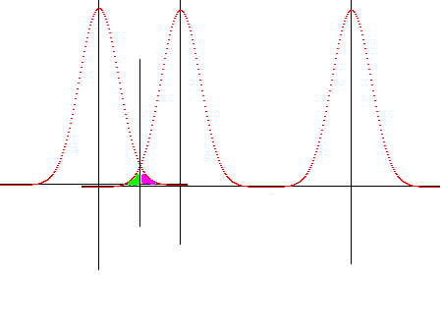
Determination Limit LOD

Slide 9
Determination limit
Conservative
Intended for quantitative analysis, not just determining whether analyte is present.
If one chooses to report only above the LOQ much “information” is lost.
Although numbers below LOQ have greater imprecision, they still convey information that is useful for decision process, ex. Pb in playground

