Slide 1
Standard Addition
Used with difficult matrices such as blood
Difficult to get an accurate comparison of the amount of analyte in sample vs. amount of analyte in a standard made up in water
Matrix effects will cause 50mg/L of Fe in blood to look different than 50mg/L of Fe in water
When potential matrix effects due to difficult matrices exist, the method of standard additions is used.

Slide 2
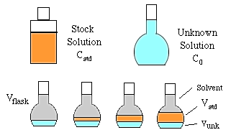
Method of Standard Addition adds varying amount of standard to an unknown which already contains some analyte
Add same quantity of unknown sample to a series of flasks
Add varying amounts of standard (made in solvent) to each flask, ex. 0,5,10,15mL)
Fill each flask to line, mix and measure

Slide 3
Volume std. added | Peak area
0 | 18.2
5 | 23.5
10 | 29.0
15 | 37.0
Go to spreadsheet

Slide 4
Sample Preparation
S²_{overall} = s²_{analysis} + s²_{sampling} + _{s2sample prep}
The sample preparation step is by far the most error prone, labor intensive part of the analysis

Slide 5
Sample Prepartion should:
Be done without losing any of the analyte.
Bring analyte into the best chemical form for method to be used Examples:
a.) Digestion: Commonly used for metal analysis. It is a procedure which dissolves inorganic materials in concentrated acid
M + nH⁺ → M^{n+} + n/2H₂
Metals dissolve in HNO₃

Slide 6
Sample Prep into best chemical form
b.) Derivitization: Selectivly reacting analyte with reagent to make it detectable. Ex. Colorizing something or making something volatile for GC analysis

Slide 7
Sample Preparation should:
3. Remove some interferents (Interferents are substance(s) that are present in the sample that respond to the detector in the same way the analyte does
This difficulty can sometimes be overcome with extraction. Extraction is a purification step. (Analyte is soluble in extraction medium while, ideally, other interfering species are not soluble.)

Slide 8
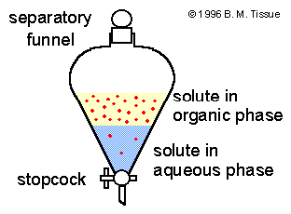
A. Extraction Techniques
Liquid extraction techniques
a.) Simple liquid/ liquid extraction. Analyte is extracted into extraction solvent, interferent is not. Extraction is limited by equil.
distribution between 2 solvents

Slide 9
Example liquid/liquid extraction problem
If K_{eq} = [4]_{hexane}
[1]_{water}
And we have 5 moles of analyte present originally. The sample is originally in 100mL of water. The analyte is much more soluble in hexane then is the interferents. If we extract the sample with 10mL of hexane, how much analyte will remain in the water phase after one extraction? Two extractions? Three extractions?

Slide 10
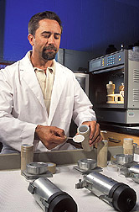
b. Microwave assisted extraction
Sample and solvent will be placed in teflon lined bomb
Ran at temp. 50-100ºC warmer than b.p. of solvent, at high pressure
Solvent extract analyzed chromatographically

Slide 11
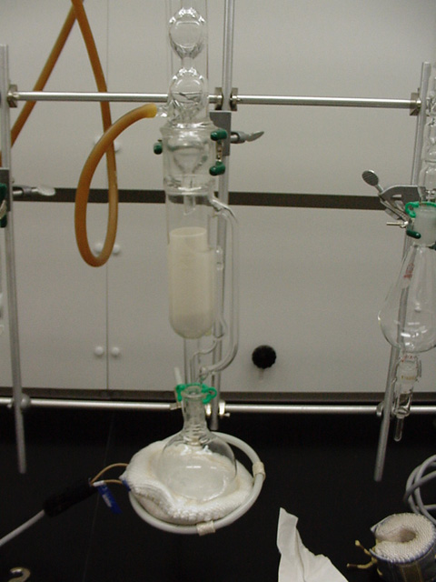
c. Soxhlet extraction
Continuous heated liquid/ liquid extraction

Slide 12
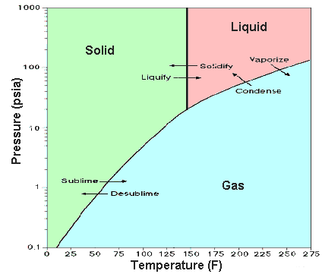
d. Supercritical fluid extraction
Supercritical fluids have higher solute-solvent interactions than do gases allowing higher specificity
Supercritical fluids have higher mobilities than liquids allowing faster extraction time

Slide 13
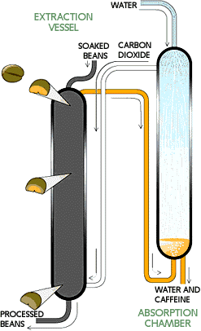

Slide 14
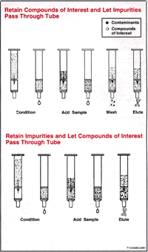
2. Solid phase extraction

Slide 15
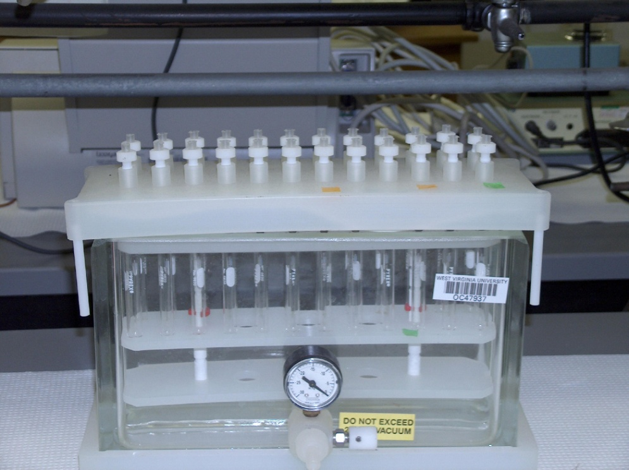
B. Preconcentration
Solid phase extraction
Easily allows concentration from 10 liters to 1mL concentration of 10,000!

