Slide 1
Statistics Outline
Types of Error
A. Systematic vs. random
II. Statistics
A. Ways to describe a population
1. Distribution
2. Mean, median, mode
3. Standard deviation
B. Standard deviation and probability
C. Significance testing
D. Q test

Slide 2
I. Types of Error
Systematic vs. random
Systematic error: Consistent error that theoretically can be detected and corrected.
How can you detect a systematic error?

Slide 3
Examples of systematic error:

Slide 4
Random error:
Cannot be eliminated. It is due to the physical limitations of the measurement.
Example: reading the buret by different people, electrical noise,
Seatbelt study

Slide 5
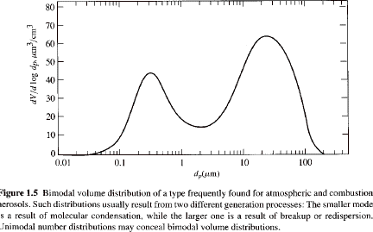
II. Statistics
Ways to describe a population:
I. Distribution
Bimodal

Slide 6
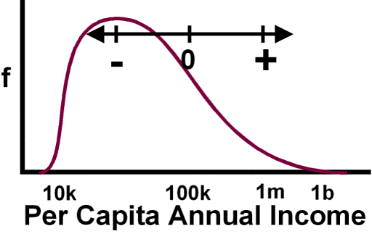
Skewed distribution

Slide 7
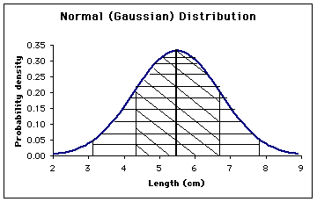
Gaussian distribution (also called normal distribution)

Slide 8
2. Ways to describe a population
Mean: average
Median: central data point in a data set
Mode: the most frequent data point in a data set.
For a perfectly Gaussian distribution, mean, median, mode are exactly the same
Income study

Slide 9
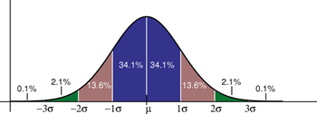
Statistics and Probability
Standard deviations from the mean

Slide 10
Standard deviation & probability
Z statistic is used to calculate the probability of a value lying within a certain range
Z = value – mean z statistic
std. dev. assumes Gaussian
distribution

Slide 11
Is there a significant difference between my data sets?
t test answers this question
t test with known value
used when the true value is known
Paired t test
Unpaired t test

Slide 12
Known value t test
A new procedure for the rapid determination of sulfur in kerosenes was tested on a sample known, from its method of preparation, to contain 0.123% sulfur. The results were 0.112, 0.118, 0.115, and 0.119. Do the data indicate there is a bias in the method?

Slide 13
Meaning of t values
If t_{exp} > t_{critical} difference is significant
If t_{exp} < t_{critical} difference is not significant

Slide 14
Paired t test
Used when comparing 2 methods, 2 analysts, 2 labs, etc. Used when a relationship between the two determinations is expected

Slide 15
Unpaired t test
Used when comparing 2 data sets where no relationship between individual determinations is expected

Slide 16
Q Test
Way to get rid of spurious data
Can only be used once on a particular data set
Q = gap If Q_{obs} > Q_{table} the value range can be rejected w/ specified
degree of confidence

