Slide 1
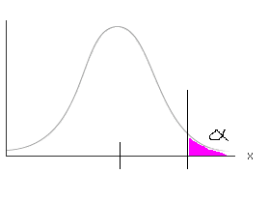
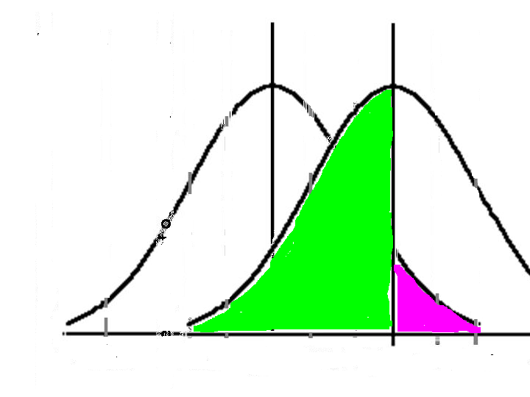
Which error is our legal system specifically designed to address?
Legal system is designed to minimize Type I errors
A Type I error would be to conclude that a person is guilty when, in fact they are innocent.
Since a person is presumed innocent until proven guilty, the decision limit is set such that there is a low probability that an innocent person will be convicted.
Legal system does not explicitly address Type II errors
A type II error is concluding that a person is innocent when in fact they are guilty.
The result is while few innocent people are found guilty, many more guilty people are set free

Slide 2
Which type of error is more difficult to address?
Delaney clause of 1958 –
No additive [in processed food] shall be deemed to be safe if it is found to induce cancer when ingested by man or animal…
No detectable level of pesticide may remain in processed food even if that level is far below what will cause cancer.
Detection limits have improved significantly 10³ – 10⁶ better what may have been acceptable in 1958 may now by 10⁶x over limit
In 1996 it was changed to be based on health effects

Slide 3
Wise Use of Statistics
Statistics is useful because it gives us a measure of how much confidence we have in our data.
As a scientist, the most important thing you can do when reporting data is give an idea of its degree of uncertainty

Slide 5
pg
fs
μg
Hours or days
Sub-μm
mm

Slide 7
Limitations of Science
Human epidemiological data is rarely complete at low levels
Animal data is usually at the top end, may not always be valid to extrapolate to humans
Extrapolation: Never extrapolate more than one order of magnitude from data

Slide 8
Average Loss of Life Expectancy (LLE)
Activity, risk, or state and associated LLE in days
Being male 2800 Heart disease 2100 Being unmarried 2000 Being black (as compared to white) 2000 Smoking cigarettes (1 pack/day) 1600 Coal Mining 1100 Cancer 980 30 lb overweight 900 Grade school dropout 800 Being poor 700 Stroke 520 15 lb overweight 450 All accidents 435 Vietnam army duty 400 Living in southeastern U.S. 350 Construction worker (accidents) 320 Driving a car (risk of accidents) 200 Pneumonia and influenza 130
Alcohol 130 Suicide 95 Homicide 90 Occupational Accidents 74 Small cars (vs standard size) 50 Drowning 40 Raising speed limit, 55 to 65 mph 40 Falls 39 Poison + suffocation + asphyxiation 37 Fire, burns 27 Radiation worker entire adult life 12 Firearms 11 Diet drinks, one per day for life 2 All electric power nuclear (UCS) 1.5 Hurricanes and tornadoes 1 Airline crashes 1 Hydroelectric power (dam failures) 0.5 Lifetime at nuclear power plant 0.4 All electric power nuclear (NRC) 0.03

Slide 9
Panic Inducing Medical News
Column 1 can cause | Column 2 in | Column 3
1. Fatty foods | cancer | Twins
2. Stress | Spontaneous remission | Arthritis sufferers
3. Red wine | Glaucoma | 7 out of 10 women
4. Day care | Hypothermia | Rats
5. Computer terminals | Depression | Overweight smokers
6. Coffee | Sexual dysfunction | Men between 25 and 40
7. Smoking | A feeling of well being | Two income families
8. Exercise | Heart disease | children

Slide 10
Precision vs. Accuracy

