Slide 1
Concentration Units
Molarity
Formality:
Normality
What is the molarity of a 6N H₂SO₄ solution?
How do you make 100mL of a 4N H₂SO₄ solution from conc. H₂SO₄?

Slide 2
Sampling
Difficult in real world
S_{o}² = s_{m}² + s_{s}²
Where:
s_{o}² = overall variance
s = standard deviation
s_{m}² = variance of analytical method
s_{s}² = variance of sampling

Slide 3
Cork
l___l___l___l___l___l___l___l___l___l___l
0 10 20 30 40 50 60 70 80 90 100
Rubber
l___l___l___l___l___l___l___l___l___l___l
0 10 20 30 40 50 60 70 80 90 100

Slide 4
Sampling alone can introduce significant error
Sampling error will be significant whenever the # of defining units becomes too few
Std. deviation associated with sampling can be defined as:
σ_{n} = npq
n = # of particles taken
p = probability of drawing A = n_{A}/(n_{A} + n_{B})
q = probability of drawing B = n_{B}/(n_{A} + n_{B})

Slide 5
Grab and Composite Samples
Grab: Individual sample collected at a particular time and place – example
Limitations:
Composite: Mixture of grab samples taken over a period of time – example
Limitations:

Slide 6
To composite or not composite

Slide 7
Compositing Demo
Analysis # | Mixed | Core
1
2
3
4
5
6
Mean
Std. dev.

Slide 8
How do you know when you have taken enough samples?

Slide 9
Types of Sampling Schemes
Random: no operator bias, least uncertainty, largest # of samples
Stratified: judgemental, requires least # of samples, used most often, based on prior knowledge, most uncertainty
Systematic: 1st sample is randomly chosen, after that taken at fixed time & space intervals Lake diagram

Slide 10
What is the best sampling scheme for my project?
Consider
Costs
Use of data
Heterogenity of system
Pollutant mobility
Most projects will require more than one sampling strategy examples

Slide 11
Sampling strategy?

Slide 12
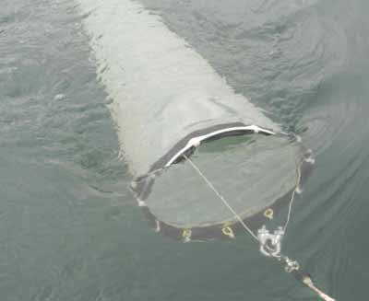
Sampling strategy?

Slide 13
Quality control
Contamination
Preservation and storage
Duplicates: 10% duplicate amount necessary
Split samples
Reagent blank
Method blank
Matrix spike

Slide 14
Quality Control
Blind field duplicates
Field QC checks
Field blanks
Trip blanks

Slide 15
Field records documentation requirements
Name of sample collector
Date and time of sampling
Field conditions:
Sample type
Label with requested analytical parameters and preservation technique
Chain of custody

