Slide 1
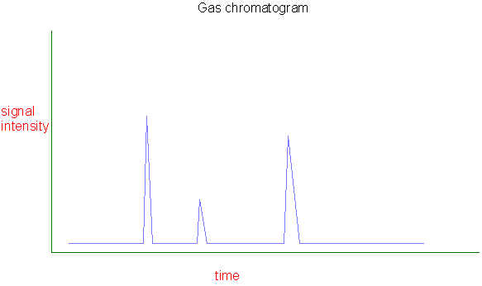
Chromatography
Way to separate components in a mixture
Notes:
Go over chromatography exercise first.
The different dyes in the black markers had different water solubilities. This allowed them to be separated. Chromatography makes use of all different types of properties in order to get separation between components in a mixture.

Slide 2
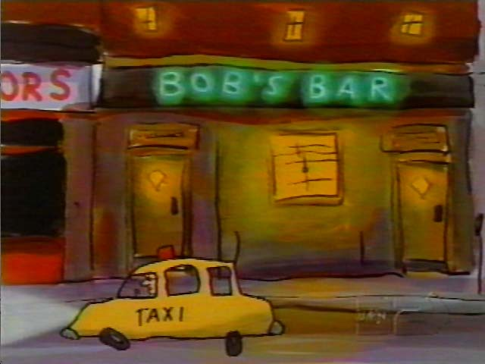
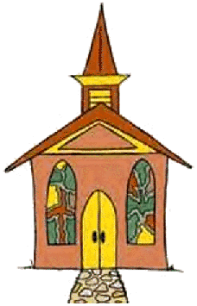
Chromatography Analogy
Sinner, saint, agnostic, or hypocrite, who will get to the end of Main Street first?
Notes:
After do analogy, ask them what property was being used for separation?

Slide 3
How are things separated in chromatography?
Based on different properties
Water solubility
Gas solubility
Solubility in a certain chemical like ethanol
Boiling point
Etc.

Slide 4
Spearmint Oil Demonstration
What would happen to spearmint oil in a closed container?
System would eventually reach equilibrium where rate of evaporation and condensation are equal
Chromatography has its basis in the fact that chemical substances tend to partially escape into surrounding environment, like spearmint oil here

Slide 5
If spearmint oil is in closed container, some of the gas molecules will eventually strike the condensed phase and condense back into it.
When the rate of condensation of the gas becomes equal to the rate of evaporation of the liquid or solid, the amount of gas, liquid and/or solid no longer changes.
The gas in the container is in equilibrium with the liquid or solid.
The pressure exerted by the gas in equilibrium with a solid or liquid in a closed container at a given temperature is called the vapor pressure.
Notes:
Define condensation: gas going from atmosphere into liquid phase opposite? Evaporation: moving from liquid phase into gas phase

Slide 6
Effect of Temperature
Lower Temperature
Higher Temperature
At higher temperature, more molecules have enough energy to escape from the liquid or solid. At a lower temperature, fewer molecules have sufficient energy to escape from the liquid or solid.
High vapor pressure at high temp, low vapor pressure at low temp.
Two components in mixture? Each would have its own vapor pressure, go into gas at different temperatures
Notes:
After talk about this page, ask them what would happen if had two components in mixture. Draw a chromatogram with increasing temperature on x axis and quantity of material on y axis.

Slide 7
Chromatography is dynamic
In chromatography, one component is always moving
Think of chromatography as a race, starting line all components mixed together, as race progresses, materials that have preference for the moving phase will pull ahead of substances that prefer stationary phase
Chromatography movie
Which balls (molecules) have a greater affinity for mobile phase? Blue or yellow?
Notes:
There are 3 main types of chromatographic analysis that are most useful for forensic analysis, gas chromatography, liquid chromatography and thin layer chromatography

Slide 8
Gas chromatography

