Slide 1
Forensic Examination of Metals (and other things that emit light)

Slide 2
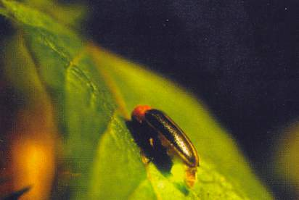
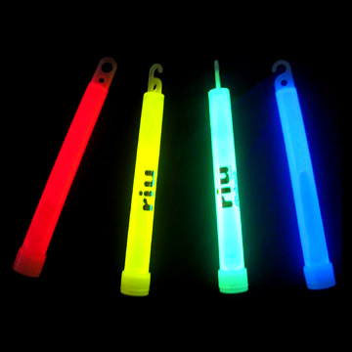
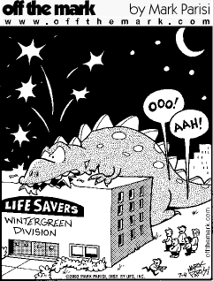
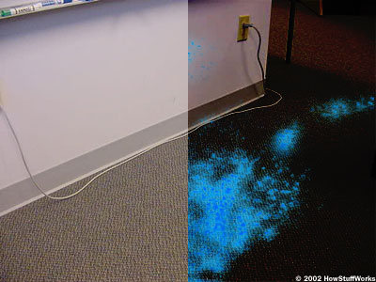
Examples
Notes:
Fireflies, light sticks, wintergreen lifesavers, fireworks, and luminol (used for the forensic examination of where blood might have been) all emit light when atoms or molecules in an excited state return to the ground state

Slide 3
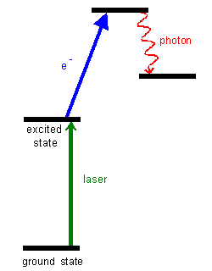
All of these emit light when atoms or molecules in an excited state return to the ground state
Energy: Capacity to do work
Kinetic Energy: Energy of motion
Potential Energy: Stored energy
Notes:
What all of the molecules or atoms in the previous slide have in common is that somehow they were excited from the ground state up to the excited state. This might be done by black light in the case of luminol or it might be done with heat from a mini-explosion in fireworks. The different colors in fireworks comes from different metals that are present in the firework RED: Strontium compounds; YELLOW: Sodium compounds; GREEN: Barium compounds; BLUE: Copper compounds plus a chlorine producer; PURPLE: a mixture of strontium and copper compounds; GOLD: charcoal or lampblack; SILVER: burning titanium, aluminum or magnesium powder or flakes.

Slide 4
Riboflavin Demonstration
Why does the riboflavin solution glow?

Slide 5
Potential Energy
In chemistry potential energy exists in bonds of molecules
Whenever bonds are broken or formed there is a potential for energy to be released and the system to do work
C₄H₁₀ + O₂ → CO₂ + H₂O + energy!
Notes:
The potential energy stored in gasoline is converted into mechanical energy every time you drive your car

Slide 6
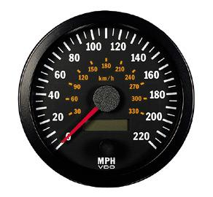
Macroscopically energy seems continuous
Yes
Energy a molecule can possess actually exists in discrete steps
NO
Notes:
It is possible to go 25mph, 35mph, 30mph, 31,31,257mph etc. but microscopically energy is only available at discrete energy levels

Slide 7
Link
Notes:
Explain this picture What happens to a molecule, like luminol is it becomes excited by an external source, a UV lamp, an electron from luminol will take that excess energy a go from the ground state to the excited state, increasing the amount of potential energy available. The molecule wants to get rid of the excess energy and it can do it by releasing it in the form of heat or light or a combination of the two but it can only get rid of it in discrete steps, each step corresponds to a energy step Light has specific measurements of wavelength, each wavelength corresponds to a different color so when an electron goes from one level to another the step size will dictate the color. Hi
High energy blue
Low energy red
In between colors intermediate energy
Energy of the transition E = hf where E = energy; h= Planck’s constant; f = frequency
Frequency is related to the wavelength of light f = c/w where c=speed of light; w=wavelength of light

Slide 8
Example of a flame test
Link

Slide 9
Energy and Colors
E = hf
Where:
E = energy
h = Planck’s constant
f = frequency
And f = c/w
Where:
c = speed of light
w = wavelength of light
Color | Wavelength
Red | 780-622
Orange | 622-597
Yellow | 597-577
Green | 577-492
Blue | 492-455
Violet | 455-390

Slide 10
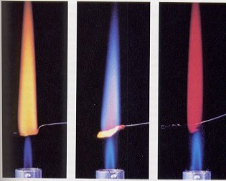
Which gap from the ground state to the excited state is largest? Smallest?
Sodium, Potassium, or Lithium?
Sodium Potassium Lithium
If energy did not have discrete energy levels, what color would the light emitted be? (Hint think about color wheel)
Notes:
Explain flame test
The size of the gap from the ground state to the excited state is different for Na vs. K vs. Li
We are inputting energy into the atom from the flame, allowing the electrons to go from the ground state to the excited state, the atoms are then losing the energy falling back down to the ground state
The color of the light emitted reveals something about the identity of the material being heated

Slide 11
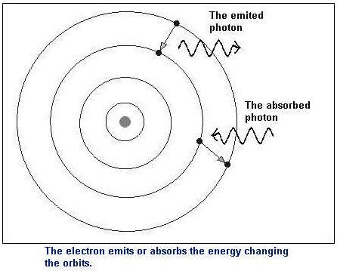
Model of an Atom
Notes:
Explain this model, center is nucleus of atom, rings are places an electron can occupy these are called orbitals An electron is excited from one orbital to the next by addition of energy, then it releases this energy and the electron falls back, releasing light at the same time

Slide 12
How can we make use of this forensically?
Flame tests can be used to qualitatively identify metals
Emission spectroscopy can qualitatively and quantitatively identify metals

Slide 13
Atomic Spectra

Slide 14
Metal Poisoning
The mysterious death of Robert Curley
How did Mr. Curley die?
Who was responsible for his death?
How was the case solved?
Where was Thallium found?

Slide 15
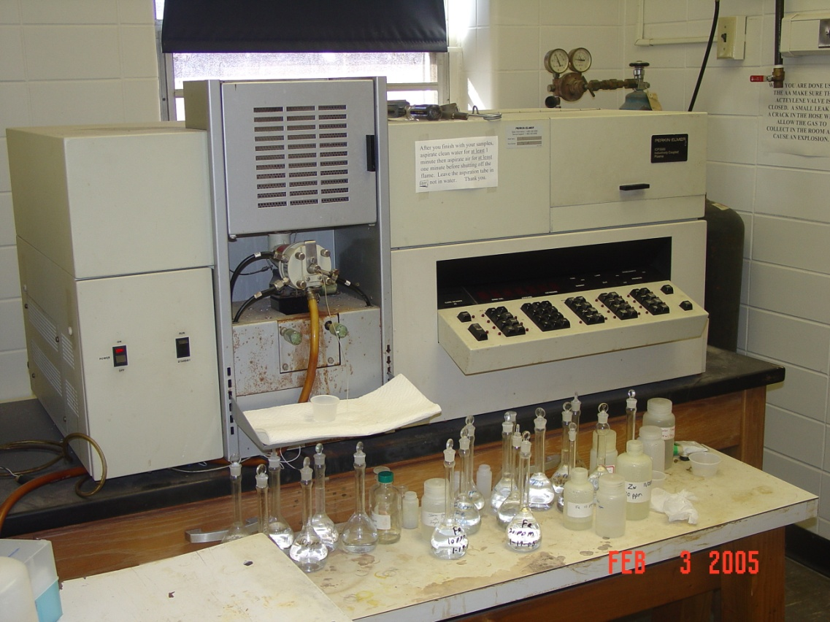
Atomic Absorption Spectroscopy
Key to solving this case
How does this work? Movie

Slide 16
Calibration Curves
These curves relate a physical measurement to an assigned value
Graphical analysis of data gives an equation of a line which can then be used for unknown values
Examples: thermometers
Millimeters of Hg are calibrated with specific distances on glass thermometer
Speedometers: Rotations of tires are counted and related to speed displayed on dashboard

Slide 17
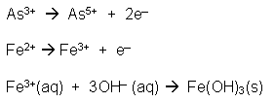
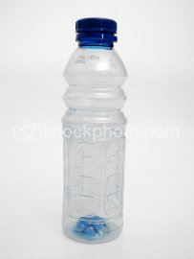
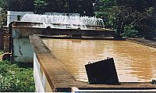
Calibration makes quantitation possible
Notes:
Arsenic-rich ground water is a serious threat to 20 million people in Bangladesh. Solar oxidation and removal of arsenic (SORAS) is a simple method that uses irradiation of water with sunlight in PET plastic, or other UV transparent bottles, to reduce arsenic levels in drinking water.
Groundwater in Bangladesh contains Fe2+ ions and Fe3+ ions. Fe3+ forms an insoluble hydroxide precipitate. Arsenic with an oxidation state of three, As(III), is only weakly adsorbed but arsenic with an oxidation state of five, As(V), is strongly adsorbed to the surface of iron(III) hydroxide particles as they precipitate out of solution.
The SORAS method involves adding about 6 drops of lemon juice to a litre of water in a 1.5 L PET bottle. The bottle is shaken vigorously for 30 seconds, then placed horizontally in sunlight for 4 to 5 hours. The UV energy, oxygen and water in the bottle produce oxidising conditions:
At the end of the day, the bottle is stood vertically. The As5+ is adsorbed onto the surface of the brown Fe(OH)3 as it precipitates overnight. The next morning, the liquid is decanted off or filtered through fine cloth leaving the last 100 mL, containing iron(III) hydroxide and arsenic(V), to be discarded. The citric acid from the lemon juice enhances the photochemical oxidation of the arsenic(III) and leads to much faster formation and settling out of precipitate.
Here are data that can be used to produce an AAS calibration graph for the arsenic levels in this study.

Slide 18
Calibration Curve Data
Before SORAS treatment the ground water had an absorbance of 0.28
After SORAS treatment the ground water had an absorbance of 0.13
What are the concentrations of As in the ground water before and after treatment?
Total As concentration | Absorbance
0 | 0
50μg/L | 0.12
100μg/L | 0.23
150μg/L | 0.35

Slide 19
Arsenic Concentration
People generally require about two liters of water a day and the recommended daily intake of arsenic by an adult is set at 150 micrograms (150 µg). How much arsenic would a person be expected to receive if they drink the untreated water? If they drink the water treated by the SORAS method?

Slide 20
Breathalyzer

Slide 21
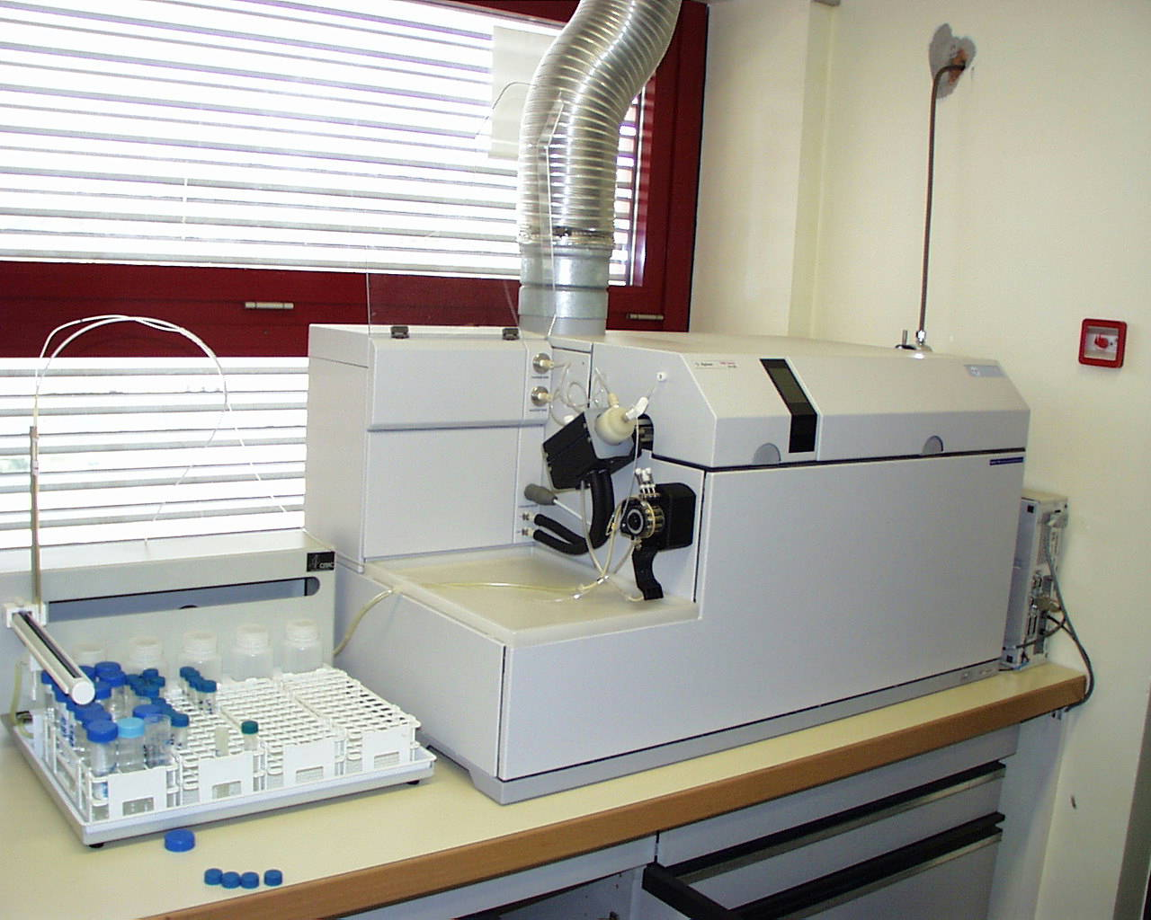
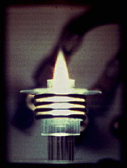
Other Metal Detecting Instrumentation ICP/MS
Excitation achieved with plasma 7-10,000 ºC
Has been used in identification & characterization of bullet & glass fragments
Are two bullets from same manufacturer/ lot?

Slide 22
Antimony & Silver Concentrations in the Kennedy Assasination Bullets
 | Silver (ppm) | Antimony (ppm) | Sample
Q1 | 8.8 + 0.5 | 833 + 9 | Connally stretcher bullet
Q9 | 9.8 + 0.5 | 797 + 7 | Fragments from Connally’s wrist
Q2 | 8.1 + 0.6 | 602 + 4 | Large fragment from car
Q4, 5 | 7.9 + 0.3 | 621 + 4 | Fragments from Kennedy’s brain
Q14 | 8.2 + 0.4 | 642 + 6 | Small fragments found in car
Notes:
Conclusions from these results: There is evidence of 2 bullets, one at composition of 815ppm Sb & 9.3 ppm Ag & 2nd at 622 ppm Sb & 8.1 ppm Ag These were analyzed by neutron activation analysis.
Both bullets have a composition highly consistent with WCC/MC bullet lead although other sources cannot be entirely ruled out.
The bullet found in the Connally stretcher also damaged Connally’s wrist. The absence of bullet fragments from the back wounds of Kennedy and Connally prevented any effort at linking these wounds to the stretcher bullet.
Is there a database of different bullet manufacturer’s and the elemental composition? No, it is unrealistic. Does evidence whose value cannot be statistically defined have a place in a legal proceeding? A 1999 ruling by the New Jersey Supreme Court ruled that it indeed does have a place.

Slide 23
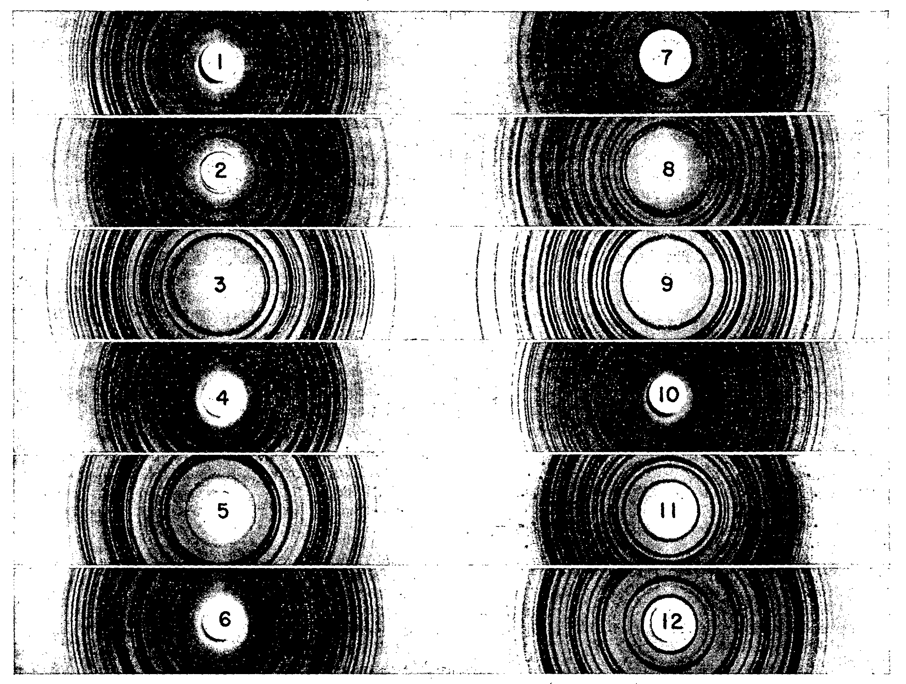
X-Ray Diffraction
Used to identify compounds present in sample
Bounces X-rays off of crystal structure
X-ray crystal link
Notes:
Disadvantage of this technique is it is not that sensitive
Advantage is it tells you how elements are combined in substance
These are x-ray powder diffraction patterns of narcotics
End of lecture for today

Slide 24
Toxicology
LD₅₀: The lethal dose which will kill 50% of the population. Typically determined with animals for pesticides, medicines, etc.
Notes:
Case of Robert Curley brings up another interesting point. What did he die of? (Thalium poisoning) Where else was Thalium detected? Thermos bottle, his wife, and step daughter. Why did Robert die but not his wife and step daughter? Because he had higher levels of thallium in him than they did. This brings us to something called the LD50

