Slide 1
Physical Properties Demonstration
Why is there a difference in the behavior of the two cans of soda? (Hint: think about what is contained in each can.)

Slide 2
Density Demonstration
Density = mass/volume
Assume the density of H₂O = 1g/mL
Estimate what is the density of diet soda?
What is the density of regular soda?
Which can weighs more? How do you know?

Slide 3
Density
Density is an intensive property, no matter the size of an object, a given material will have the same density

Slide 4
Metric system
Prefix | Abbreviation | Meaning
mega- | M | 10⁶
kilo- | k | 10³
deci- | d | 10⁻¹
centi- | c | 10⁻²
milli- | m | 10⁻³
micro- | μ | 10⁻⁶
nano- | n | 10⁻⁹
pico- | p | 10⁻¹²

Slide 5
Answer the following questions in your notebook to the best of your ability
How old are you?
What is your checking account balance?
How many people are in this room?
What was the high temperature in Phoenix, AZ yesterday?
What is the temperature outside?

Slide 6
Significant figures
More accurate measurements require greater time and money
Measuring device determines how accurate of measurement you can make

Slide 7
Using Measuring devices
Digital devices like balances – what you see is what you get
Analog devices – can estimate to one place past the decimal point

Slide 8
Physics Applied to Forensic Applications
1. Skidmark Forensics
My Cousin Vinny clip
Real-world applications
2. Gun recoil
* Real-world applications

Slide 9
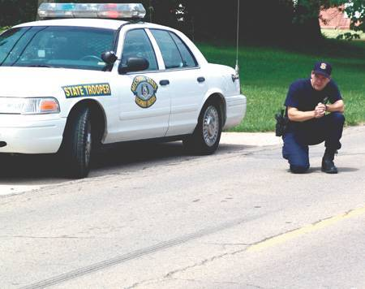
Skidmarks
f = μmg
f = force
μ = coefficient of friction This varies by surface. Tables of different tires and road surfaces are available.
m = mass of object
g = acceleration due to gravity constant = 9.8m/s²

Slide 10
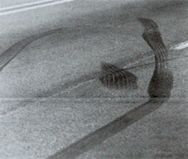
What effects the length of a skidmark?
Speed

Slide 11
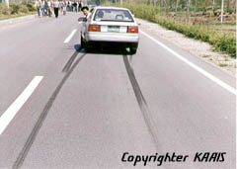
Skidmark Distance
d = v²/2μg
Where:
d = distance of skid
v = velocity (speed)
μ = coefficient of friction
g = acceleration of gravity 9.8m/s²

Slide 12
Skidmark Distance
v =
Where:
d = distance of skid
v = velocity (speed)
μ = coefficient of friction
g = acceleration of gravity 9.8m/s²

Slide 13
Problem
Police measure a 30m skidmark from a car whose tire/road combination give
μ = 0.7. How fast was the car going?
The posted speed limit was 40mph. Was the car speeding before it started to skid?

Slide 14
A 1983 Ford Escort ran into another car that was stopped at a walkway in a school zone. The posted speed limit was 20mph. The accident left skidmarks 28 feet long. Was the escort driver speeding? The value for μ = 0.6166) What kind of factors could change your answer?

Slide 15
The driver of the Escort in court was very adamant that he was not speeding on that roadway. (Previously he had gotten a speeding ticket in that vicinity and therefore set his cruise control for 19mph.) A defense expert testified that other data indicate a speed less than 20mph. What could have been overlooked that would exonerate the driver?

Slide 16
Collisions and Transfer of Energy
Kinetic Energy = skid work + crush work
1/2mv² = μmgd + Kx
Where: m = mass of vehicle
v = velocity (speed)
μ = coefficient of friction
g = acceleration due to gravity
d = distance
K = crush coefficient
x = average crush depth

Slide 17
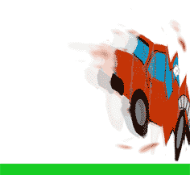
Collisions and Energy Transfer
V =
Where: m = mass of vehicle
v = velocity (speed)
m = coefficient of friction
g = acceleration due to gravity
d = distance
K = crush coefficient
x = average crush depth

Slide 18
Example Problem
A compact car skidded 85 feet before crashing into a brick wall. The front end of the car was crushed, more or less evenly 35cm. How fast was the car going prior to starting the skid? (The car weighed 3000 pounds. The coefficient of friction between the tire and road surface is 0.68 and the crush coefficient of the car is 89,000kg/m.)

Slide 19
In the previous example, it was raining. If the same car had the same accident on dry roads, what would be the effect (qualitatively)?
How does μ change for dry, wet, snowy roads?

Slide 20
Elastic collision
Plastic collision
Momentum: Force an object exerts
p = mv
Where: p = momentum
m = mass of object
v = velocity of object

Slide 21
Elastic Collision
Momentum is conserved
A 1500kg car rear-ends a 3000kg truck stopped at a stoplight. The vehicles “bounce” off one another causing the truck to lurch forward at a speed of 8m/s and the car to go backward at a speed of 8m/s. How fast was the car going initially (in mph)?

Slide 22
Plastic Collision
A vehicle (1800 kg) turning at an intersection was rear ended by a 3200 kg truck and together they collided into the intersection at a speed of 16mph. When the vehicle was turning it was going 8mph. How fast was the truck going? (The collision resulted in a straight ahead trajectory.)

Slide 23
Plastic Collision
On a rainy night a 3500kg truck and a 2000kg car suffered a head-on collision. Luckily both drivers were seatbelted and had only minor injuries. Analysis of the accident scene revealed skidmarks 2.4m long from the POI. Blackbox data from the truck revealed it was going 37mph when the accident occurred. How fast was the car going? (μ = 0.72)

Slide 24
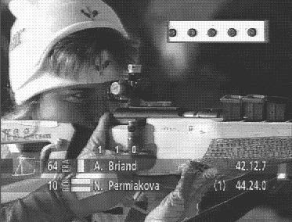
Gun Recoil
A Winchester .308 cartridge launches a bullet of mass 150 grains (1 grain = 64.8 mg) with a speed of 2820 ft/s (1 ft = 30.5 cm). This rifle has a weight of about 8 lbs (2.2 lbs = 1 kg). How fast will the gun recoil?

Slide 25
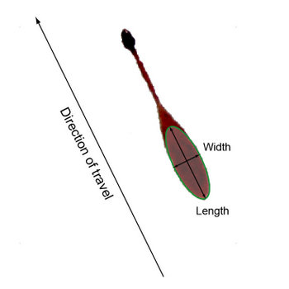
Other Applications of Physics in Forensic Analysis
Blood Spatter Analysis
Allows you to recreate the events in the crime
Passive blood spatter patterns
High and Low velocity
Cast-off patterns
Fingerprints/ shoe impressions & DNA

Slide 26
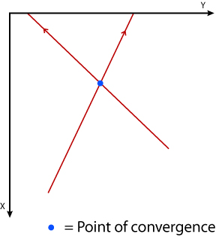
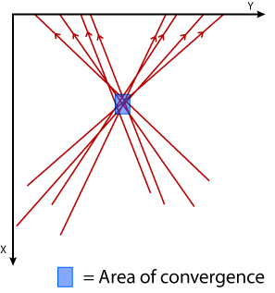
Using Physics to Help Reconstruct a Crime Scene

Slide 27
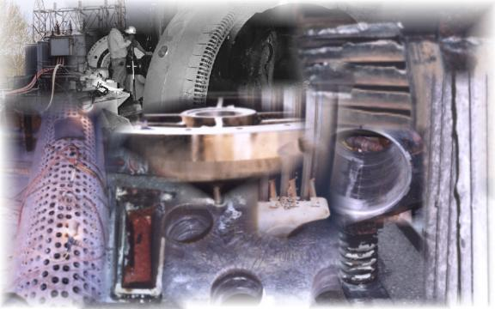
Equipment Failure
Analysis of breaks can tell cause of break

