Slide 1
Trace Evidence
“For the microscopic debris that covers our clothes and bodies are the mute witnesses , sure and faithful, of all our movements and of all our encounters.”
Dr. Edmond Locard

Slide 2
Locard Exchange Principle "It is impossible for a criminal to act, especially considering the intensity of a crime, without leaving traces of this presence."
After two 10-year-old girls were murdered by Ian Huntley in Soham, England, the burnt remains of their Manchester United shirts were found along with Huntley's hair. How does Locard's exchange principle come into a crime scene?

Slide 3
Forensic Entomology
What conclusions can you make about the length of time the body has been there before it was discovered?
Does the chief suspect have an alibi?

Slide 4
Trace Evidence in Footwear
Challenge yourself in lab to find at least 15 unique characteristics that are identifying to that shoe (and no others) – DOCUMENT!

Slide 5
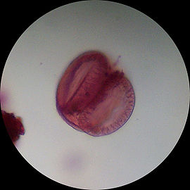
Forensic Use of Palynology
Palynology is the science that studies contemporary and fossil palynomorphs, including pollen, spores, dinoflagellate cysts, acritarchs, chitinozoans and scolecodonts, together with particulate organic matter (POM) and kerogen found in sedimentary rocks and sediments.
How do you think palynology can be used forensically?
Pine pollen

Slide 6
Case Study: Pollen Analysis Reveals Murder Season
In 1994 a mass grave containing 32 male skeletons was discovered in Magdeburg, Germany in the center of the city
Area was under Gestapo control until 1945 and then was in East Germany (Soviet controlled)

Slide 7
Who were the victims? Who were the murderers?
Hypotheses:

Slide 8
Pollen
Air contains pollen throughout the vegetation period
Pollen from a particular species is released only at its flowering time.
Pollen is inhaled & therefore will be deposited in the nasal-pharyngeal tract
Pollen profile can indicate the seasonal spectrum of pollen at the time of death.

Slide 10
Results:
Scientists rinsed the nasal cavities of seven skulls and found a high concentration of plantain pollen, as well as some lime and rye and birch.
Compared results to soil pollen and did not find significant overlap indicating that pollen was inhaled.
DNA and anthropometric data indicated all victims were young and male
Some skulls exhibited decayed teeth but none had any indication of dental work
Who were these victims?

Slide 11
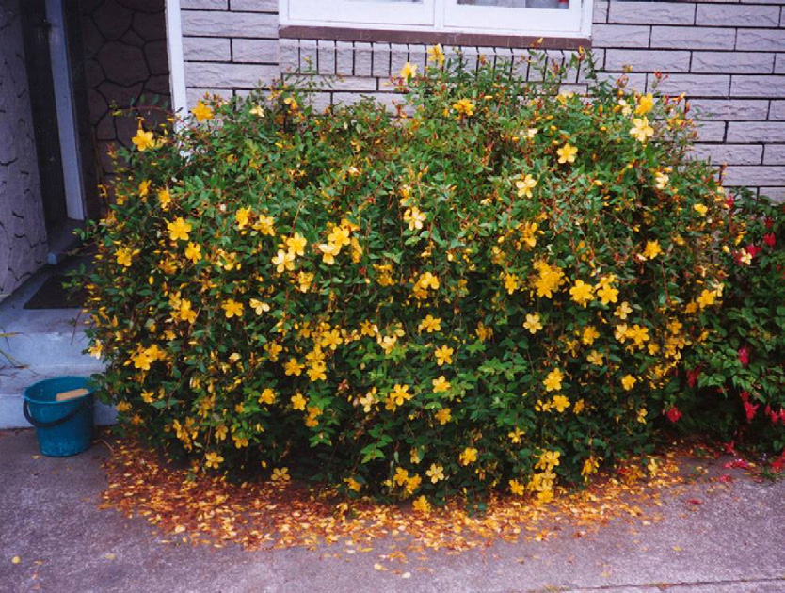
2nd Case: Was the suspect at the scene of the crime?

Slide 12
The Case:
Go to http://course1.winona.edu/jfranz/Present/Forensics/CHEM_190_supplementary_material.htm
The chief suspect indicated he had never been at the crime scene. Based on the evidence here, is he telling the truth? What would qualify your answer? What other evidence would you like to see in order to be able to convict? What other evidence is there? How does the pollen data help the case? Would you convict without the pollen data? Why or why not?

