Slide 1
Computer Forensic Technician and Digital Data Recovery
You can hit delete, but it’s not gone.

Slide 2
Well what do they do?
In two words: Data Recovery
Work alongside cops and investigators to relocate and rebuild previously deleted data.
From removable media such as USB storage drives, digital cameras, etc.
Solid state drives, hard drives, etc.
To preserve integrity of data collected, and the source it was collected from.
To help with cases from child porn, to medical malpractice, to eFraud, to employee misconduct, to terrorism.

Slide 3
Needs some schoolin’
Most have four year degrees:
In Criminal Justice, Computer Science and other related fields.
Most require subsequent certification:
Comp TIAA A+ certification
Net+, various Microsoft certs.
Or, some universities are now creating cybercrime majors for 4yr degrees.
However, since its new, its unproven.
Most skills will develop from supplementary training.

Slide 4
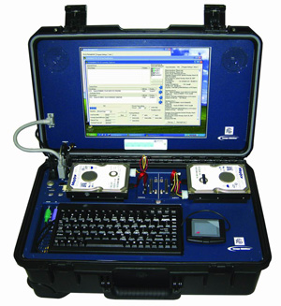
Lookin’ to work local?
Most counties in MN staff someone for their criminal computer cases.
FBI and/or BCA may be more realistic job oppurtunities for criminal aspect.
Could work in private business data recovery for all-purpose reasons.

