Slide 1
Criminalist
By Steven Scheffert

Slide 2
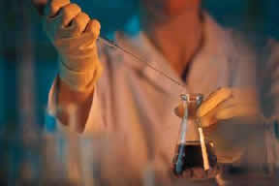
Responsibilities
Criminalists analyze and interpret evidence
Use the science of criminalistics and apply it to solve crimes

Slide 3
Duties
Examine, test, and analyze samples
Interpret lab findings and test results
Collect and preserve evidence
Reconstruct crime scenes
Prepare reports and present findings
Testify as an expert witness at trial

Slide 4
Important Skills
Information gathering
Information organization
Reading comprehension
Problem Identification
Scientific background
Critical Thinking
Chemistry
Public Safety and security
Inductive reasoning

